Slide 1
Aggregate Planning and Master Scheduling (Ch.11)
9
  CYCU
  Prof. CK Farn
mailto: ckfarn@gmail.com
http://www.mgt.ncu.edu.tw/~ckfarn/cycu
  2022.12

Slide 2
Aggregate Planning
Intermediate-range capacity planning that typically covers a time horizon of 2 to up to 18 months
Useful for organizations that experience seasonal or other variations in demand
Goal:
  Achieve a production plan that will effectively utilize the organization’s resources to satisfy demand

Slide 3
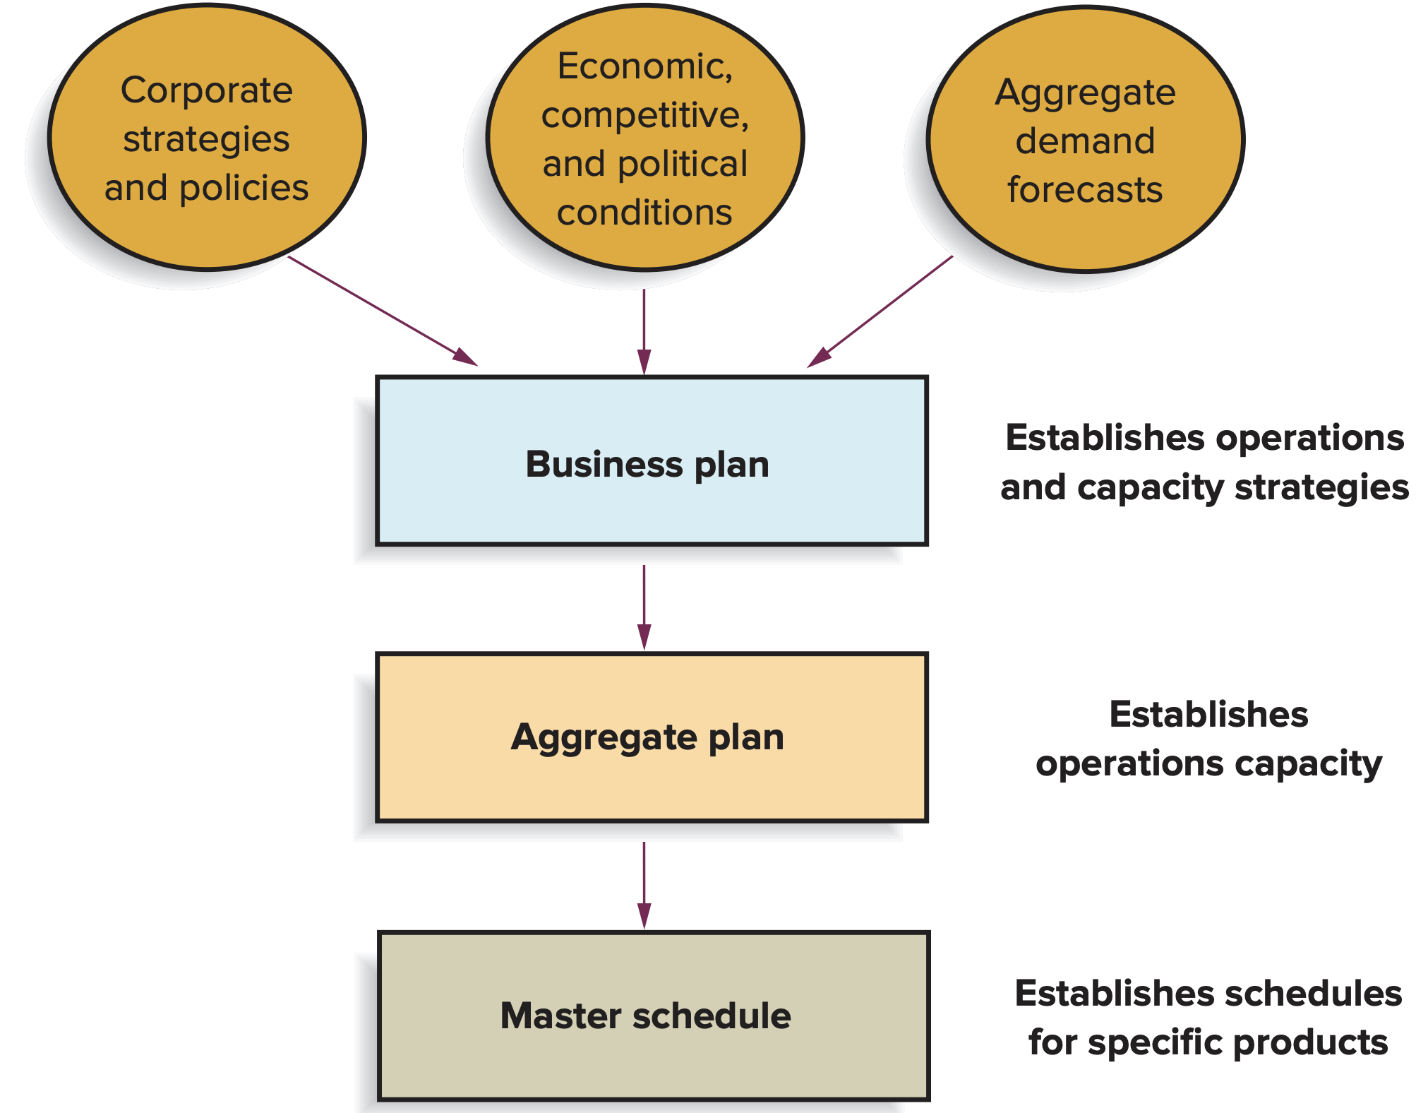
The Planning Sequence

Slide 4
Why Use Aggregate Planning
Why do organizations need to do aggregate planning?
  Planning
    It takes time to implement plans
  Strategic
    Aggregation is important because it is not possible to predict with accuracy the timing and volume of demand for individual items
  It is connected to the budgeting process
  It can help synchronize flow throughout the supply chain; it affects costs, equipment utilization, employment levels, and customer satisfaction

Slide 5
Aggregation
The plan must be in units of measurement that can be understood by the firm’s non-operations personnel
  Aggregate units of output per month
  Dollar value of total monthly output
  Total output by factory
  Measures that relate to capacity such as labor hours

Slide 6
Dealing with Variation
Most organizations use rolling 3, 6, 9, and 12 month forecasts
  Forecasts are updated periodically, rather than relying on a once-a-year forecast
  This allows planners to take into account any changes in either expected demand or expected supply and to develop revised plans

Slide 7
Rolling Forecast
Assumption: one item; 5 weeks forecast, freeze for a week
Yellow: Order; Blue: frozen forecast
 | +0 | +1 | +2 | +3 | +4 | +5 | +6 | +7 | +8
W1
W2
W3
W4
W5
100 | 110 | 80 | 75 | 120 | 120
110 | 90 | 80 | 100 | 110 | 110
90 | 95 | 110 | 115 | 100 | 120
95 | 100 | 110 | 100 | 110 | 120
100 | 110 | 120 | 100 | 110

Slide 8
Strategies to counter variation
Maintain a certain amount of excess capacity to handle increases in demand
Maintain a degree of flexibility in dealing with changes
  Hiring temporary workers
  Using overtime
Wait as long as possible before committing to a certain level of supply capacity
  Schedule products or services with known demands first
  Wait to schedule other products until their demands become less uncertain

Slide 9
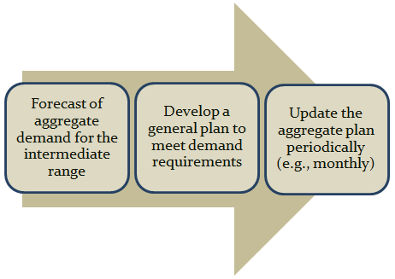
Overview of Aggregate Planning

Slide 10
Demand and Supply
Aggregate planners are concerned with the
  Demand quantity
    If demand exceeds capacity, attempt to achieve balance by altering capacity, demand, or both
  Timing of demand
    Even if demand and capacity are approximately equal, planners still often have to deal with uneven demand within the planning period

Slide 11
Aggregate Planning Inputs
Resources
  Workforce/production rates
  Facilities and equipment
Demand forecast
Policies
  Workforce changes
  Subcontracting
  Overtime
  Inventory levels/changes
  Back orders
Costs
  Inventory carrying
  Back orders
  Hiring/firing
  Overtime
  Inventory changes
  Subcontracting

Slide 12
Aggregate Planning Outputs
Total cost of a plan
Projected levels of
  Inventory
  Output
  Employment
  Subcontracting
  Backordering

Slide 13
Aggregate Planning Strategies
Proactive
  Alter demand to match capacity
Reactive
  Alter capacity to match demand
Mixed
  Some of each

Slide 14
Demand Options
Pricing
  Used to shift demand from peak to off-peak periods
  Price elasticity is important
Promotion
  Advertising and other forms of promotion
Back orders
  Orders are taken in one period and deliveries promised for a later period
New demand
  Create new demand to absorb excess capacity generated due to peak time demands

Slide 15
Supply Options
Hire and layoff workers
Overtime/slack time
Part-time workers
Inventories
Subcontracting

Slide 16
Prominent Aggregate Planning Strategies
Maintain a level workforce
Maintain a steady output rate
Match demand period by period
Use a combination of decision variables

Slide 17
Aggregate Planning Pure Strategies
Level capacity strategy:
  Maintaining a steady rate of regular-time output while meeting variations in demand by a combination of options:
    Inventories, overtime, part-time workers, subcontracting, and back orders
Chase demand strategy:
  Matching capacity to demand; the planned output for a period is set at the expected demand for that period

Slide 18
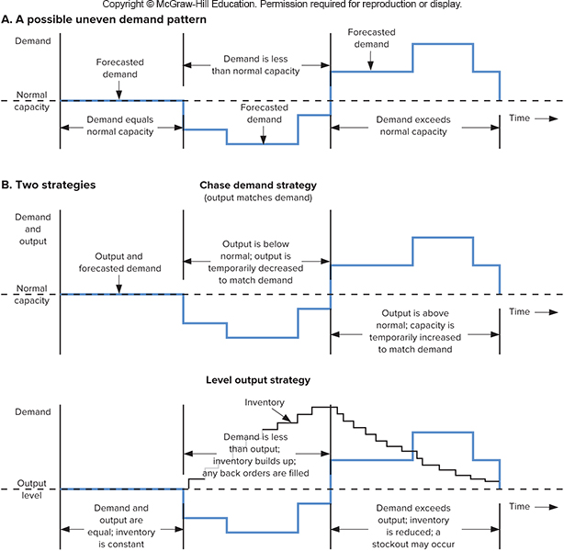
Variations in demand and capacity

Slide 19
Chase Approach
Capacities are adjusted to match demand requirements over the planning horizon
  Advantages
    Investment in inventory is low
    Labor utilization in high
  Disadvantages
    The cost of adjusting output rates and/or workforce levels

Slide 20
Level Approach
Capacities are kept constant over the planning horizon
Advantages
  Stable output rates and workforce
Disadvantages
  Greater inventory costs
  Increased overtime and idle time
  Resource utilizations vary over time

Slide 21
Techniques for Aggregate Planning
General procedure:
  Determine demand for each period
  Determine capacities for each period
  Identify pertinent company or departmental policies
  Determine unit costs
  Develop alternative plans and costs
  Select the plan that best satisfies objectives. Otherwise return to step 5.

Slide 22
Trial-and-Error Techniques
Trial-and-error approaches consist of developing simple tables or graphs that enable planners to visually compare projected demand requirements with existing capacity
Alternatives are compared based on their total costs
Disadvantage of such an approach is that it does not necessarily result in an optimal aggregate plan

Slide 23
Trial-and-Error Techniques (cont.)
Period | 1 | 2 | 3 | 4 | 5 |  | Total
Forecast
Output
Regular time
Overtime
Subcontract
Output – Forecast
Inventory
Beginning
Ending
Average
Backlog
Costs
Output Regular
Overtime
Subcontract
Hire/Lay off
Inventory
Back orders
Total
TABLE 11.4 Worksheet/spreadsheet

Slide 24
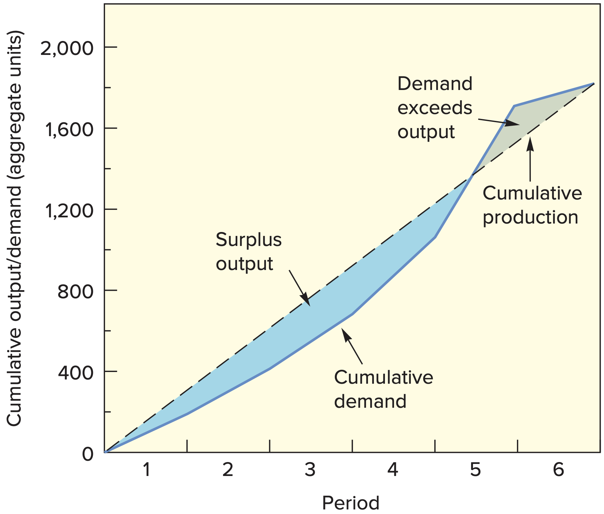
Cumulative Graph

Slide 25
Mathematical Techniques
Linear programming models
  Methods for obtaining optimal solutions to problems involving the allocation of scarce resources in terms of cost minimization or profit maximization.
Simulation models
  Computerized models that can be tested under different scenarios to identify acceptable solutions to problems

Slide 26
Linear programming models
 |  | Period 1 | Period 2 | Period 3 | … | Ending inventory period n | Unused capacity | Capacity
Period | Beginning inventory | 0 | h | 2h | … | (n–1)h | 0 | I₀
1 | Regular time | r | r + h | r + 2h | … | r+(n–1)h | 0 | R₁
 | Overtime | t | t + h | t + 2h | … | t+(n–1)h | 0 | O₁
 | Subcontract | s | s + h | s + 2h | … | s+(n–1)h | 0 | S₁
2 | Regular time | r + b | r | r + h | … | r+(n–2)h | 0 | R₂
 | Overtime | t + b | t | t + h | … | t+(n–2)h | 0 | O₂
 | Subcontract | s + b | s | s + h | … | s+(n–2)h | 0 | S₂
3 | Regular time | r + 2b | r + b | r | … | r+(n–3)h | 0 | R₃
 | Overtime | t + 2b | t + b | t | … | t+(n–3)h | 0 | O₃
 | Subcontract | s + 2b | s + b | s | … | s+(n–3)h | 0 | S₃
 | Demand |  |  |  | … |  |  | Total
r = Regular production cost per unit
f = Overtime cost per unit
s = Subcontracting cost per unit
h = Holding cost per unit period
b = Backorder cost per unit per period
n = Number of periods in planning horizon
TABLE 11.4 Worksheet/spreadsheet

Slide 27
Aggregate Planning Example 1
Period | 1 | 2 | 3 | 4 | 5 | 6 | Total
Forecast | 200 | 200 | 300 | 400 | 500 | 200 | 1,800
Costs
  Output
    Regular time = $2 per skateboard
    Overtime = $3 per skateboard
    Subcontract = $6 per skateboard
  Inventory = $1 per skateboard per period on average inventory
  Back orders = $5 per skateboard per period
Planners for a company that makes several models of skateboards are about to prepare an aggregate plan that will cover six periods.
They want to evaluate a plan that calls for a steady rate of regular-time output, mainly using inventory to absorb the uneven demand but allowing some backlog. Overtime and subcontracting are not used because they want steady output. They intend to start with zero inventory on hand in the first period.

Slide 28
Aggregate Planning Example 2
Period | 1 | 2 | 3 | 4 | 5 | 6 | Total
Forecast | 200 | 200 | 300 | 400 | 500 | 200 | 1,800
Output
Regular time | 300 | 300 | 300 | 300 | 300 | 300 | 1,800
Overtime | --- | --- | --- | --- | --- | ---
Subcontract | --- | --- | --- | --- | --- | ---
Inventory
Output 2 Forecast | 100 | 100 | 0 | (100) | (200) | 100 | 0
Inventory
Beginning | 0 | 100 | 200 | 200 | 100 | 0
Ending | 100 | 200 | 200 | 100 | 0 | 0
Average | 50 | 150 | 200 | 150 | 50 | 0 | 600
Backlog | 0 | 0 | 0 | 0 | 100 | 0 | 100

Slide 29
Aggregate Planning Example 3
Period | 1 | 2 | 3 | 4 | 5 | 6 | Total
Costs
Output
Regular time | $600 | $600 | $600 | $600 | $600 | $600 | $3,600
Overtime | --- | --- | --- | --- | --- | ---
Subcontract | --- | --- | --- | --- | --- | ---
Hire/Layoff | --- | --- | --- | --- | --- | ---
Inventory | $50 | $150 | $200 | $150 | $50 | $0 | $600
Backlog | $0 | $0 | $0 | $0 | $500 | $0 | $500
Total | $650 | $750 | $800 | $750 | $1,150 | $600 | $4,700

Slide 30
Mathematical Techniques
Technique | Solution Approach | Characteristics
Spreadsheet | Heuristic (trial and error) | Intuitively appealing, easy to understand; solution not necessarily optimal
Linear programming | Optimizing | Computerized; linear assumptions not always valid
Simulation | Heuristic (trial and error) | Computerized model can be examined under a variety of conditions
TABLE 11.7 Summary of mathematical planning techniques

Slide 31
Aggregate Planning in Services
Hospitals:
  Aggregate planning used to allocate funds, staff, and supplies to meet the demands of patients for their medical services
Airlines:
  Aggregate planning in this environment is complex due to the number of factors involved
  Capacity decisions must take into account the percentage of seats to be allocated to various fare classes in order to maximize profit or yield
Restaurants:
  Aggregate planning in high-volume businesses is directed toward smoothing the service rate, determining workforce size, and managing demand to match a fixed capacity
  Can use inventory; however, it is perishable

Slide 32
Aggregate Planning in Services (cont.)
The resulting plan in services is a time-phased projection of service staff requirements
Aggregate planning in manufacturing and services is similar, but there are some key differences:
  Demand for service can be difficult to predict
  Capacity availability can be difficult to predict
  Labor flexibility can be an advantage in services
  Services occur when they are rendered

Slide 33
Yield Management
An approach to maximizing revenue by using a strategy of variable pricing; prices are set relative to capacity availability
  During periods of low demand, price discounts are offered
  During periods of peak demand, higher prices are charged
  Users of yield management include
    Airlines, restaurants, hotels, restaurants

Slide 34
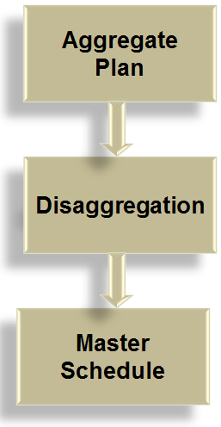
Disaggregation

Slide 35
Disaggregating the Aggregate Plan
Master schedule:
  The result of disaggregating an aggregate plan
  Shows quantity and timing of specific end items for a scheduled horizon

Slide 36
Master Scheduling
The heart of production planning and control
  It determines the quantity needed to meet demand from all sources
  It interfaces with
    Marketing
    Capacity planning
    Production planning
    Distribution planning
  Provides senior management with the ability to determine whether the business plan and its strategic objectives will be achieved

Slide 37
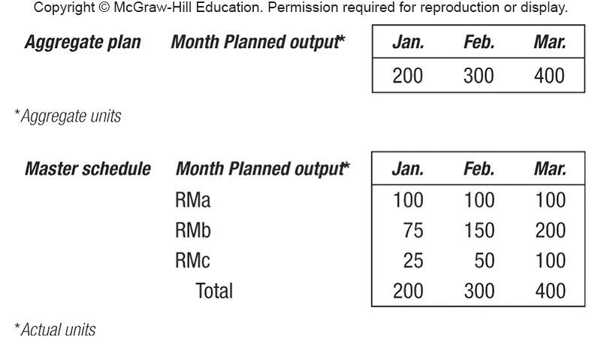
Master Schedule

Slide 38
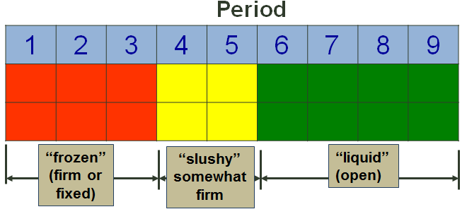
Time Fences

Slide 39
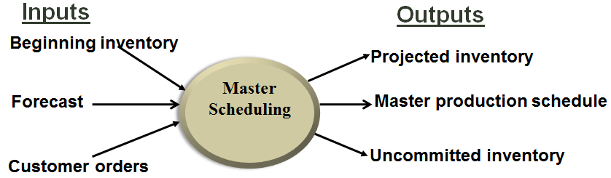
The Master Scheduling Process

Slide 40
The Master Scheduling Process (cont.)
The master production schedule (MPS) is one of the primary outputs of the master scheduling process
  Once a tentative MPS has been developed, it must be validated
Rough cut capacity planning (RCCP) is a tool used in the validation process
  Approximate balancing of capacity and demand to test the feasibility of a master schedule
  Involves checking the capacities of production and warehouse facilities, labor, and vendors to ensure no gross deficiencies exist that will render the MPS unworkable

Slide 41
MPS –
Forecasts and Customer Orders
 | 1 | 2 | 3 | 4 | 5 | 6 | 7 | 8
Forecast | 30 | 30 | 30 | 30 | 40 | 40 | 40 | 40
June July
Beginning inventory
June July
64 | 1 | 2 | 3 | 4 | 5 | 6 | 7 | 8
Forecast | 30 | 30 | 30 | 30 | 40 | 40 | 40 | 40
Customer orders (committed) | 33 | 20 | 10 | 4 | 2

Slide 42
MPS – Projected On Hand
Beginning inventory
June July
64 | 1 | 2 | 3 | 4 | 5 | 6 | 7 | 8
Forecast | 30 | 30 | 30 | 30 | 40 | 40 | 40 | 40
Customer orders (committed) | 33 | 20 | 10 | 4 | 2
Projected on-hand inventory | 31 | 1 | –29
Forecast is larger than customer orders in week 3; projected on-hand inventory is 1 – 30 = –29
Customer orders are larger than forecast in week 1; projected on-hand inventory is 64 – 33 = 31
Forecast is larger than customer orders in week 2; projected on-hand inventory is 31 – 30 = 1

Slide 43
Determining MPS and Projected On Hand
Week | Inventory from Previous Week | Requirements | Inventory before MPS |  | (70) MPS |  | Projected Inventory
1 | 64 | 33 | 31 |  |  |  | 31
2 | 31 | 30 | 1 |  |  |  | 1
3 | 1 | 30 | −29 | + | 70 | = | 41
4 | 41 | 30 | 11 |  |  |  | 11
5 | 11 | 40 | −29 | + | 70 | = | 41
6 | 41 | 40 | 1 |  |  |  | 1
7 | 1 | 40 | −39 | + | 70 | = | 31
8 | 31 | 40 | −9 | + | 70 | = | 61

Slide 44
Available-to-Promise
June July
64 | 1 | 2 | 3 | 4 | 5 | 6 | 7 | 8
Forecast | 30 | 30 | 30 | 30 | 40 | 40 | 40 | 40
Customer orders (committed) | 33 | 20 | 10 | 4 | 2
Projected on-hand inventory | 31 | 1 | 41 | 11 | 41 | 1 | 31 | 61
MPS |  |  | 70 |  | 70 |  | 70 | 70

Slide 45
Available-to-Promise
June July
6464 | 1 | 2 | 3 | 4 | 5 | 6 | 7 | 8
Forecast | 30 | 30 | 30 | 30 | 40 | 40 | 40 | 40
Customer orders (committed) | 33 | 20 | 10 | 4 | 2
Projected on-hand inventory | 31 | 1 | 41 | 11 | 41 | 1 | 31 | 61
MPS |  |  | 70 |  | 70 |  | 70 | 70
Available-to-promise inventory (uncommitted) | 11 |  | 56 |  | 68 |  | 70 | 70

