Slide 1
Funneling excercise
5
  Department of Information Management
  CYCU
  CK Farn
mailto: ckfarn@gmail.com
  2023.10

Slide 2
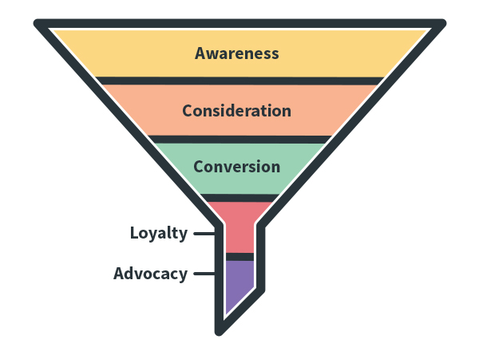
Sales Funnel
Universal
Suspect
Prospect
Best Few
Client
Delivery
Services

Slide 3
Research funnel
Understand the general state of the area
Understand the specific topic
Possible alternatives
Decide on a question
Conduct research
Search with a vague idea
Read the title page of a few hundred papers
Title, authors, journal, keywords, affiliation
Universal
Suspect
Browse through several dozens related papers
Methodology, theory/model
Prospect
Research gap
Mapping to real phenomena
Major researchers, key papers
Major theories
In depth reading
Best Few
Key reference paper
Theoretical foundation
Methodology
Client
Delivery
Research design
Collect data
Analysis
Services

Slide 4
Conduct your own funnel
Decide on a term in the MIS field that you like
  If you have no idea, choose “purchase intention”
Search with Google Scholar
  Limit your search to terms in the TITLE of the papers
  Narrow your search by including or excluding terms
  Sort by relevance
Make a simple tally of the results, by browsing through the first 50 items
  Makes use of Excel (copy and paste, …)
  In doing your own research, you may want to browse through 300+ papers
Answer the followings:
  Distribution of publication years
  Distribution of sources (journal)
  Are there author names that appears frequently? Countries? Affiliated universities?
  Distribution of keywords

Slide 5


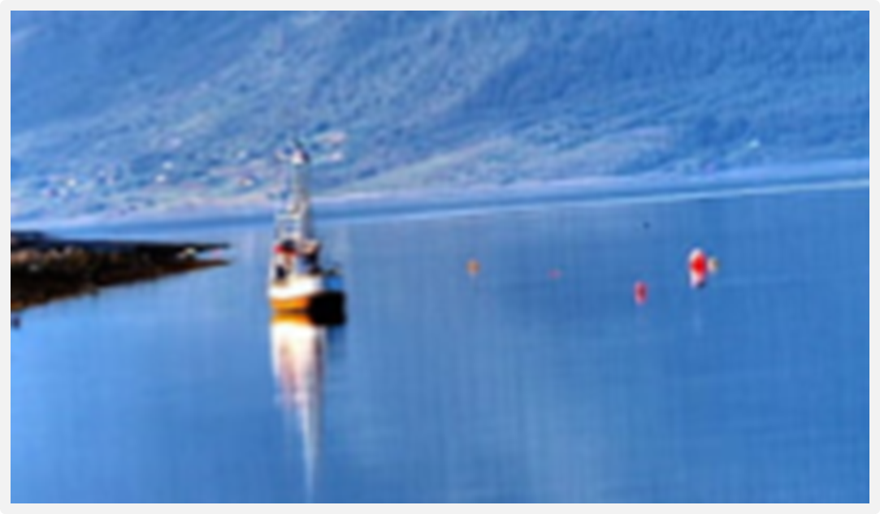

Landscape and zooming in

Slide 6
Assignment #4:
Landscape of the research field
Answer the followings:
  Distribution of publication years
  Distribution of sources (journal)
  Are there author names that appears frequently? Countries? Affiliated universities?
  Distribution of keywords
Prepare a short ppt document, no more that FIVE pages
File name: HW4_SID_Name.ppt
Upload your ppt file to
https://mega.linkin.tw/index.php/s/mz3FMroNYn8xDJx
Due in one week

Slide 7
Assignment #5:
Zooming in
Pick the top 10 papers that you think are most relevant, read the abstract and browse through the content
Answer the followings:
  The theories and models that appear most frequently
  Distribution of the dependent variables
  The authors that are cited the most
  The profile of the results
Prepare a short ppt document, no more that SIX pages
File name: HW5_SID_Name.ppt
Upload your ppt file to https://mega.linkin.tw/index.php/s/QdzoWCmcNGeod6t
Due in three weeks

