Slide 1
Qualitative Research 1
質性研究/定性研究
12
  Department of Information Management
  CYCU
  CK Farn
mailto: ckfarn@gmail.com
  2023.12

Slide 2
Qualitative research
The researcher himself acts as the instrument of research
Through interviews, observations, document analysis, etc., to obtain further understanding through the interpretation of data

Slide 3
Why Use Qualitative Research?
“Most of what influences what we say and
do occurs below the level of awareness.
That’s why we need new techniques:
to get at hidden knowledge –
to get at what people don’t know they know.”
Jerry Zaltman
Notes:
Qualitative research includes an array of interpretative techniques which seek to describe, decode, translate, and otherwise come to terms with the meaning, not the frequency, of certain more or less naturally occurring phenomena in the social world.
Qualitative research can be used in both the data collection and data analysis stages of a research project.

Slide 4
Qualitative Research
Group
Interviews
Focus Groups
Observation
Data
Collection
Techniques
IDIs
Ethnography
Case Studies
Action Research
Grounded Theory
Notes:
This slide highlights many of the qualitative techniques that are useful for data collection.

Slide 5
Qualitative Research
Textual Analysis
Artifacts
Behavioral Observations
Other
Techniques
Trace Evidence
Debriefings
Notes:
This slide highlights many of the qualitative tools useful for data collection or data analysis.

Slide 6

Data Sources
People
Organizations
Texts
Environments
Artifacts/ media products
Events and happenings
Notes:
Qualitative research draws data from people and organizations. Whether the source is people or organization, we can use their behavior, texts, events and so on as data. Chapter 9 focuses on observation methods.

Slide 7
Distinction between
Qualitative & Quantitative
Theory
Building
Theory
Testing
Notes:
This slide reflects information from exhibit 7-2
Quantitative research is the precise count of some behavior, knowledge, opinion or attitude. While the survey is not the only quantitative method, it is the dominant one. Quantitative research is often used for theory testing. For example, it might answer the question “Will a $1-off instant coupon or a $1.50 mail-in rebate generate more sales for Kellogg’s Special K?” It requires that the researcher maintain a distance from the research so as not to bias the results.
Qualitative research is sometimes called interpretive research because it seeks to develop understanding through detailed description. It builds theory but rarely tests it. Several key distinctions exist between qualitative and quantitative research and these are elaborated on in Exhibit 7-2. The next several slides highlight these distinctions.

Slide 8
Understanding the research question
Research question
  What is my study about?
Form
  Am I asking a “who,” “what,” “where,” “why,” or “how” question?
The form of the research question provides hints on choosing the appropriate research strategy

Slide 9
Choice of research strategy
First step: Definition of the research question
Determine the type of research question
In general
  what (什麼): exploratory (探索性)
  how (如何), why (為何): confirmatory (驗證)

Slide 10
Types of Empirical research
By stage of research
  Exploratory 探索性
    hypothesis building
  Confirmatory 驗證性
    hypothesis testing
By data collection approach
  Qualitative Research 質性研究
    Case study, observation, participant observation, ethnography…
  Quantitative Research 定量研究（數量化研究）
    Experimentation, survey, content analysis…

Slide 11
Empirical research types
There is a high association between exploratory research and qualitative research
Sense making in exploratory research:
  the process by which people give meaning to their collective experiences, or to the insights derived from the data collected

Slide 12
Explore: Formation of Constructs
Conceptual Level
X
Y
Inference: Causal relationship
Abstraction,
Conceptualization
x
y
Observation
Analysis: Association
Observation
Operational Level

Slide 13
The Roots of Qualitative Research
Qualitative
Research
Economics
Psychology
Sociology
Semiotics
符號學
Anthropology
Communication
Notes:
Qualitative research methodologies have roots in a variety of disciplines. These are named in the slide.
Some believe that qualitative data are too subjective and susceptible to human error and bias in data collection and interpretation. The fact that results cannot be generalized from a qualitative study to a larger population is considered a fundamental weakness.
Despite these limitations, managers are returning to these techniques as quantitative techniques fall short of providing the insights needed to make those ever-more-expensive decisions.
Managers must deal with the issue of trustworthiness of qualitative data using the following techniques:
Using literature searches to build probing questions,
Justifying the method chosen,
Using a field setting,
Choosing sample participants for relevance rather than representation of target population,
Using questions that will find the exception to the rule,
Carefully structuring the data analysis,
Comparing data across multiple sources and contexts,
And conducting peer-researcher debriefing on results for added clarity, insights, and reduced bias.

Slide 14
Research philosophy in social science
Positivism 實證主義
  Comte (康德)
  the only authentic knowledge is that which is based on sense experience and positive verification.
Interpretivism or Anti- positivism/Hermeneutics 詮釋主義
  Max Weber (韋伯) ，Hegel (黑格爾): dialectics 辯證法
  The study of the interpretation of written texts (also, verbal and nonverbal forms of communication)
  Non-positivist research is usually qualitative, while positivist research is more quantitative.
Interactionism
  Meaning is produced through the interactions of individuals.

Slide 15
Types of qualitative research
Biography 傳記研究
  Study of an individual, as well as the experience he states
Phenomenology 現像學
  Study of many individuals, as well as the experience they state
Grounded Theory 紮根理論
  Sociology: For a specific situation, try to deduce a theory from a phenomenon
Ethnography 民俗誌
  Anthropology: Descriptions and interpretations of a culture

Slide 16
Types of qualitative research ₂
Case study 個案研究
  Descriptions and interpretations of one or more objects
  Using multiple data collection approaches
Action research 行動研究
  Organizational development: The researcher participates in the action to plan, implement, and monitor the change of the action, and uses the researcher's theory and experience to serve the research object
Historical research 歷史研究
  Explain the connections between events

Slide 17
Qualitative research process
Data collection
Data reduction
Data display
Conclusion drawing and Verification
  Triangulation

Slide 18
Data collection in qualitative research
Secondary data, documents
Observation
Interviews

Slide 19
Methodological Triangulation 三角驗證
using multiple datasets, methods, theories, and/or investigators to address a research question
help to enhance the validity and credibility of findings and mitigate the presence of any research biases
mainly used in qualitative research triangulation.

Slide 20


Focus of Research
Qualitative
Understanding
Interpretation
Quantitative
Description
Explanation
Notes:
This slide reflects information from exhibit 7-2
As mentioned in the previous slide, quantitative research is used to describe and explain. It can also be used to predict. However, qualitative research is focused on understanding and interpretation.

Slide 21

Researcher Involvement
Qualitative
High
Participation-based
Quantitative
Limited
Controlled
Notes:
This slide reflects information from exhibit 7-2
Researcher involvement in quantitative research should be minimal lest bias be introduced. However, in qualitative research, the researcher must have a high level of involvement to probe for understanding. In quantitative research, for instance, participants may never see or speak to a member of the research team. They may simply answer a self-administered survey. In qualitative research, participants may be interviewed by the researcher or spend several hours with the researcher.

Slide 22

Research Design
Qualitative
Longitudinal
Multi-method
Quantitative
Cross-sectional or longitudinal
Single method
Notes:
This slide reflects information from exhibit 7-2.
Quantitative studies are usually single mode. In other words, they will usually rely on one data collection technique whether it be a telephone survey, email survey, or experiment. However, qualitative studies may use several methods in one study to increase the researcher’s ability to interpret and justify the results.

Slide 23

Sample Design and Size
Qualitative
Non-probability
Purposive
Small sample
Quantitative
Probability
Large sample
Notes:
This slide reflects information from exhibit 7-2.
Quantitative studies prefer samples greater than 200 and samples that are representative of the target population. Not all quantitative studies meet these criteria but these are desirable. Qualitative studies rely on small sample sizes – less than 25 people is common. The emphasis on selecting the sample is to include people with heterogeneous opinions, attitudes, and experiences.

Slide 24



Data Type and Preparation
Qualitative
Verbal or pictorial
Reduced to verbal codes
Quantitative
Verbal descriptions
Reduced to numeric codes
Notes:
This slide reflects information from exhibit 7-2.
How qualitative and quantitative researchers would treat these ads as research would be very different.
Qualitative research can also use software to conduct content analysis but words and pictures are used as codes, rather than numbers. The researcher would take the copy and images in these ads and look for themes and patterns…for example, that they all contain people, that they all contain Web URLs, that one of three is promoting a particular proprietary research service while the others are more general.
Quantitative studies take verbal descriptions of consumer behavior, attitudes, and opinions and they use numbers to represent those descriptions in a database. The researcher would take the copy and images of these ads and code them with numbers. People in ads would get a 1 for male, 2 for female, 3 for indeterminate gender. Ad themes might be “1” for proprietary research service (Conceptor for Decision Analyst), “2” for institutional theme (like ‘curiosity’ for Synovate), a “3” might be assigned for general capabilities (like qualitative research services for Harris Interactive).

Slide 25

Turnaround
Qualitative
Shorter turnaround possible
Long elapse time
Insight development ongoing
Quantitative
May be time-consuming (for a sample)
Short elapse time
Insight development follows data entry
Notes:
This slide reflects information from exhibit 7-2.
Quantitative studies are traditionally time-consuming, but new methods such as web surveys are allowing for fast turnaround. The key is to recognize whether those methods are appropriate for the study at hand. Qualitative research can be faster due to the small sample sizes, but coding and analyzing hours of interviews can also be time consuming. One advantage of qualitative research is that insight development goes on throughout the study so interviews can be stopped when the appropriate answers are identified. This is not the case with quantitative studies.

Slide 26
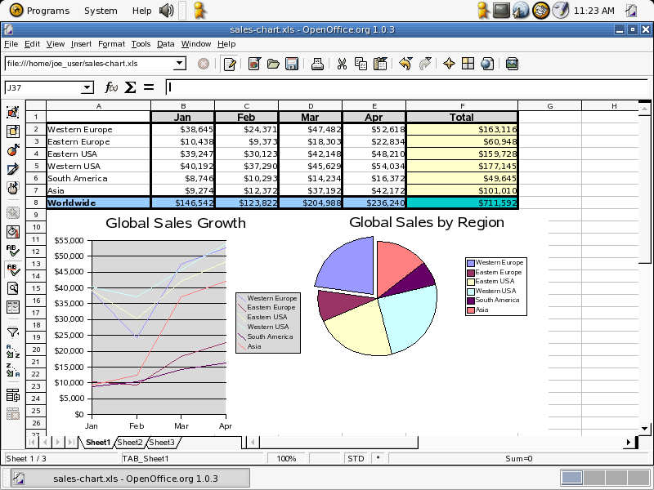
Data Analysis
Qualitative
Nonquantitative; human
Judgment mixed with fact
Emphasis on themes
Quantitative
Computerized analysis
Facts distinguished
Emphasis on counts
Notes:
This slide reflects information from exhibit 7-2.
Quantitative data analysis is conducted using statistical software programs such as SAS, SPSS, or Jump. The analysis focuses on the facts identified in the study.
Qualitative research is not coded into numeric values. Human interpretation and judgment are critical in creating insight from the data.
Content analysis...especially with the development of software like XSight...is a primary computerized analytical approach. It is far more than a count of words; such software can help reveal themes and underlying emphasis within texts.
When researchers work with focus group and IDI transcripts, the content analysis software can assist the moderator in debriefing. The ability of video to be 'marked' with such software as Video Marker from FocusVision makes the analytical process better able to link interpretations to specific content from a qualitative method participant.

