Slide 1
Business Data Analytics and Data Driven Operations
7
CYCU
Prof. CK Farn
mailto: ckfarn@gmail.com
http://www.mgt.ncu.edu.tw/~ckfarn/cycu
2023.05

Slide 2
Agenda
Business Data Analytics
Data Driven Operations

Slide 3
Data analytics
The process of collecting, cleaning, and analyzing data to extract meaningful insights
A powerful tool that can be used to improve business performance in a number of ways
In today's data-driven world, data analytics is an essential tool for businesses of all sizes
By using data analytics, businesses can improve their performance, increase their profits, and gain a competitive edge
Decision making based on data analysis

Slide 4
Importance of Data Analytics ₁
Improved decision-making
providing insights into customers, operations, and markets
identifying opportunities, solve problems, and improve efficiency
Increased customer satisfaction
understanding customer behavior and preferences
delivering more personalized and relevant products and services
leading to increased customer satisfaction and loyalty
Reduced costs
helping businesses identify areas where they can save money by reducing waste, improving efficiency, and optimizing processes

Slide 5
Importance of Data Analytics ₂
Increased revenue
identifying new opportunities and improving customer satisfaction, data analytics can help businesses increase revenue
Enhanced competitive advantage
using data analytics to gain insights that their competitors do not have, businesses can gain a competitive advantage

Slide 6
How DA can be used in business
Marketing
track customer behavior, identify target audiences, and measure the effectiveness of marketing campaigns
Sales
identify potential customers, track sales leads, and close deals
Customer service
track customer satisfaction, identify problems, and resolve issues
Operations
improve efficiency, identify areas for improvement, and reduce costs.
Finance
track financial performance, identify risks, and make better investment decisions
etc.

Slide 7
IT as an enabling technology
Data collection through sensors and devices
Bar code, RFID (Radio frequency Identification), NFC (Near Field Communications)
Tracking movements of mouse and touch screens
Big data storage
Analysis if data that was impossible a decade ago
Make relevant decisions
Data driven decisions
Process changes

Slide 8
Roles of IT in business data analytics
Data collection and sharing
collect data from a variety of sources, including internal systems, external databases, and social media
Data storage
store data in a secure and efficient manner
Data management
manage the data lifecycle, from collection to deletion
Data analysis (in conjunction with statistics)
use a variety of tools and techniques to analyze data.
Data visualization
create visualizations of data to make it easier to understand.
Data reporting
generate reports that summarize the findings of data analysis.

Slide 9
Visualization
The process of representing data in a visual format
use of charts, graphs, maps, and other visual representations
Makes data easier to understand
Identifies trends
Compares values
Identifies outliers

Slide 10
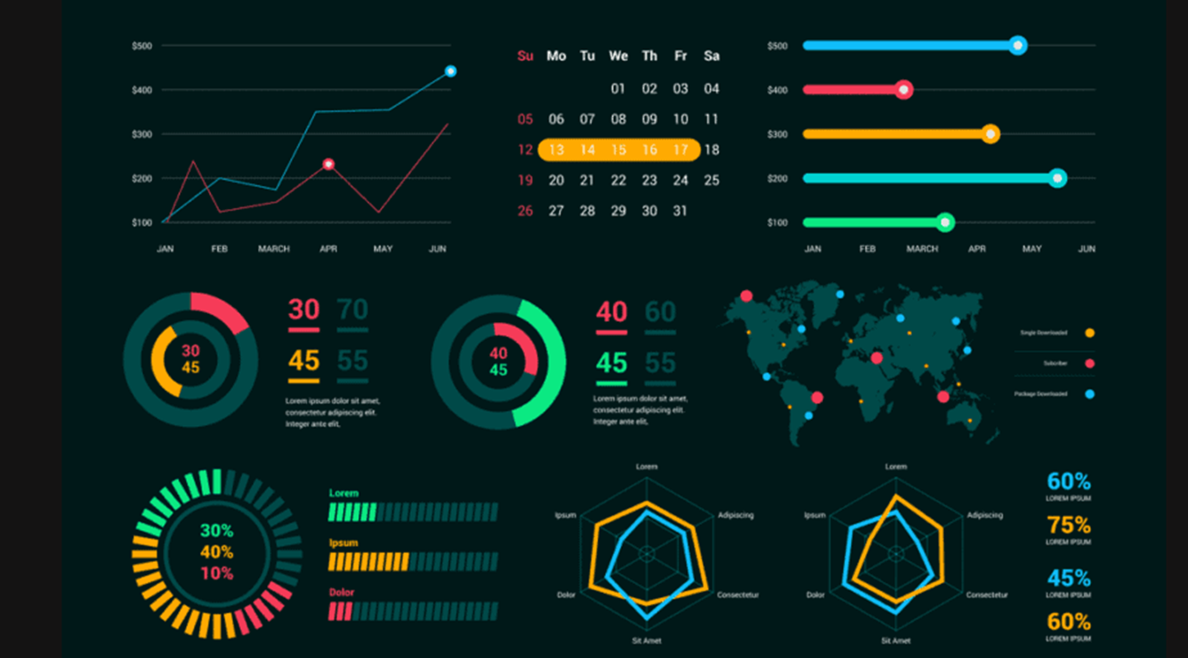
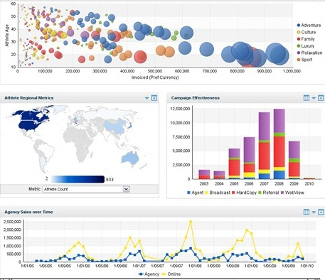
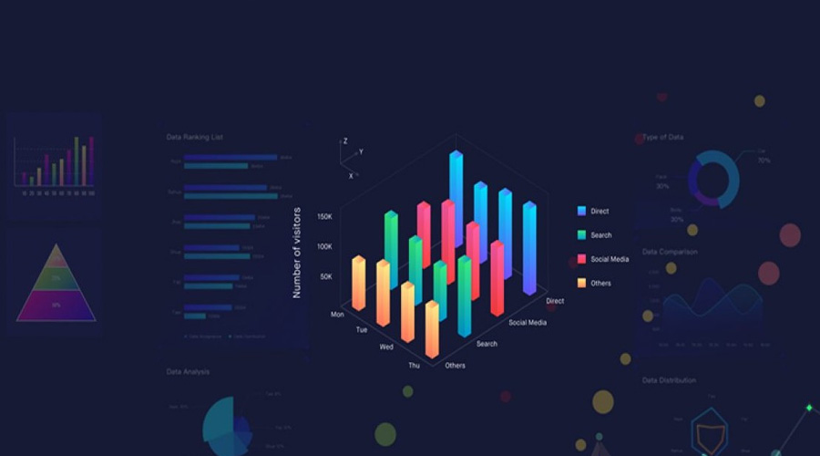
Visualization

Slide 11
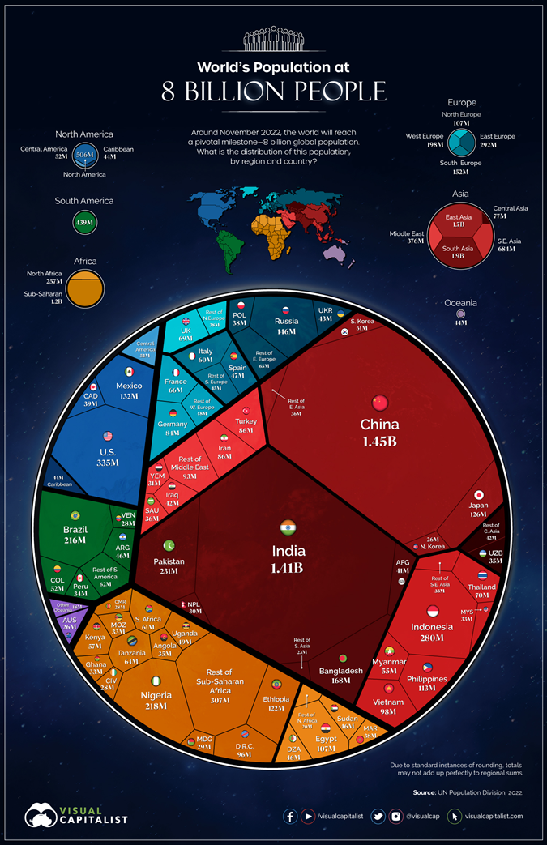

Slide 12
Examples of Visualization
What is data visualization
https://www.youtube.com/watch?v=YaGqOPxHFkc
World Population
https://www.biologicaldiversity.org/programs/population_and_sustainability/world_population_video.html

Slide 13
Relating concepts
Data warehousing
process of collecting and storing data from a variety of sources into a single repository
makes it easier to access and analyze data from different parts of the business
Business intelligence (BI) tools
software applications that help businesses to collect, analyze, and visualize data
can be used to identify trends, make predictions, and improve decision-making
Big data
massive amounts of data that is generated by businesses and other organizations
extract insights from this data that would not be possible to obtain with traditional data analysis methods

Slide 14
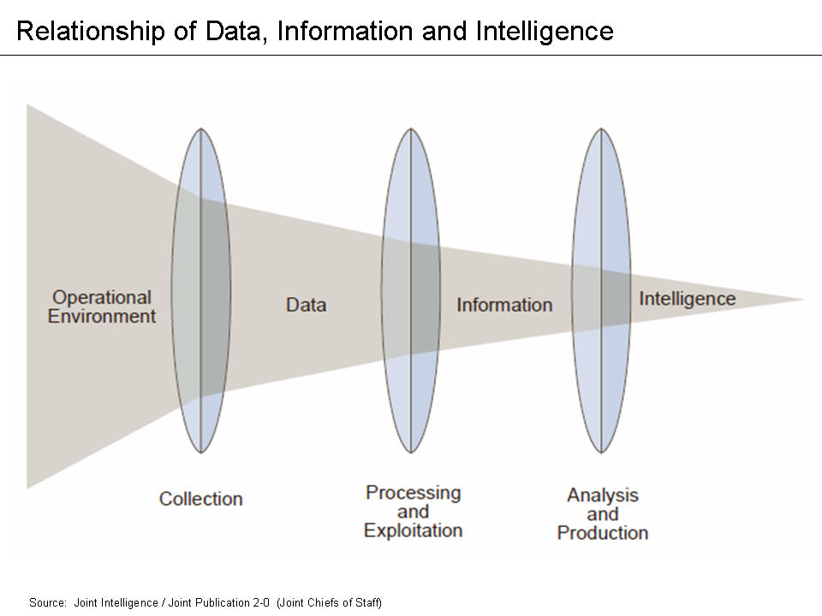

Slide 15
Types of data used in analytics
Structured data
data that is organized in a regular way, such as in a table or spreadsheet. Structured data is typically easy to process and analyze.
Unstructured data
data that is not organized in a regular way, such as text, images, and videos
can be more difficult to process and analyze, but it can also be more valuable
Semi-structured data
data that is somewhere in between structured and unstructured data

Slide 16
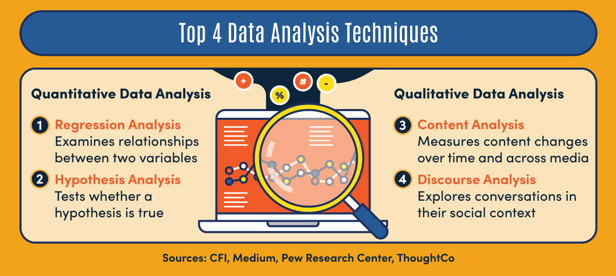
Data Analysis techniques

Slide 17
Web sentiment
The process of extracting and analyzing the opinions and emotions expressed in text data on the web
A variety of sources:
social media, blogs, product reviews, and news articles
Sentiment analysis can be used to understand how people feel about a particular product, service, or issue
can be used to improve products and services, make better business decisions, and target marketing campaigns

Slide 18
Techniques
Techniques for web sentiment analysis:
lexicon of words that have been associated with positive, negative, and neutral sentiment
text data is then analyzed to identify the words that occur in it
the frequency of occurrence of these words is then used to determine the overall sentiment of the text

Slide 19
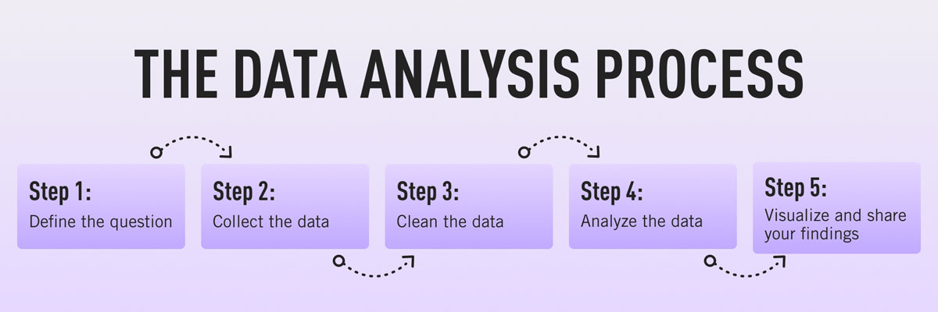
Process of doing business data analytics
Define the business problem
What do you want to achieve?
What information do you need to make better decisions?
Collect the data
The data can come from a variety of sources, such as customer transactions, social media, and surveys
Clean the data
Removing errors and inconsistencies from the data
Analyze the data
Using statistical and machine learning techniques to extract insights from the data

Slide 20
Process of doing business data analytics 2
Visualize the data
Creating charts, graphs, and other visuals to help you communicate the insights that you have found
Share the insights
Share the insights that you have found with the people who need them
Include business leaders, marketing teams, or product developers
Take action
Take action based on the insights that you have found
Review and rework

Slide 21
Data-driven operations
The approach of making decisions and conducting business activities based on data and analysis
using data to gain insights, identify patterns, and make informed decisions to optimize operations and achieve desired outcomes
in a data-driven organization, data is collected, processed, and analyzed to drive decision-making across various departments and functions
allows businesses to rely on objective information rather than relying solely on intuition or past experiences. By leveraging data, organizations can improve efficiency, identify opportunities, mitigate risks, and enhance customer experiences

Slide 22
Data-driven operations ₂
Data-driven operations often involve using advanced analytics, machine learning, and artificial intelligence techniques to extract valuable insights from large volumes of data
It often involve new IT solutions to collect data never collected before

Slide 23
Examples
Fare collections on public transportations (e.g. buses)
Five years ago
“Peep” on a ride, when entering or exiting a bus
Two decades ago
Human collection with tickets
Now
“Peep” when entering and exiting a bus
So what?

Slide 24
Insights can be gained
By time of the day
By day of the week
By traffic among stations
Design of new routes and new time tables

Slide 25
Can we do something about traffic lights?
What are your proposals?

