Slide 1
International Business Case Study
Course Introduction
1
  CYCU
  Prof. CK Farn
mailto: ckfarn@gmail.com
http://www.mgt.ncu.edu.tw/~ckfarn/cycu
  2024.09

Slide 2
Instructor
Prof. CK Farn
  Retired professor from National Central University
  B.S.E., Mech. Engineering, National Taiwan University
  M.Sc., Management Sciences (POM), UMIST, Manchester, UK
  Ph.D., Management (MIS), UCLA, USA
Email: ckfarn@gmail.com
Google “ckfarn”

Slide 3
Preparations
Web pages
  http://www.mgt.ncu.edu.tw/~ckfarn/2024Fall.html
Class time
  Fri. 09:10-12:00
  Break once
  Discussions on make up lessons
Roll call
  English name
  Nameplate
Team formation
  Teams of 4, mixed gender

Slide 4

Teaching materials
Textbook
  C. Hill (2021), Global Business Today, 12th ed., McGraw Hill.
  A textbook that is adopted in many universities in the U.S.
  600+ pages
  Lecture and self study
PowerPoint slides
  On my web page, feel free to download

Slide 5
Objective of this class
Merging into the US program
  English reading, writing, listening and speaking
  Discussions and asking questions
  Presentations, including Q&A
  Learn how to learn: information collection and report formulation
Teamwork
  Team assignments
Subject matter
  International Business
English
Chinese
IB
Non
IB

Slide 6
Class content
Lecture
  Instructor prepared slides
Assignments (team and individual)
  Responding to a task assigned by instructor
  Writeup and presentation
Questions and discussions
  Class discussions
    Roll call, warm call and cold call

Slide 7
Assessments
Assignments: 25%
Participation: 25%
Mid-term quiz: 25%
Final exam: 25%

Slide 8
Tools for conduction inquiry
Google: Search
Generative AI
  ChatGPT (if you are a paid customer, it will provide VIP service)
  Gemini
  Chat PDF: understanding PDF documents
  Perplexity
  …

Slide 9
Gen AI: ChatGPT
Training by the service provider (OpenAI)
  Accumulate knowledge
  Further training by user organization
User ask questions
Answer questions based on its knowledge repository
  Hallucination
  You have to provide background information
  You have to verify its answer
  Multiple iterations

Slide 10
Gen AI: ChatGPT
Query
Background
Main question
Finetuning through dialog
Generic
ChatGPT
Specific
ChatGPT
Info
Source
Info
Source
Final answer

Slide 11
Gen AI: Perplexity
Query
Background
Main question
Search
Engine
Gen AI
Info
Source
Answer

Slide 12
Future assignments
Expected to use multiple tools
Reveal the tools used
Present how you makes use of the tools
  Tracing your interactions with the tool
You are responsible for the final answers
  If you submit it, then you are satisfied with the results
  If you think the answers are not accurate, not to the point, have more dialogs with the tools
You can feed the answer from one tool to the other
  e.g. Ask ChatGPT to polish, summarize the final essay for you, and specify the length of the essay

Slide 13
Presentation of documents

Slide 14
Presenting Yourself
Documents
  Preparing documents
Presentation Slides
  Preparing Powerpoint slides
Typography in presentation materials
  Avoiding errors
  Use of punctuations
  Widows and orphans
  Fonts and typeface
  Colors

Slide 15
Unacceptable presentation
Many documents in Taiwan are sloppy
Why particular about these
Some are simply WRONG
  Have to be corrected
Some are undesirable, causing difficulties in reading and understanding

Slide 16
Punctuations
Use of Chinese punctuation in English documents: No No!
  、。「」『』
There were no punction marks in Chinese before May 4th Movement in 1919
  Punctuation marks were introduced to Chinese
  Adapted to the Chinese language
  Chinese only symbols
  Change of size and location
  , ， ? ？ :： (（

Slide 17
Appropriate use of space
Comma, colon, semicolon, period…
  Must not have leading space
  Must have space after the punctuation mark (unless there is a higher priority rule)
Open quote, open parenthesis (priority)
  Must have leading space
  Must not have space after the punctuation mark
End quote, close parenthesis (priority)
  Must not have leading space
  Must have space after the punctuation mark

Slide 18
Quotation Marks
Erroneous use of quotation marks
  What is the ”word” you try to quote?
  If you use many quoted terms like ”wiki bus” and ”Hawaiin island” in addition to ”Maui girls”, then you are in trouble.
  Use of quote
    You are quoting an entire sentence
    Including the tone of the sentence

Slide 19
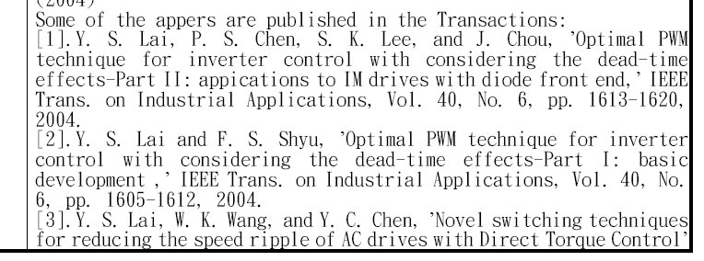
Quotes₁

Slide 20
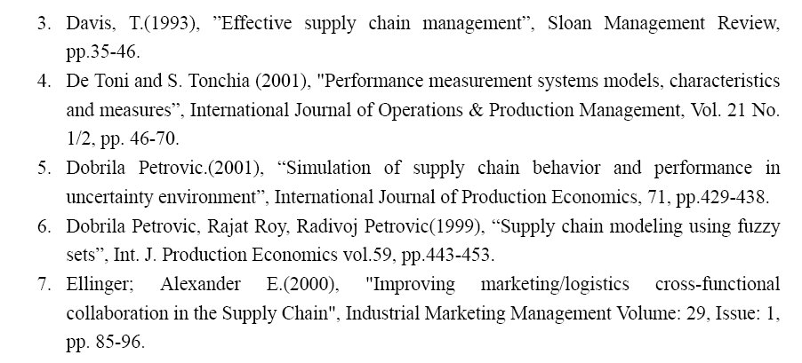
quotes₂

Slide 21
Layout and typography
Use of even margin
  Even margin is good for texts in wide column
  For narrow columns, even margin is undesirable
Widow and orphan
  Widow: the beginning of a paragraph (a single line of text consisting of one or more words) that appears at the bottom of a page
  Orphan: a single line of words (or syllable) of a paragraph of text that sits at the top of a page
  How to avoid: making use of MS Word functions

Slide 22
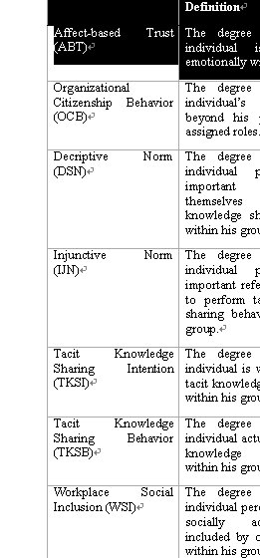
Even margin
Even margin looks ugly here

Slide 23
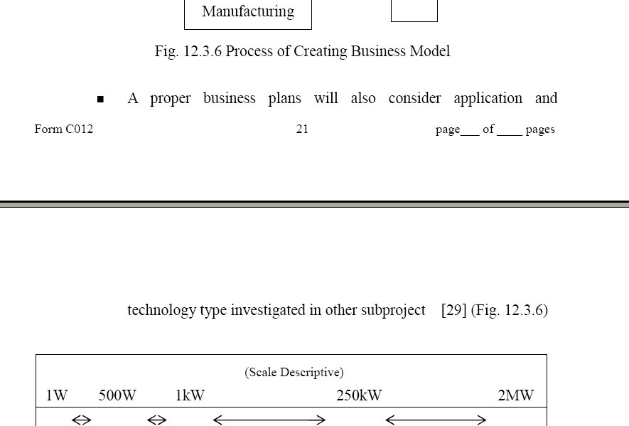
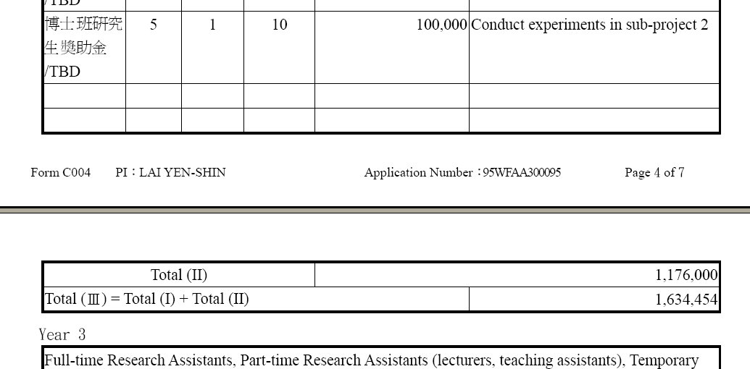
Orphan

Slide 24
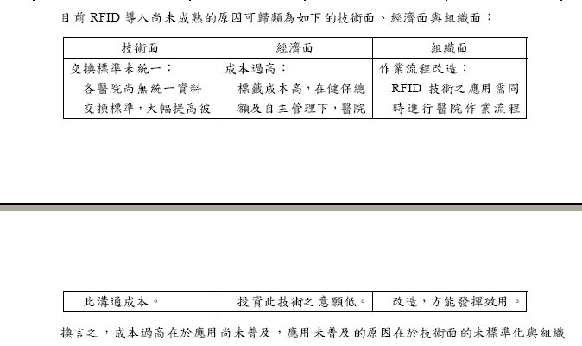
Orphan

Slide 25
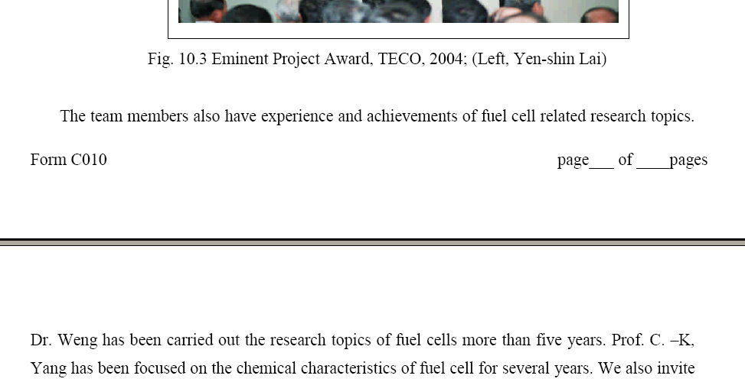
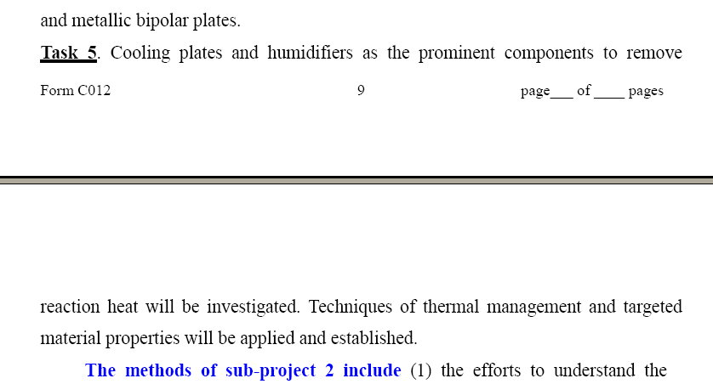
Widow

Slide 26
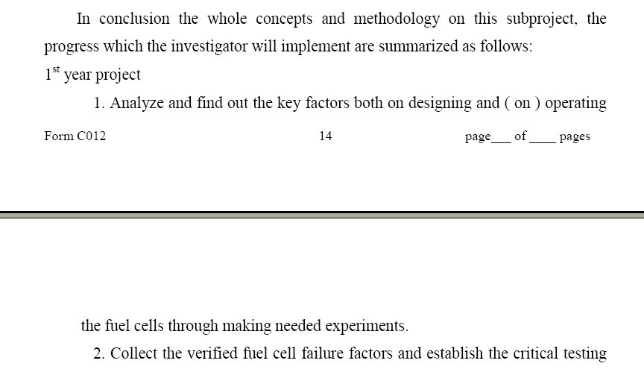
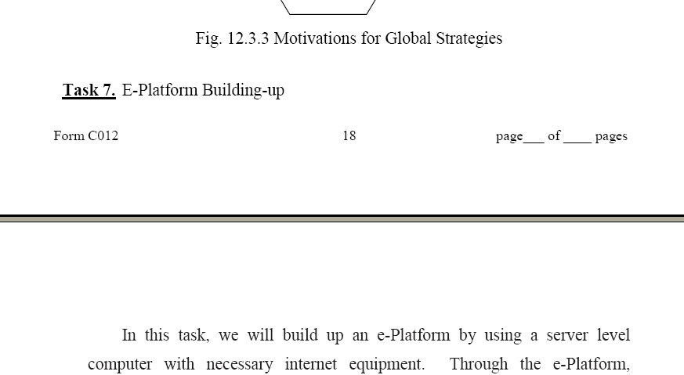
Widow

Slide 27
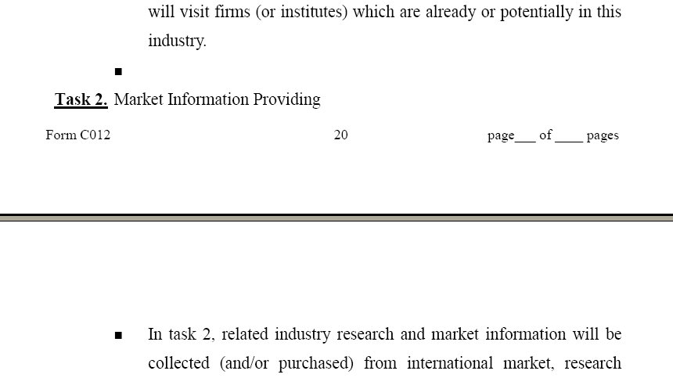
Widow

Slide 28



Typeface: Serif and Sans Serif fonts
A serif is a small line or stroke regularly attached to the end of a larger stroke in a letter or symbol within a particular font or family
Serif fonts: fonts with serif
  As opposed to Sans Serif fonts
  Serif fonts yielded slightly faster reading speeds

Slide 29
Pitch of fonts
Fixed-pitch and Variable-pitch fonts
  Chinese characters are fixed-pitch
  Old typewriters used fixed-pitch font, to match up the gear mechanisms (Pica: 10 to an inch, Elite: 12 to an inch)
  In typesetting for newspaper, magazines and books, variable pitch fonts are used
  Except for tables of numbers

Slide 30
Fonts and size
Fonts
  Typeface, e.g. Times Roman
  Font, e.g. 12 points Times Roman (including size)
Points
  Following conventional typesetting, 1 point = 1/72 inch
  With 12-point fonts, single spacing, 6 lines to an inch
  Early Apple Macintosh computers have screens with 72 pixels to an inch, why?
  WYSIWYG: What you see is what you get

Slide 31
Family of Typeface
Serif
serif
Sans serif
Pica (10 pitch) Elite (12 pitch) | Lucida Sans Typewiter
Times Roman Bookman | Helvetica, Arial
Fixed-
pitch
Pitch
Variable-
pitch

Slide 32
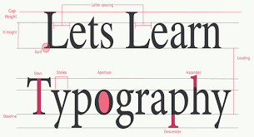
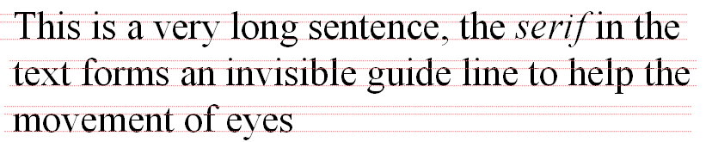
Characteristics of typeface
Effects of Serif:
  Result in faster reading speeds: good for the body of text
Usage of Sans Serif typeface
  Clarity and legibility
  No guidelines: slow down reading speed
  Good for headlines and titles

Slide 33
Fixed-pitch typeface
Thin characters like i, l, sitting in big sofa
Fat characters like m, w, squeezed in a small bench
Uneven density
All Chinese typefaces are fixed-pitch, occupying half a Chinese character: ugly, should avoid
One should avoid using fixed pitch Chinese font when typing English
One should avoid using fixed pitch Chinese font when typing English

Slide 34
Safe choice of fonts
Main body of text, 12 points or less
  Variable-pitch Serif fonts
  e.g. Times New Roman, Bookman, Palatino
Headers, titles
  Arial, Helvetica

Slide 35
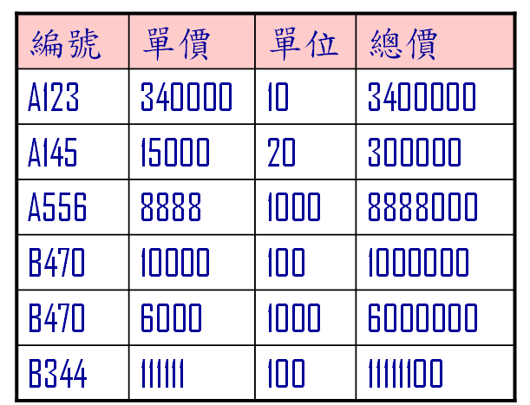
Presenting Numbers₁
What is wrong?

Slide 36
Presenting Numbers₂
No comma
  How many digits?
Aligned to the left
  Which is the largest number?
Variable pitch fonts
  Misaligned

Slide 37
Presenting Numbers₃
Fixed-pitch fonts
編號 | 單價 | 單位 | 總價
A123 | 340000 | 10 | 3400000
A145 | 15000 | 20 | 300000
A556 | 8888 | 1000 | 8888000
B470 | 10000 | 100 | 1000000
B470 | 6000 | 1000 | 6000000
B344 | 111111 | 100 | 11111100

Slide 38
Presenting Numbers₄
Aligned left
編號 | 單價 | 單位 | 總價
A123 | 340000 | 10 | 3400000
A145 | 15000 | 20 | 300000
A556 | 8888 | 1000 | 8888000
B470 | 10000 | 100 | 1000000
B470 | 6000 | 1000 | 6000000
B344 | 111111 | 100 | 11111100

Slide 39
Presenting Numbers₅
Add comma
編號 | 單價 | 單位 | 總價
A123 | 340,000 | 10 | 3,400,000
A145 | 15,000 | 20 | 300,000
A556 | 8,888 | 1000 | 8,888,000
B470 | 10,000 | 100 | 1,000,000
B470 | 6,000 | 1000 | 6,000,000
B344 | 111,111 | 100 | 11,111,100

Slide 40
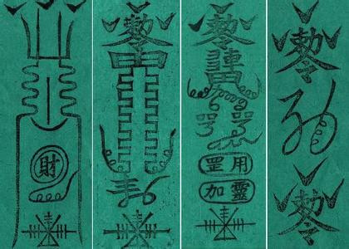
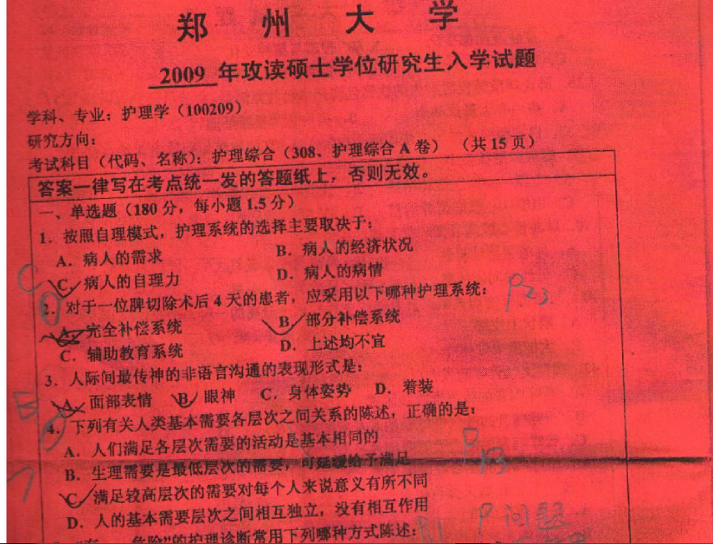

Color
Many people believe that red is eye catching, can be used to highlight important information. Is it true?
粉牆畫白虎、青紙寫烏龍

Slide 41
Contrast is the key!
Can you see it?
Can you see it?
Can you see it?
Can you see it?
Can you see it?
Can you see it?
Can you see it?
Can you see it?
Can you see it?
Can you see it?
Can you see it?
Can you see it?

Slide 42
Red is not always the best
Red may not be eye catching.
It stands out only when there
is a contrast with the background.
Can you see it?
Can you see it?
Can you see it?
Can you see it?
Can you see it?
Can you see it?
Can you see it?
Can you see it?
Can you see it?

Slide 43
Use of shadow
Can you see it?
Can you see it?
Can you see it?
Can you see it?
Can you see it?
Can you see it?
Can you see it?
Can you see it?
Can you see it?
Can you see it?
Can you see it?
Can you see it?

Slide 44
Amount of information
Some slides has too many information
  Not enough time
  Spacing
My rule of thumb: no more than 10 lines of text
To attract attention, focus, punch, use few words with Sans serif font
Must have page number

Slide 45
Example of line spacing and font size
Prof. CK Farn
  Retired professor from National Central University
  B.S.E., Mech. Engineering, National Taiwan University
  M.Sc., Management Sciences (POM), UMIST, Manchester, UK
  Ph.D., Management (MIS), UCLA, USA
Email: ckfarn@gmail.com
Google “ckfarn”

Slide 46
Example of line spacing and font size
Prof. CK Farn
  Retired professor from National Central University
  B.S.E., Mech. Engineering, National Taiwan University
  M.Sc., Management Sciences (POM), UMIST, Manchester, UK
  Ph.D., Management (MIS), UCLA, USA
Email: ckfarn@gmail.com
Google “ckfarn”

Slide 47
Assignment #1: use of tools
Individual
Try to understand the term WTO, and prepare an essay around 500 words
  Explain what is WTO
  Provide a brief history of WTO and its current organization
  Who are members of WTO
The assignment should include three parts:
  1. List the tools you used, and a list of questions that you asked the tool
  2. The final 500 words essay
  3. A comprehensive evaluation of the answer, and your experience with the tools
File name: IBC_HW1_SID_Name.pdf
Upload your pdf file before 23:59 Sept. 26 to: https://next.ezview.asia/s/RaASHLxfGxjWeXw

