Slide 1
Globalization
2
  CYCU
  Prof. CK Farn
mailto: ckfarn@gmail.com
http://www.mgt.ncu.edu.tw/~ckfarn/cycu
  2024.09

Slide 2
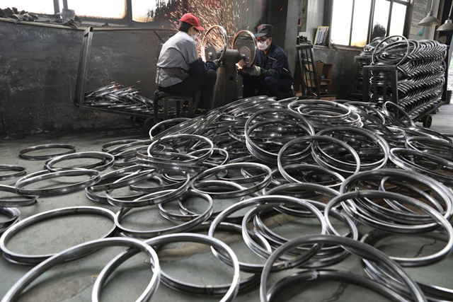
Opening Case
Detroit Bikes
By 2018, about 95 percent of bikes sold in U.S. were assembled in China; about 65 percent of component parts were also produced in China.
American consumers benefitted from lower prices.
Detroit Bikes is an exception to outsourcing trend but struggled with production and local sourcing.
2018 tariffs and resulting trade war was a mixed blessing for Detroit Bikes, due to supply chain disruptions.
Detroit Bikes is trying to avoid raising prices, other companies say they have no choice.
Notes:
Sources: Rajesh Kumar Sing, “U.S. Bike Firms Face Uphill Slog to Replace Chinese Supply Chains,” Reuters Business News, January 14, 2020; Michael Martin, “For One U.S. Bike-Maker, Tariffs Are a Mixed Bag,” National Public Radio, May 18, 2019; Jim Vinoski, “Detroit Bikes: Promoting Urban Cycling by Revitalizing U.S. Bicycle Manufacturing,” Forbes, September 20, 2019.

Slide 3
Introduction
World Economy Today
  Fewer self-contained national economies.
  More integrated global economic system with lower barriers to trade and investment.
  Transformation is called globalization.
  Today, benefits of globalization are more in dispute than at any time in the last half century.
    This shift has created many challenges and some opportunities, too.
    Globalization continues to impact almost everything we do.
Notes:
The opening case illustrates how this shifting landscape has affected the U.S. bicycle industry. As globalization took hold in the 1980s and 1990s, many U.S. bicycle manufacturers outsourced their manufacturing to other nations, and most notably China, choosing instead to focus on the design and marketing of bikes. This was good for American consumers, in so far as it lowered the cost of bikes, and good for American bicycle firms, in so far as it helped to grow demand for their products. On the downside, some assembly workers lost their jobs, but advocates of globalization argued that these losses would be more than offset by the creation of jobs elsewhere in the economy as a result of greater economic growth fostered by globalization.
Irrespective of the current policy debate, the fact remains that globalization has and will probably continue to have an impact on almost everything we do. The impact of globalization is evident in our everyday lives.

Slide 4
What Is Globalization?
A shift toward a more integrated and interdependent world economy.
Two facets:
  Globalization of markets.
  Globalization of production.
Whether you like it or not, Globalization is there
However, since 2018, there has been an exception: Sino-American trade war
Notes:
LO 1-1 Understand what is meant by the term globalization.

Slide 5
Globalization of Markets
The merging of historically distinct and separate national markets into one huge global marketplace.
In many markets, tastes and preferences of consumers in different nations are converging on some global norm, creating a global market.
  Examples: Coca-Cola, McDonald’s, IKEA, Starbucks, Apple.
The most global of markets are for industrial goods and materials that serve universal needs around the world.
  Aluminum, oil, wheat, microprocessors.
Notes:
The most global of markets are not typically markets for consumer products—where national differences in tastes and preferences can still be important enough to act as a brake on globalization. They are markets for industrial goods and materials that serve universal needs the world over. These include markets for commodities such as aluminum, oil, and wheat; for industrial products such as microprocessors, DRAMs (computer memory chips), and commercial jet aircraft; for computer software; and for financial assets, from U.S. Treasury bills to Eurobonds, and futures on the Nikkei index or the euro. That being said, it is increasingly evident that many newer high-technology consumer products, such as Apple’s iPhone, are being successfully sold the same way the world over.

Slide 6
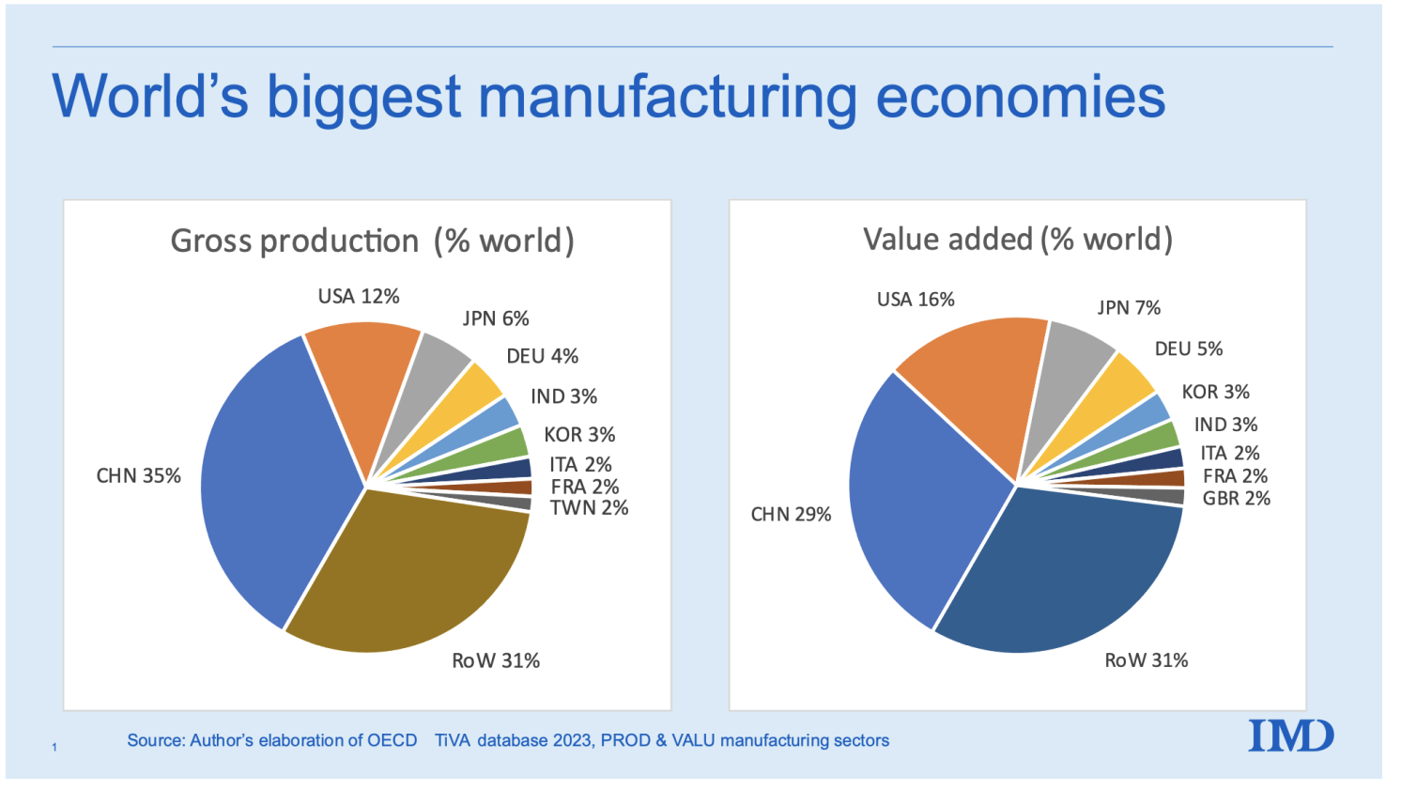
Globalization of Production
Sourcing of goods and services from locations around the globe to take advantage of national differences in the cost and quality of factors of production (labor, energy, land, and capital).
Lower overall cost structure.
Improvement of the quality or functionality of a product to compete more effectively.
China has become known as “the world‘s factory” starting 1987
Notes:
For example, Boeing has made extensive use of outsourcing to foreign suppliers. Consider Boeing’s 777 first introduced in 1995: Eight Japanese suppliers make parts for the fuselage, doors, and wings; a supplier in Singapore makes the doors for the nose landing gear; three suppliers in Italy manufacture wing flaps; and so on. In total, some 30 percent of the 777, by value, is built by foreign companies. And for its most recent jet airliner, the 787, Boeing has pushed this trend even further; some 65 percent of the total value of the aircraft is outsourced to foreign companies, 35 percent of which goes to three major Japanese companies.

Slide 7
Impediments to globalization
Formal and informal trade barriers.
Barriers to foreign direct investment.
Transportation costs.
  International transportation, especially ocean freight shipping
Economic and political risk.
Managerial challenge for coordinating a globally dispersed supply chain.
Notes:
The globalization of markets and production will probably continue. Modern firms are important actors in this trend, their actions fostering increased globalization. These firms, however, are merely responding in an efficient manner to changing conditions in their operating environment—as well they should.

Slide 8
The Emergence of Global Institutions
Global Institutions
  Manage, regulate, and police the global marketplace.
  Promote the establishment of multinational treaties to govern the global business system.
  Created by voluntary agreement between individual nation-states.
World Trade Organization (WTO)
  Polices world trading system and ensures nation-states adhere to the rules established in W T O treaties.
  Succeeded the General Agreement on Tariffs and Trade (GATT).
  164 member nations: 98 percent of world trade (2020).
Notes:
As markets globalize and an increasing proportion of business activity transcends national borders, institutions are needed to help manage, regulate, and police the global marketplace and to promote the establishment of multinational treaties to govern the global business system.

Slide 9
The Emergence of Global Institutions ₂
International Monetary Fund (IMF)
  Maintains order in the international monetary system.
  Lender of last resort.
  Requires nation-states to adopt specific economic policies in return for loans.
World Bank
  Promotes development using low-interest loans.
  Seen as less controversial than IMF.

Slide 10
The Emergence of Global Institutions ₄
United Nations (UN)
  Committed to maintaining international peace and security on basis of UN Charter:
    Develops friendly relations among nations.
    Promotes cooperation in solving international problems.
    Promotes respect for human rights.
    A center for harmonizing the actions of nations.
  Includes 193 member countries.
Notes:
Although the UN is perhaps best known for its peacekeeping role, one of the organization’s central mandates is the promotion of higher standards of living, full employment, and conditions of economic and social progress and development—all issues that are central to the creation of a vibrant global economy. As much as 70 percent of the work of the UN system is devoted to accomplishing this mandate.

Slide 11
The Emergence of Global Institutions ₅
Group of Twenty (G20)
  Comprised of finance ministers and central bank governors of the 19 largest world economies plus the EU and European Central Bank.
  Represents 90 percent of global GDP.
  Became a forum for a coordinated policy response to the financial crisis of 2008 and 2009.
Notes:
Established in 1999, the G20 comprises the finance ministers and central bank governors of the 19 largest economies in the world, plus representatives from the European Union and the European Central Bank. Collectively, the G20 represents 90 percent of global GDP and 80 percent of international global trade.

Slide 12
Drivers of Globalization 1
Two Macro Factors
  Decline in barriers to free flow of goods, services, and capital.
  Technological change.
Notes:
LO 1-2 Recognize the main drivers of globalization.

Slide 13
International Trade and FDI
International Trade
  a firm exports goods or services to consumers in another country.
Foreign direct investment (FDI)
  a firm invests resources in business activities outside its home country.
During 1920s and 1930s, many nations put up barriers to international trade to protect domestic industries.
Notes:
The advanced industrial nations of the West committed themselves after World War II to progressively reducing barriers to the free flow of goods, services, and capital among nations.10 This goal was enshrined in the General Agreement on Tariffs and Trade (see Table 1.1 on the next slide).
The most recent negotiations to be completed, known as the Uruguay Round, were finalized in December 1993. The Uruguay Round further reduced trade barriers; extended GATT to cover services as well as manufactured goods; provided enhanced protection for patents, trademarks, and copyrights; and established the World Trade Organization to police the international trading system.

Slide 14
Table 1.1 Average Tariff Rates on Manufactured Products as Percentage of Value
Country | 19 13 | 19 50 | 19 90 | 2018
France | 21 percent | 18 percent | 5.9 percent | 3.9 percent
Germany | 20 | 26 | 5.9 | 3.9
Italy | 18 | 25 | 5.9 | 3.9
Japan | 30 | -- | 5.3 | 2.5
Netherlands | 5 | 11 | 5.9 | 3.9
Sweden | 20 | 9 | 5.9 | 3.9
United Kingdom | -- | 23 | 5.9 | 3.9
United States | 44 | 14 | 5.7 | 3.1
Sources: The 19 13 to 19 90 data are from “Who Wants to Be a Giant?” The Economist: A Survey of the Multinationals, June 24, 1995, pp. 3 to 4. The 2018 data are from the World Tariff Profiles 2019, published by the World Trade Organization.
Notes:
Table 1.1 summarizes the impact of GATT agreements on average tariff rates for manufactured goods among several developed nations. As can be seen, average tariff rates have fallen significantly since 1950 and by 2018 stood at about 3.0 to 4.0 percent.

Slide 15
Declining Trade and Investment Barriers
After WWII, advanced Western countries reduced barriers.
  GATT, Uruguay Round, and WTO.
Trade in goods and services has been growing faster than world output for decades.
By 2019, sales of foreign affiliates of multinational corporations reached $27 trillion.
Notes:
The advanced industrial nations of the West committed themselves after World War II to progressively reducing barriers to the free flow of goods, services, and capital among nations.10 This goal was enshrined in the General Agreement on Tariffs and Trade (see Table 1.1 on the next slide).
The most recent negotiations to be completed, known as the Uruguay Round, were finalized in December 1993. The Uruguay Round further reduced trade barriers; extended GATT to cover services as well as manufactured goods; provided enhanced protection for patents, trademarks, and copyrights; and established the World Trade Organization to police the international trading system.

Slide 16
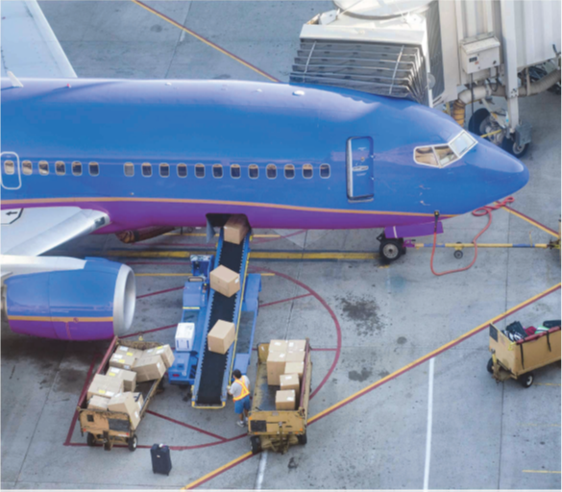
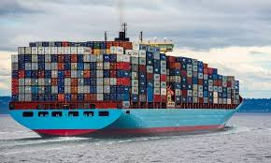
Implications of fast-paced volume of world trade
More companies dispersing parts production.
Economies of nation-states becoming more intertwined.
World becoming significantly wealthier.

Slide 17
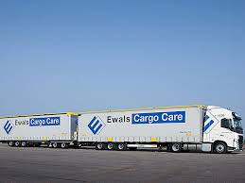
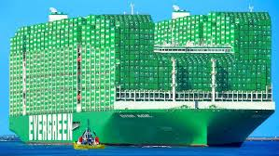
About Ocean Shipping
Container ships and bulk carriers
Container ships
  Size of standard container: 19.10.5“ x 8‘ x 8’6” in foottoday, mostly 40 feet
  TEU: twenty-foot equivalent unit
  In 2024, the largest class of container ship has the capacity of 24,346 TEU https://en.wikipedia.org/wiki/List_of_largest_container_ships#:~:text=As%20of%20January%202024%2C%20the,the%20capacity%20of%2024%2C346%20TEU
What is the capacity of a trailer truck?
  2 to 4 TEU!
Notes:
The advanced industrial nations of the West committed themselves after World War II to progressively reducing barriers to the free flow of goods, services, and capital among nations.10 This goal was enshrined in the General Agreement on Tariffs and Trade (see Table 1.1 on the next slide).
The most recent negotiations to be completed, known as the Uruguay Round, were finalized in December 1993. The Uruguay Round further reduced trade barriers; extended GATT to cover services as well as manufactured goods; provided enhanced protection for patents, trademarks, and copyrights; and established the World Trade Organization to police the international trading system.

Slide 18
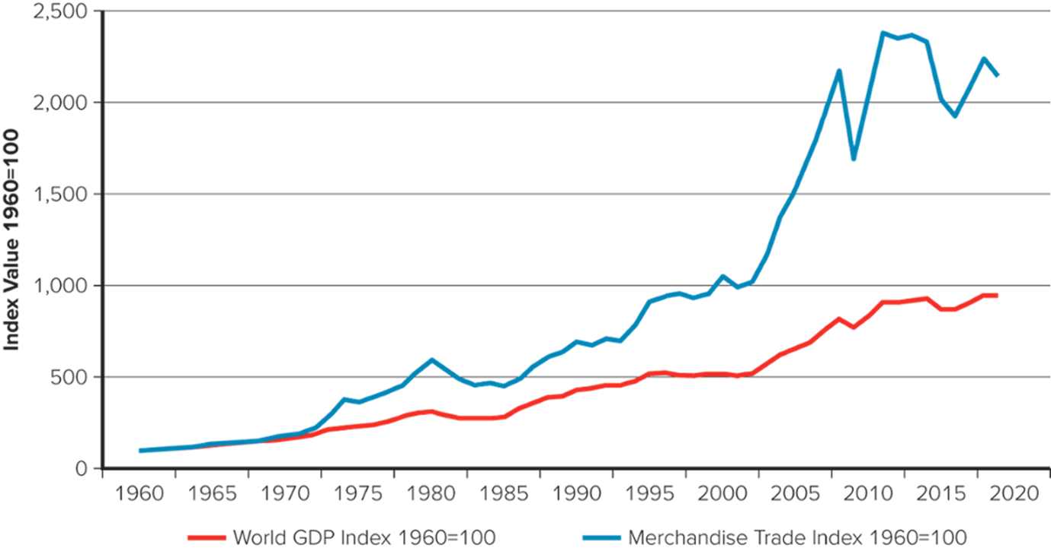
Figure 1.1 Value of World Merchandised Trade and World Production 1960 to 2019
Sources: World Bank, 2020; World Trade Organization, 2020; United Nations, 2020.
Notes:
Figure 1.1 charts the growth in the value of world merchandised trade and world production between 1960 and 2019 (the most recent year for which data are available). The data are adjusted to take out the effect of inflation and is indexed at a value of 100 in 1960 to allow for an “apples to apples” comparison.

Slide 19
Other factors affecting Globalization
Some firms finding home markets under attack from foreign competitors.
Global financial crisis of 2008 to 2009 and drop in global output that occurred led to more calls for trade barriers to protect jobs at home.
  Resulting trade wars, such as one between U.S. and China.
  May slow the rate of globalization and production.
COVID-19 global pandemic has had a significant impact on global supply chains, and thus on globalization.
Notes:
The World Trade Organization has forecasted that due to the ongoing COVID-19 pandemic, world trade will slump by as much as one third in 2020, while cross border investment may fall by 40%.

Slide 20
Role of Technological Change
Transportation Technology.
  Commercial jets, superfreighters.
  Innovation of containerization has significantly lowered shipping costs.
  Container ships over 24,000TEU
ICT: Information and Communication Technology
  Since World War I I, microprocessor created explosive growth of high-power, lost-cost computing.
  Microprocessors also advanced telecommunications.
  In 2019, 4.5 billion Internet users (58 percent of global population).
  Reduces constraints of location, scale, and time zones.
Notes:
Moore’s law: The power of microprocessor technology doubles and its costs of production fall in half every 18 months.

Slide 21
Technological Advancement
Implications for the Globalization of Production.
  Lower transportation costs makes geographically dispersed production system more economical; allows firms to better respond to demand shifts.
Implications for the Globalization of Markets.
  Low-cost communication networks create electronic global marketplace.
  Low-cost transportation makes shipping products around the world economical.
  Reduced cultural distance.
  Converging consumer tastes and preferences.
Notes:
Despite these trends, we must be careful not to overemphasize their importance. While modern communications and transportation technologies are ushering in the “global village,” significant national differences remain in culture, consumer preferences, and business practices.

Slide 22
The Changing Global Economy: 1960s
U.S. dominated the world economy, world trade.
U.S. dominated world FDI.
U.S. MNEs dominated international business.
About half the world was off limits to Western international business.
U.S. was dominant in industrial power, accounting for about 38 percent of world manufacturing output.
Notes:
LO 1-3 Describe the changing nature of the global economy.

Slide 23
The Changing Global Economy: Today
U.S. accounts for only 24 percent.
Germany, France, the U.K., and Canada had similar decline.
Rapid economic growth now in countries like China, India, Russia, and Brazil.
Chinese economy could surpass U.S. within a decade.
Further relative decline by the U.S. and others is likely.
Notes:
Overall, the World Bank has estimated that today’s developing nations may account for more than 60 percent of world economic activity by 2030, while today’s rich nations, which currently account for more than 55 percent of world economic activity, may account for only about 38 percent.

Slide 24
Table 1.2 Changing Demographics of World Output and World Exports
Country | Share of World Output in 1960 (%) | Share of World Output Today (%) | Share of World Exports Today (%)
United States | 38.3 percent | 24.0 percent | 8.2 percent
Germany | 8.7 | 4.6 | 7.1
France | 4.6 | 3.2 | 2.8
Italy | 3.0 | 2.4 | 2.4
United Kingdom | 5.3 | 3.3 | 2.3
Canada | 3.0 | 2.0 | 2.2
Japan | 3.3 | 6.0 | 3.6
China | N A | 15.2 | 11.1
Sources: Output data from World Bank database, 2019. Trade data from W T O Statistical Database, 2019.
2021
2021
Notes:
As can be seen from Table 1.2, from 1960 to today, China’s share of world output increased from a trivial amount to 15.2 percent, making it the world’s second-largest economy in terms of its share in world output (the U.S. is still the largest economy overall). Other countries that markedly increased their share of world output included Japan, Thailand, Malaysia, Taiwan, Brazil, and South Korea.

Slide 25
The Changing Foreign Direct Investment Picture
World output generated by developing countries has been steadily increasing since 1960s.
Stock of foreign direct investment (total cumulative value of foreign investments) generated by rich industrial countries is declining.
Cross-border flows of foreign direct investment is rising.
Largest developing country recipients of FDI are China, Mexico, and Brazil.
Notes:
Reflecting the dominance of the United States in the global economy, U.S. firms accounted for 66.3 percent of worldwide foreign direct investment flows in the 1960s. British firms were second, accounting for 10.5 percent, while Japanese firms were a distant eighth, with only 2 percent. The dominance of U.S. firms was so great that books were written about the economic threat posed to Europe by U.S. corporations. Several European governments, most notably France, talked of limiting inward investment by U.S. firms.

Slide 26
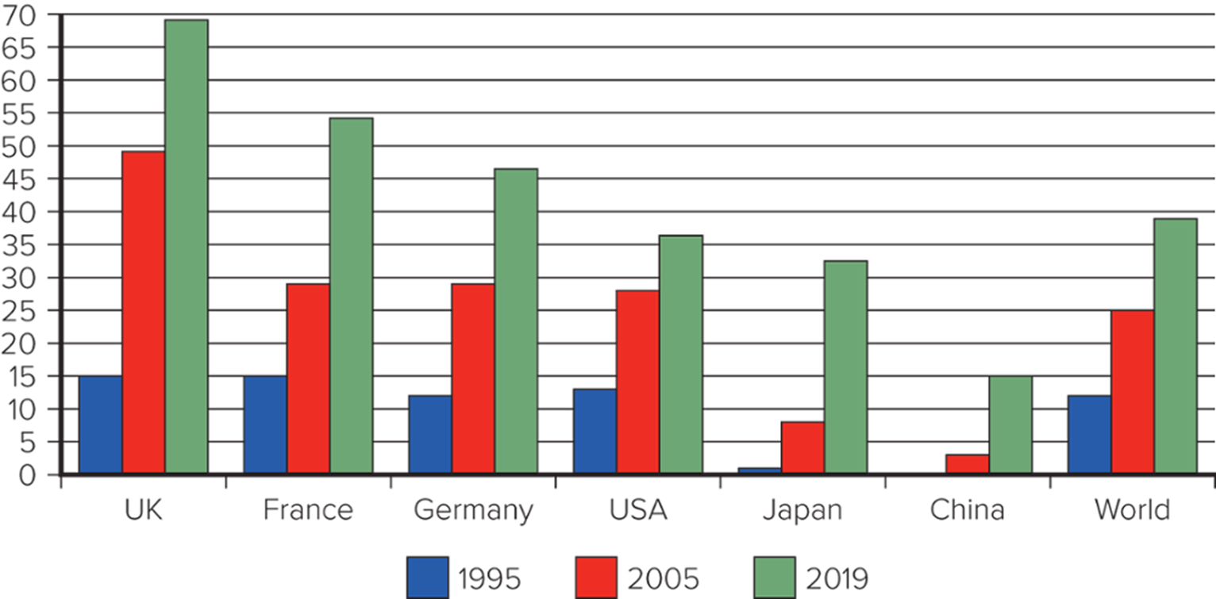
Figure 1.2 FDI Outward Stock as a Percentage of GDP
Sources: OECD data 2020, World Development Indicators 2020, UNCTAD database, 2020.
Organization for Economic Co-operation and Development
United Nations Conference on Trade and Development
Notes:
Figure 1.2 illustrates a striking increase in the outward stock of FDI over time. For example, in 1995 the outward stock of FDI held by U.S. firms was equivalent to 13 percent of U.S. GDP; by 2019, that figure was 36 percent. For the world as a whole, the outward stock of FDI increased from 12 percent to 39 percent over the same time period.
The clear implication is that, increasingly, firms based in a nation depend for their revenues and profits on investments and productive activities in other nations. We live in an increasingly interconnected world.

Slide 27
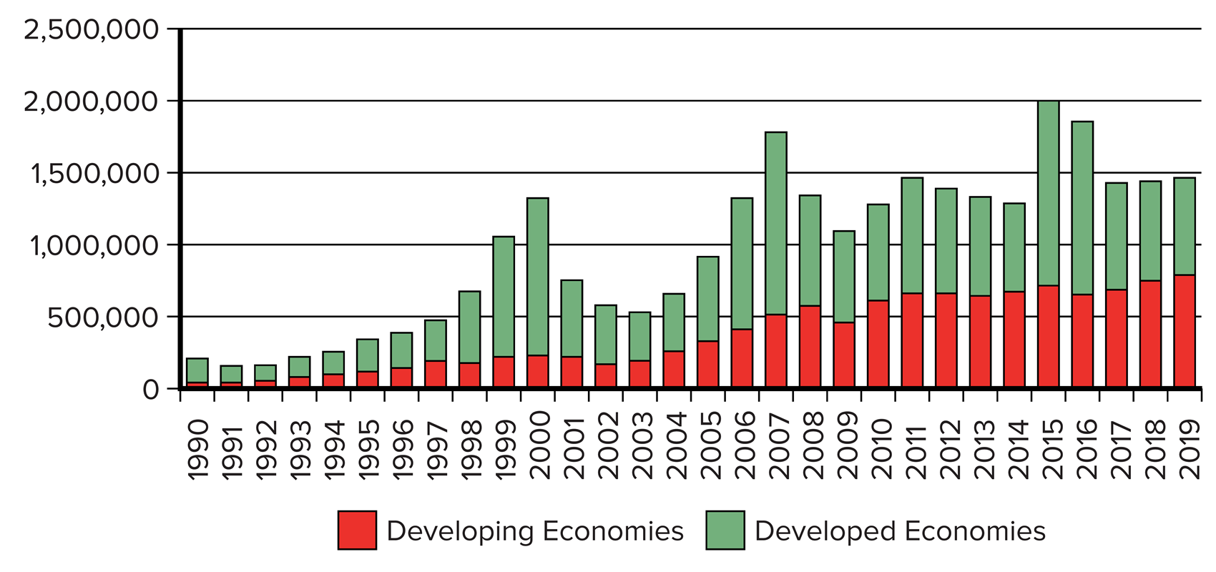
Figure 1.3
F D I Inflows (in millions of dollars) 19 90 to 2019
Source: United Nations Conference on Trade and Development, World Investment Report 2020.
Notes:
Figure 1.3 illustrates two other important trends—the long-term growth in cross-border flows of foreign direct investment that has occurred since 1990, and the increasing importance of developing nations as the destination of foreign direct investment.

Slide 28
The Changing Nature of the Multinational Enterprise
A multinational enterprise (MN E) is any business that has productive activities in two or more countries.
In last 50 years, rise of non-U.S. multinationals and growth of mini-multinationals.
Non-U.S. Multinationals.
  Large number of U.S. multinationals reflects U.S. economic dominance.
  Today, world economy is shifting away from North America and western Europe.

Slide 29
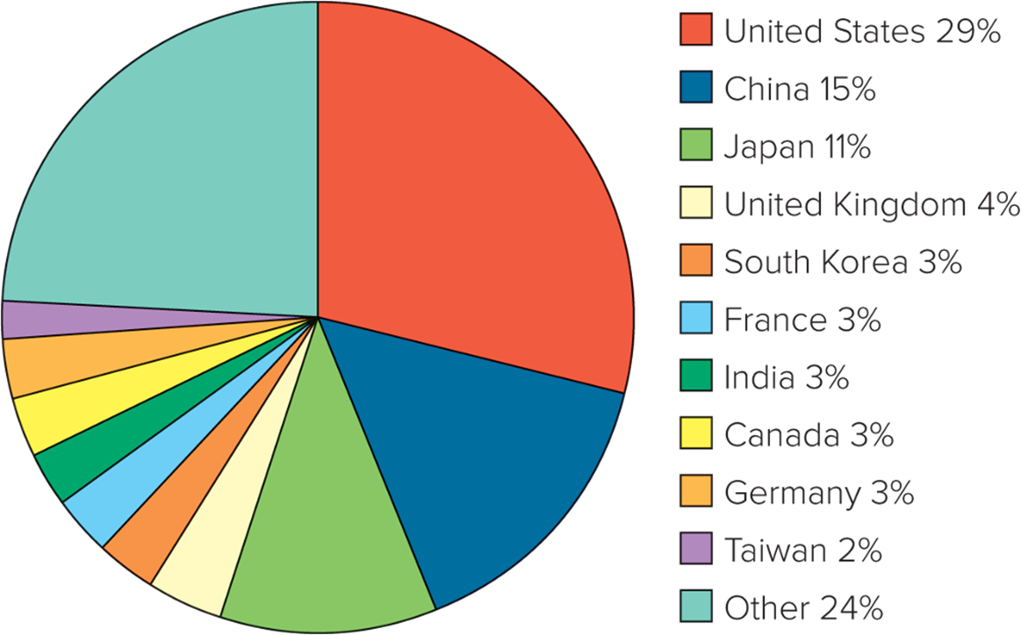
Figure 1.4 National Share of the Largest 2,000 Multinational Corporations in 2019
Source: Forbes Global 2000 in 2019.
Notes:
As shown in Figure 1.4, by 2019 the U.S. share had fallen to 28.8 percent, or 575 firms, and the Japanese share had declined to 11.1 percent, while Chinese enterprises had emerged to comprise 309 of the total, or 15.5 percent. There has also been a notable increase in multinationals from Taiwan, India, and South Korea.

Slide 30
  The Rise of Mini-Multinationals
More small- and medium-size businesses (mini-multinationals) are involved in international trade and investment.
Internet lowers barriers that smaller firms face in building international sales.
Notes:
When people think of international businesses, they tend to think of firms such as ExxonMobil, General Motors, Ford, Panasonic, Procter & Gamble, Sony, and Unilever—large, complex multinational corporations with operations that span the globe. Although most international trade and investment is still conducted by large firms, many medium-sized and small businesses are becoming increasingly involved in international trade and investment.

Slide 31
The Changing World Order
Collapse of communism throughout eastern Europe.
  Greater export and investment opportunities, but political unrest is an increasing risk.
Economic development in China.
  Huge opportunities despite continued government control, but also new competition from Chinese firms.
Free market reforms and democracy in Latin America.
  New markets and new sources of materials and production, but economic and political risk remain high.
Notes:
In 1989 and 1991, a series of democratic revolutions swept the communist world. For reasons that are explored in more detail in Chapter 3, in country after country throughout eastern Europe and eventually in the Soviet Union itself, Communist Party governments collapsed. The Soviet Union receded into history, replaced by 15 independent republics. Czechoslovakia divided itself into two states, while Yugoslavia dissolved into a bloody civil war among its five successor states.
Since then, many of the former communist nations of Europe and Asia have seemed to share a commitment to democratic politics and free market economics. For half a century, these countries were essentially closed to Western international businesses. Now, they present a host of export and investment opportunities.

Slide 32
Global Economy of the Twenty-First Century
A more integrated global economy.
  New opportunities for firms.
  But political and economic disruptions can upset plans.
  Risks associated with global financial crisis.
  Impact of global supply chain disruptions.
Hedging strategies increasing in importance.
Notes:
The past quarter century has seen rapid changes in the global economy. Not withstanding recent developments such as the higher tariffs introduced by the Trump administration in the United States, barriers to the free flow of goods, services, and capital have been coming down. As their economies advance, more nations are joining the ranks of the developed world.

Slide 33
The Globalization Debate 1
Is A More Integrated and Interdependent Global Economy Good?
  Experts believe globalization promotes greater prosperity in the global economy, more jobs, and lower prices for goods and services.
  Others feel that globalization is not beneficial.
Notes:
LO 1-4 Explain the main arguments in the debate over the impact of globalization.

Slide 34
The Globalization Debate 2
Antiglobalization Protests
  Began with WTO protest in December 1999 in Seattle.
    Protest turned violent.
    Other protests have occurred worldwide.
Critics fear globalization has detrimental effects on living standards, wages, and the environment.
  Theory and evidence suggests these fears are exaggerated.
Notes:
Popular demonstrations against globalization date back to December 1999, when more than 40,000 protesters blocked the streets of Seattle in an attempt to shut down a World Trade Organization meeting being held in the city. The demonstrators were protesting against a wide range of issues, including job losses in industries under attack from foreign competitors, downward pressure on the wage rates of unskilled workers, environmental degradation, and the cultural imperialism of global media and multinational enterprises, which was seen as being dominated by what some protesters called the “culturally impoverished” interests and values of the United States.

Slide 35
The Globalization Debate ₃
Globalization, Jobs, and Income
  Critics say that falling trade barriers destroy manufacturing jobs in wealthy economies (U.S. and western Europe).
  Service activities are increasingly outsourced to nations with lower labor costs.
  Supporters say benefits outweigh the costs.
  Outsourcing allows a company to reduce its cost structure and reduce prices.
  Share of labor in national income has declined.
    Attributed to a fall in unskilled labor.
    Gap between poorest and richest segments of society has widened.
  In most countries, real income levels have increased for all.
    Many advanced economies report shortage of highly skilled workers and an excess of unskilled workers.
Notes:
One concern frequently voiced by globalization opponents is that falling barriers to international trade destroy manufacturing jobs in wealthy advanced economies such as the United States and western Europe. Critics argue that falling trade barriers allow firms to move manufacturing activities to countries where wage rates are much lower.

Slide 36
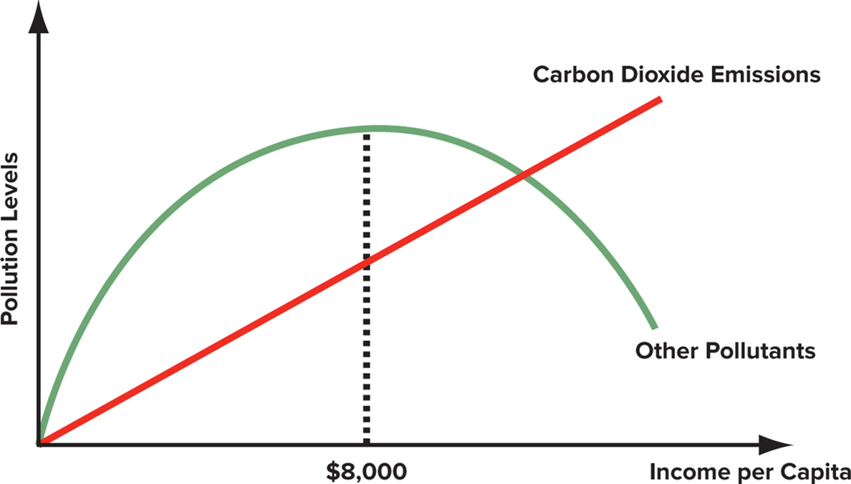
Figure 1.5 Income Levels and Environmental Pollution
Source: C. W. L. Hill and G. T. M. Hult, Global Business Today (New York: McGraw-Hill Education, 2018).
Notes:
While the hump-shaped relationship depicted in Figure 1.5 seems to hold across a wide range of pollutants—from sulfur dioxide to lead concentrations and water quality—carbon dioxide emissions are an important exception, rising steadily with higher-income levels.

Slide 37
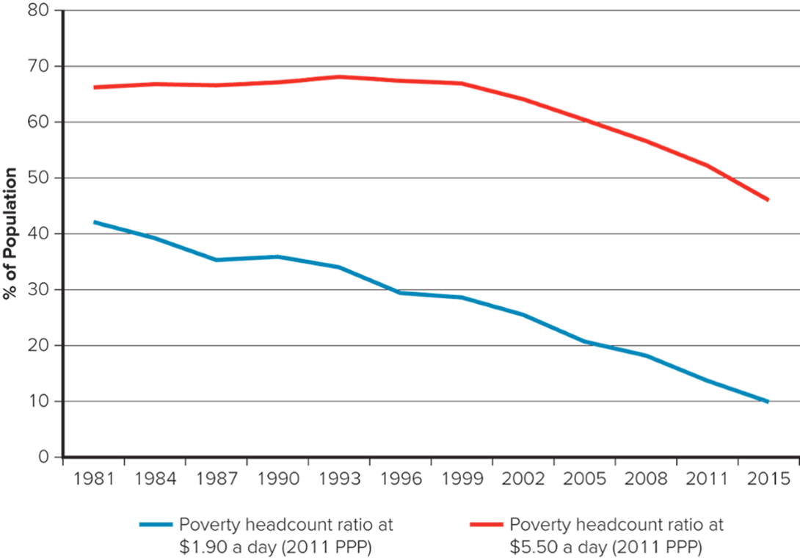
Figure 1.6 Percentage of the World's Population Living in Poverty During 19 81 to 2015
Source: World Bank Data Base on Poverty and Equity, World Development Indicators, 2019.
Notes:
According to data from the World Bank, the percentage of the world’s population living in poverty has declined substantially over the last three decades as shown in Figure 1.6.

Slide 38
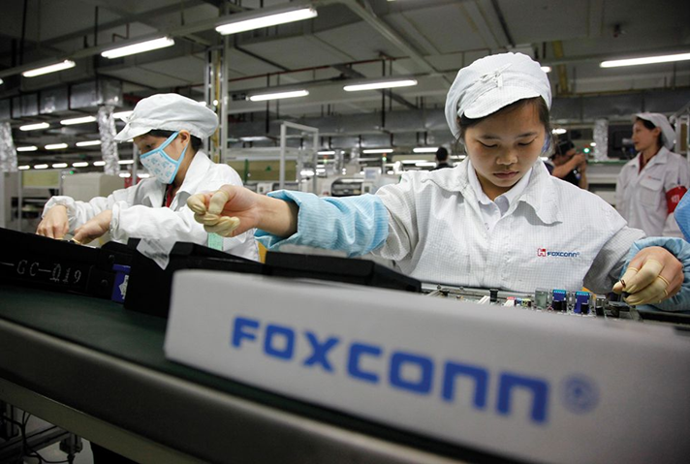
Managing in the Global Marketplace
International Business
  Any firm that is engaged in international trade or investment.
  Managing international business differs from managing domestic business.
      Practices vary by country.
      Issues are more complex.
      Need to understand rules governing international trade and investment.
      Need to convert currency.
Qilai Shen/In Pictures Ltd./Corbis/Getty Images
Notes:
LO 1-5 Understand how the process of globalization is creating opportunities and challenges for management practice.
A firm does not have to become a multinational enterprise, investing directly in operations in other countries, to engage in international business, although multinational enterprises are international businesses. All a firm has to do is export or import products from other countries.

Slide 39
Assignment #2
Group
Do a mini research on the Internet, and finish a report in teams
  Prepare a presentation with PowerPoint, no more than 6 pages
  Groups of 4
  Due Before Oct 11, 10 minutes presentation in class
Trace the development of the US-China Trade War, and assess its impact on the Taiwanese economy
File name: IBC_HW2_GroupID_Names.pdf
Upload your pdf file before 23:59 Oct. 10 to: https://next.ezview.asia/s/RaASHLxfGxjWeXw

