Slide 1
National Difference in Economic Development
4
  CYCU
  Prof. CK Farn
mailto: ckfarn@gmail.com
http://www.mgt.ncu.edu.tw/~ckfarn/cycu
  2024.09

Slide 2
Introduction
Level of economic development and its attractiveness for doing business.
  Influenced by Differences in Political, Economic, and Legal Systems
General movement toward:
  Democratic forms of government.
  Market-based economic reforms.
  Adoption of legal systems that better enforce property rights.
Notes:
In general, the past three decades have seen a general move toward more democratic forms of government, market-based economic reforms, and adoption of legal systems that better enforce property rights. Taken together, these trends have helped foster greater economic development around the world and have created a more favorable environment for international business.

Slide 3
Level of Economic Development
Affects a country’s attractiveness as a possible market or production location for firms.
Common measure is gross national income (GNI).
Purchasing power parity (PPP) adjustment provides a more direct comparison of living standards in different countries.
GNI and PPP data give a static picture of development.
Economic growth rates provide a dynamic picture of development.
Notes:
LO 3-1 Explain what determines the level of economic development of a nation.
GNI is regarded as a yardstick for the economic activity of a country; it measures the total annual income received by residents of a nation.

Slide 4
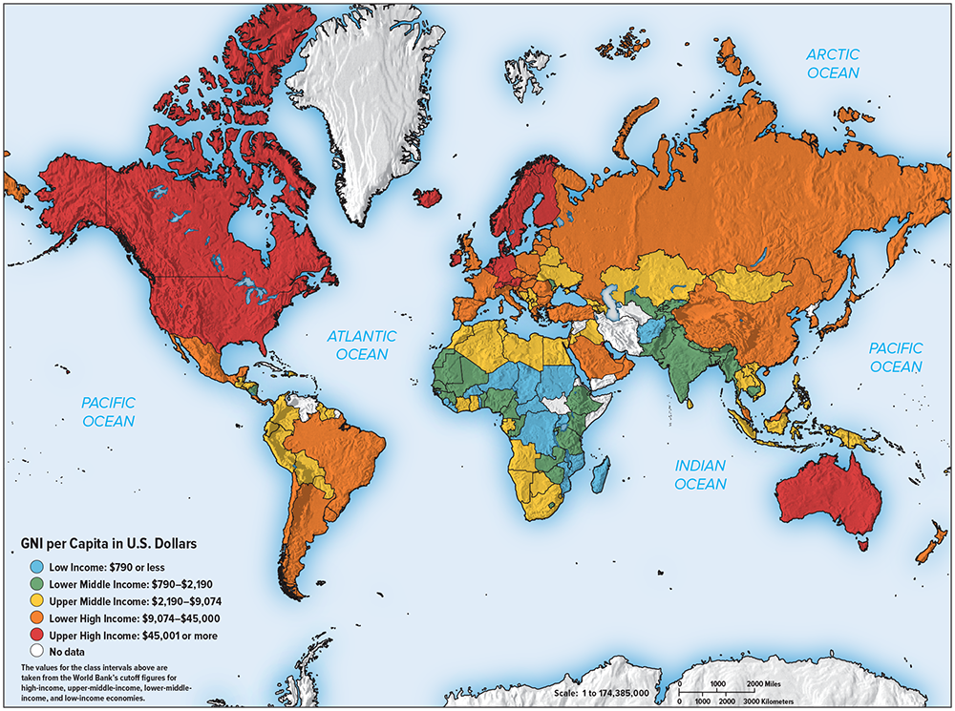
Map 3.1 GNI per Capita, 2019
Source: Freedom House, 2020. https://freedomhouse.org/explore-the-map?type=fiw&year=2020.
Notes:
Map 3.1 summarizes the GNI PPP per capita in 2019 for the nations of the world.

Slide 5
Table 3.1 Economic Data for Select Countries
Country | G N I per Capita, 2019 $ | G N I P P P per Capita, 2019 $ | Annual G D P Growth Rate, 2010 to 2019 % | Size of Economy G D P, 2019 ($ billions)
Brazil | $9,130 | $14,850 | 1.39 percent | $1,840
China | 10,410 | 16,740 | 7.69 | 14,343
Germany | 48,520 | 57,690 | 1.97 | 3,998
India | 2,130 | 6,960 | 6.74 | 2,875
Japan | 41,690 | 44,780 | 1.28 | 5,0812
Nigeria | 2,030 | 5,170 | 3.65 | 448
Poland | 15,200 | 32,710 | 3.63 | 592
Russia | 11,260 | 28,270 | 1.92 | 1,700
Switzerland | 85,500 | 72,390 | 1.85 | 703
United Kingdom | 42,370 | 48,040 | 1.86 | 2,827
United States | 65,760 | 65,880 | 2.28 | 21,428
Source: World Development Indicators Online, 2020.
Notes:
Table 3.1 gives the GNI per capita measured at PPP in 2019 for a selection of countries, along with their GNI per capita, their average annual growth rate in gross domestic product (GDP) from 2010 to 2019, and the overall size of their economy (measured by GDP).

Slide 6
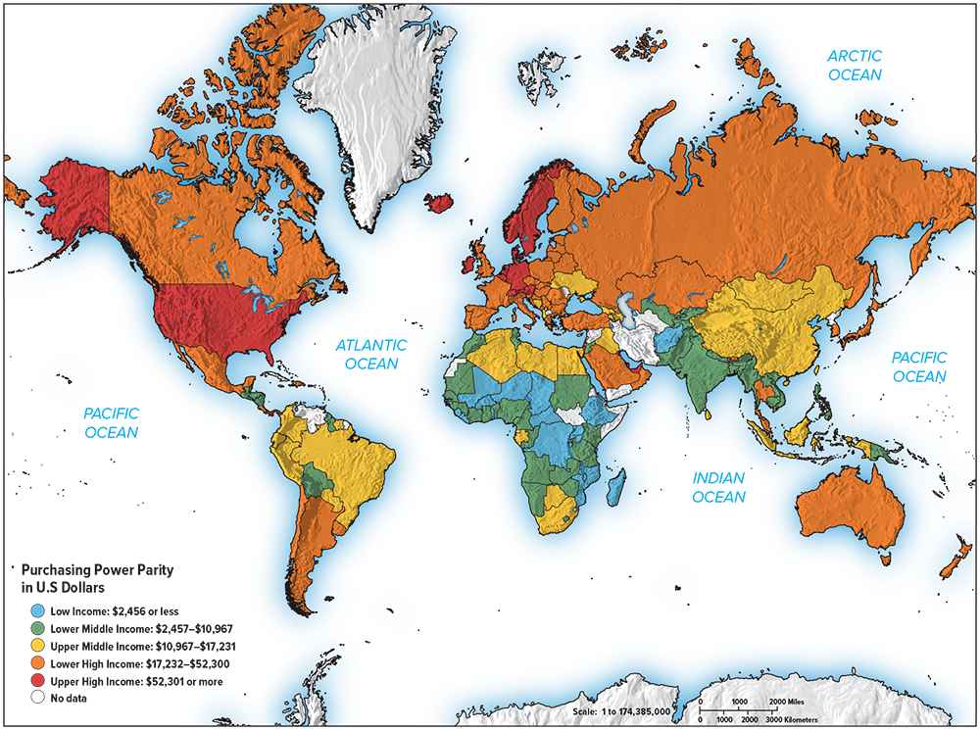
Map 3.2 GNI PPP per Capita, 2019
Source: Freedom House, 2020. https://freedomhouse.org/explore-the-map?type=fiw&year=2020.
Notes:
Map 3.2 summarizes the GNI PPP per capita in 2019 for the nations of the world.

Slide 7
Differences in Standards of Living
Official figures can be misleading.
Unrecorded cash transactions can be significant.
  India’s black or shadow economy may be around 50 percent of GDP.
  EU estimates shadow economy accounted for 10 to 12 percent of GDP in the U.K. and France, 21 percent in Italy, and 23 percent in Greece.
GNI and PPP data don’t indicate growth rates.
Notes:
The GNI and PPP data give a static picture of development. They tell us, for example, that China is poorer than the United States, but they do not tell us if China is closing the gap.

Slide 8
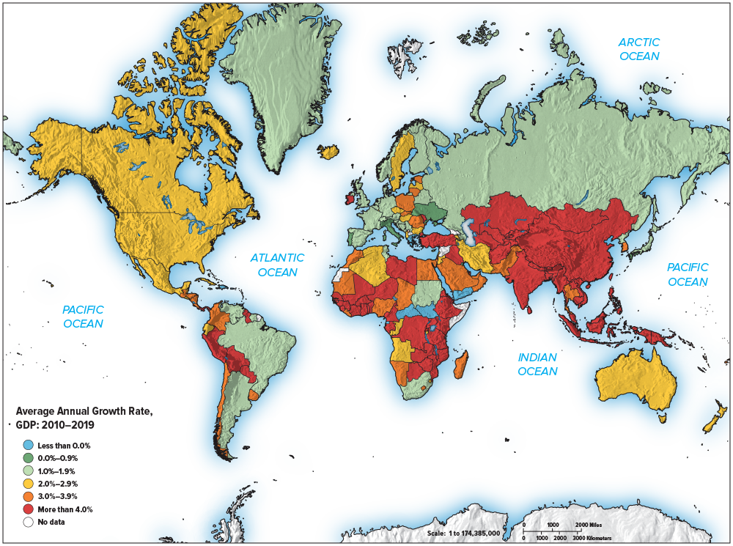
Map 3.3 Average Annual Growth Rate in GDP (%) 2010 to 2019
Source: Freedom House, 2020. https://freedomhouse.org/explore-the-map?type=fiw&year=2020.
Notes:
Map 3.3 summarizes the annual average percentage growth rate in GDP from 2010 to 2019. Although countries such as China and India are currently relatively poor, their economies are already large in absolute terms and growing far more rapidly than those of many advanced nations.

Slide 9
Human Development Index (HDI)
Broader Conceptions of Development: Amartya Sen
Economist Amartya Sen argues development should be assessed less by material output and more by the capabilities and opportunities people enjoy.
UN created the Human Development Index (HDI) based on life expectancy, education attainment, and whether average incomes are sufficient to meet basic needs of life in a country.
  Reflects Sen’s ideas and gauges a country’s economic development and likely future growth rate.
Notes:
The HDI is based on three measures: life expectancy at birth (a function of health care); educational attainment (measured by a combination of the adult literacy rate and enrollment in primary, secondary, and tertiary education); and whether average incomes, based on PPP estimates, are sufficient to meet the basic needs of life in a country (adequate food, shelter, and health care).

Slide 10
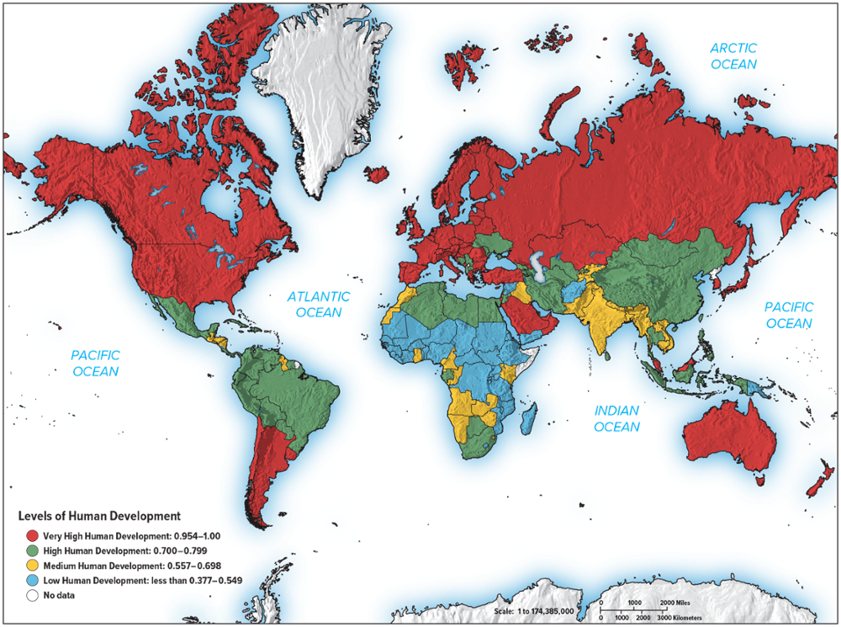
Map 3.4 Human Development Index, 2018
Source: Freedom House, 2020. https://freedomhouse.org/explore-the-map?type=fiw&year=2020.
Notes:
Map 3.4 summarizes the HDI scores for 2018, the most recent year for which data are available.

Slide 11
Political Economy and Economic Progress
Innovation and Entrepreneurship Are the Engines of Growth
  For a country to sustain long-term economic growth, the business environment needs to be conducive to innovation and entrepreneurial activity.
  Innovation: new products, new processes, new organizations, new management practices, and new strategies.
  Entrepreneurs: first to commercialize innovative new products and processes.
Notes:
The U.S. economy has benefited greatly from a high level of entrepreneurial activity, which has resulted in rapid innovation in products and process. Firms such as Apple, Google, Facebook, Amazon, Dell, Microsoft, Oracle, and Uber were all founded by entrepreneurial individuals to exploit new technology. All these firms created significant economic value and boosted productivity by helping commercialize innovations in products and processes.

Slide 12
Innovation and Entrepreneurship
Innovation and Entrepreneurship Require a Market Economy
  Countries with high economic freedom have high economic growth and richer citizens.
  Hong Kong, Switzerland, Singapore, U.S., Canada, and Germany.
Countries that lack economic freedom fail to achieve respectable economic growth.
Innovation and Entrepreneurship Require Strong Property Rights
  Individuals and businesses must have opportunity to profit from innovative ideas.
  Economist Hernando de Soto argues developing world will not benefit from capitalism until property rights are better defined and protected.
Notes:
In a planned economy, the state owns all means of production. Consequently, entrepreneurial individuals have few economic incentives to develop valuable new innovations because it is the state, rather than the individual, that captures most of the gains.

Slide 13
Political Economy and Economic Progress
The Required Political System
  Democratic regimes tend to be more conducive to long-term economic growth than dictatorships, even the benevolent kind.
  Limiting human freedom also suppresses human development and therefore limits progress.
  Some of the fastest growing economies of past 40 years began as undemocratic governments:
    China, South Korea, Taiwan, Singapore, and Hong Kong.
    But only in a well-functioning, mature democracy are property rights truly secure.
Notes:
However, those who argue for the value of a totalitarian regime miss an important point: If dictators made countries rich, then much of Africa, Asia, and Latin America should have been growing rapidly during 1960 to 1990, and this was not the case.

Slide 14
Economic Progress Begets Democracy
Democracy is often a consequence of economic growth.
  South Korea and Taiwan.
  Contributed to attitude of many Western governments towards human rights violations in China.
  If China establishes a free market system, it is hoped that greater individual freedom and democracy will follow.
Notes:
Thus, although democracy may not always be the cause of initial economic progress, it seems to be one consequence of that progress.

Slide 15
Geography, Education, Demographics, and Economic Development
Belief that geography influences economic policy, and thus economic development, goes back to Adam Smith.
  Economist Jeffrey Sachs argues that by virtue of favorable economy, certain societies are more likely to engage in trade, which promotes economic growth.
Investment in education promotes faster economic development.
Demographic forces are also important determinants of economic growth rate.
  Young and growing population.
Notes:
Belief that geography can influence economic policy, and hence economic growth rates, goes back to Adam Smith. Economist Jeffrey Sachs’s point is that by virtue of favorable geography, certain societies are more likely to engage in trade than others and are thus more likely to be open to and develop market-based economic systems, which in turn promotes faster economic growth.
Education emerges as another important determinant of economic development (a point that Amartya Sen emphasizes).
More generally, going forward, low birthrates and an aging population could potentially cause labor shortages and slower economic growth in a number of other major economies, including China, Germany, and the United States.

Slide 16
Three Trends in Political Economy Since Late 1980s
A wave of democratic revolutions swept the world and many previous totalitarian regimes collapsed.
A move away from centrally planned and mixed economies towards free markets.
A shift back toward greater authoritarianism in some nations and signs of a retreat from the free market model.
Notes:
LO 3-2 Identify the macropolitical and macroeconomic changes occurring worldwide.
The political economy of many of the world’s nation-states has changed radically since the late 1980s.

Slide 17
The Spread of Democracy
Many totalitarian regimes failed to deliver economic progress to majority of population.
New information and communication technologies have broken down ability of state to control access to uncensored information.
Economic advances of last quarter century led to increasingly prosperous middle and working classes who pushed for democratic reforms.
Notes:
As in Turkey, authoritarianism has been gaining ground in several other countries where political and civil liberties have been progressively limited in recent years, including Russia, Ukraine, Indonesia, Ecuador, and Venezuela.

Slide 18
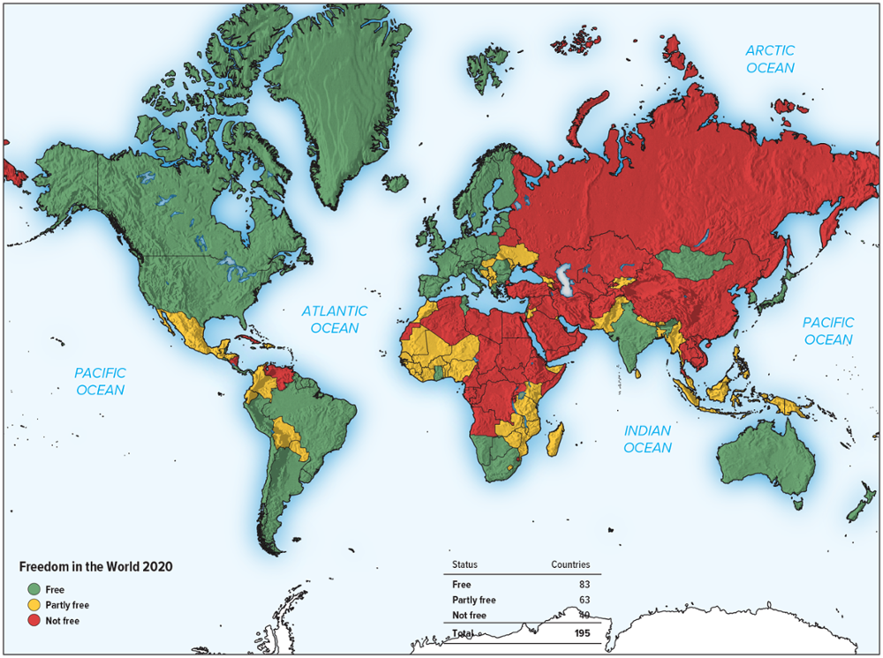
Map 3.5 Freedom in the World, 2020
Source: Freedom House, 2020. https://freedomhouse.org/explore-the-map?type=fiw&year=2020.
Notes:
Map 3.5 reports on the extent of totalitarianism in the world as determined by Freedom House. This map charts political freedom in 2020, grouping countries into three broad groupings: free, partly free, and not free.
In “free” countries, citizens enjoy a high degree of political and civil freedoms.
“Partly free” countries are characterized by some restrictions on political rights and civil liberties, often in the context of corruption, weak rule of law, ethnic strife, or civil war.
In “not free” countries, the political process is tightly controlled, and basic freedoms are denied.

Slide 19
The Spread of Market-Based Systems
Since the late 19 80s, a transformation from centrally planned command economies to market-based economies.
  Command and mixed economies failed to deliver the sustained economic performance achieved by countries that had adopted market-based systems.
  Many countries shifted to a market-based system.
Notes:
The rationale for economic transformation has been the same the world over. In general, command and mixed economies failed to deliver the kind of sustained economic performance that was achieved by countries adopting market-based systems, such as the United States, Switzerland, Hong Kong, and Taiwan. As a consequence, even more states have gravitated toward the market-based model.

Slide 20
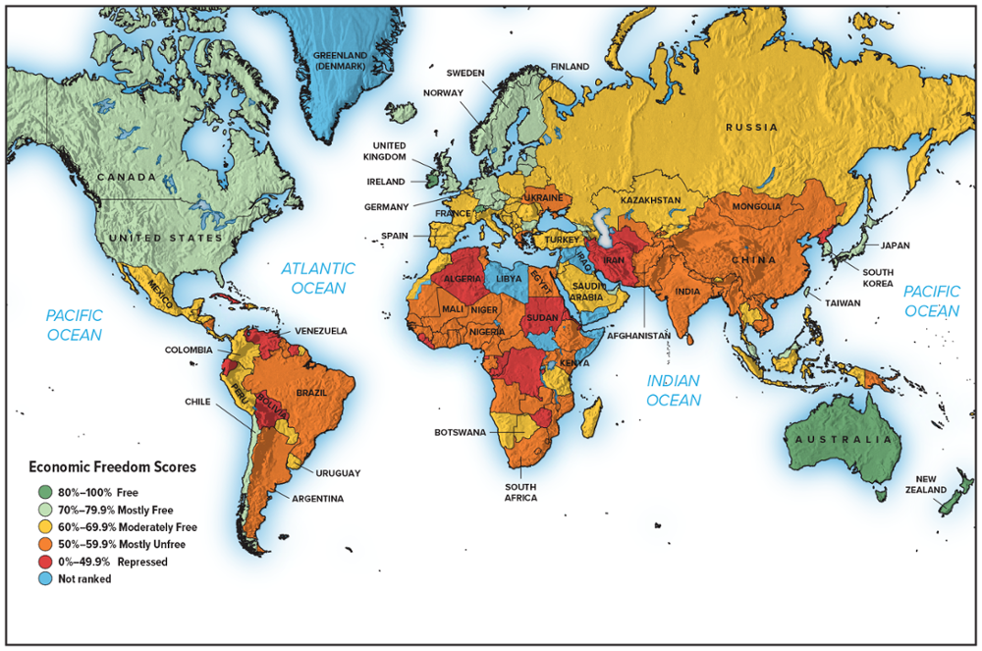
Map 3.6 Index of Economic Freedom, 2020
Source: “Interactive Heat Map.” The Heritage Foundation, 2020. https://www.heritage.org/index/heatmap?version=929.
Notes:
According to the 2020 index, which is summarized in Map 3.6, the world’s freest economies are (in rank order) Singapore, Hong Kong, New Zealand, Australia, Switzerland, Ireland, United Kingdom, Denmark and Canada. The United States was ranked 17, Germany came in at 27, Japan at 30, France at 64, Mexico at 67, Russia at 94, China at 103, India at 120, and Brazil at 144.
The economies of Zimbabwe, Venezuela, Cuba, and North Korea are to be found at the bottom of the rankings.

Slide 21
The Nature of Economic Transformation
Deregulation
  Removing legal restrictions to the free play of markets.
  Establishment of private enterprises.
  Removing price controls.
Notes:
LO 3-3 Describe how transition economies are moving toward market-based systems.
India is an example of a country that has deregulated its economy over the past two decades.

Slide 22
The Nature of Economic Transformation 2
Privatization
  Transfers ownership of state property to private individuals.
  First seen in Great Britain under PM Thatcher; now a worldwide phenomenon.
  Does not guarantee economic growth.
Legal Systems
  Laws protect private property rights and provide mechanisms for contract enforcement.
  Without a legal system in place, there is little incentive to engage in economic activity.
Notes:
The privatization movement started in Great Britain in the early 1980s when then–Prime Minister Margaret Thatcher started to sell state-owned assets such as the British telephone company, British Telecom (BT). In a pattern that has been repeated around the world, this sale was linked with the deregulation of the British telecommunications industry. By allowing other firms to compete head to head with BT, deregulation ensured that privatization did not simply replace a state-owned monopoly with a private monopoly.

Slide 23

360° View: Managerial Implications
Benefits, Costs, Risks, and Overall Attractiveness of Doing Business Internationally
  Overall attractiveness of a country depends upon balance between likely benefits of doing business in that country against the likely costs and risks.
  Benefits:
      Function of market size and current and future consumer purchasing power.
      May be able to gain first-mover advantages.
      Late entrants face late-mover disadvantages.
Notes:
LO 3-4 Explain the implications for management practice of national difference in political economy.
First-mover advantages are the advantages that accrue to early entrants into a market. Late-mover disadvantages are the handicaps that late entrants might suffer. This kind of reasoning has been driving significant inward investment into China, which may become the world’s largest economy by 2030 if it continues growing at current rates (China is already the world’s second-largest national economy). For more than two decades, China has been the largest recipient of foreign direct investment in the developing world as international businesses—including General Motors, Volkswagen, Coca-Cola, and Unilever—try to establish a sustainable advantage in this nation.

Slide 24
Doing Business Internationally: Costs
  Political costs include paying bribes or lobbying for favorable or fair treatment.
  Economic costs relate primarily to sophistication of economic system, including infrastructure and supporting businesses.
  Legal costs can be higher in countries with dramatically different product, workplace, and pollution standards, or where there is poor legal protection for property rights.
Notes:
When McDonald’s decided to open its first restaurant in Moscow, it found that to serve food and drink indistinguishable from that served in McDonald’s restaurants elsewhere, it had to vertically integrate backward to supply its own needs. The quality of Russian-grown potatoes and meat was too poor. Thus, to protect the quality of its product, McDonald’s set up its own dairy farms, cattle ranches, vegetable plots, and food-processing plans within Russia.

Slide 25
Doing Business Internationally: Risks
  Political risk: likelihood that political forces will cause drastic changes in a country's business environment that adversely affects profit and other goals of a business enterprise.
  Economic risk: likelihood that economic mismanagement will cause drastic changes in a country's business environment that adversely affects profit and other goals of a business enterprise.
  Legal risk: likelihood that a trading partner will opportunistically break a contract or expropriate property rights.
Notes:
When legal risks in a country are high, an international business might hesitate entering into a long-term contract or joint-venture agreement with a firm in that country. For example, in the 1970s when the Indian government passed a law requiring all foreign investors to enter into joint ventures with Indian companies, U.S. companies such as IBM and Coca-Cola closed their investments in India. They believed that the Indian legal system did not provide adequate protection of intellectual property rights, creating the very real danger that their Indian partners might expropriate the intellectual property of the American companies—which for IBM and Coca-Cola amounted to the core of their competitive advantage.

Slide 26
Doing Business Internationally: Overall Attractiveness
  Depends on balancing benefits, costs, and risks associated with doing business in that country.
  Generally, costs and risks are lower in economically developed and politically stable markets.
  However, potential for growth may be higher in less developed nations.
Notes:
Overall attractiveness refers to viewing a country as a potential market and/or investment site for an international business.

Slide 27
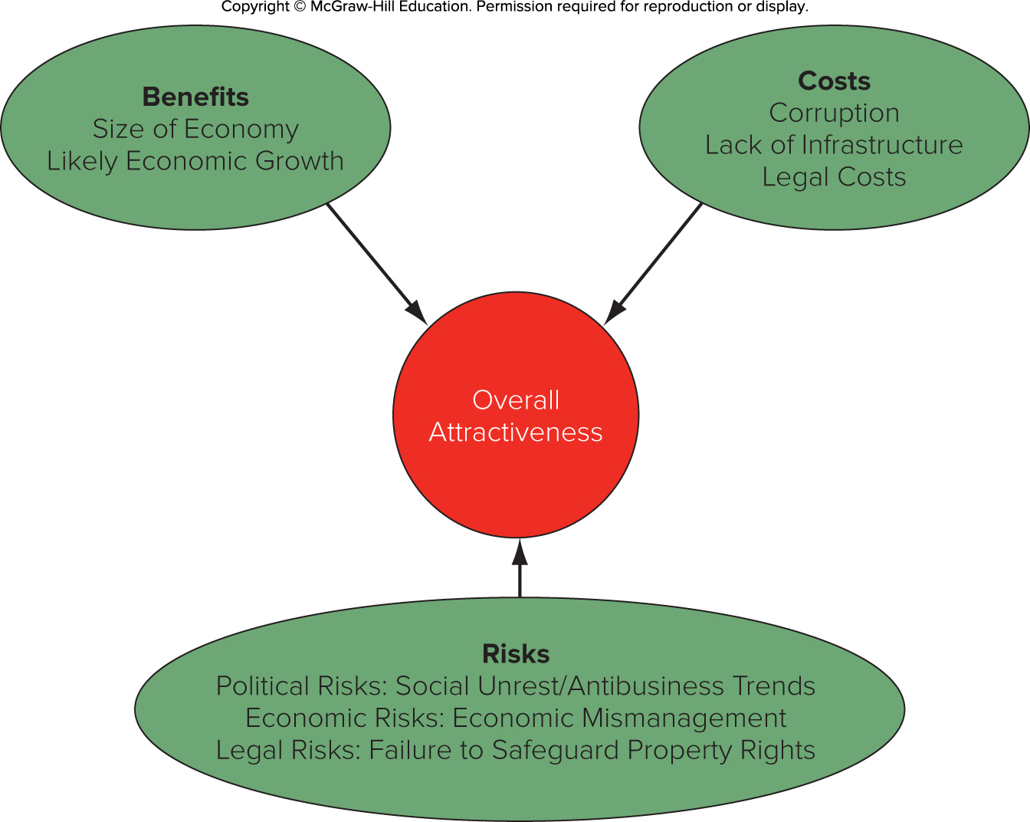
Figure 3.1 Country Attractiveness
Notes:
The overall attractiveness of a country as a potential market or investment site for an international business depends on balancing the benefits, costs, and risks associated with doing business in that country, as shown in Figure 3.1.

