Slide 1
Theories on International Trade
6
  CYCU
  Prof. CK Farn
mailto: ckfarn@gmail.com
http://www.mgt.ncu.edu.tw/~ckfarn/cycu
  2024.10

Slide 2
Introduction
Trade Policy
  Motivation for trade is to realize gains from trade.
  Economists generally advocate for lower barriers to cross-border trade, both in goods and services.
  Recent shift in U.S. trade policy away from free trade and toward managed trade.
    Pushed trade policy to political center stage.
Trade and investment policies have an extremely important impact on international business practices.
Notes:
When economists talk about the gains from trade, what they mean is that trade allows countries to specialize in the production (and export) of goods and services that they can produce most efficiently, while importing goods and services that they cannot produce so efficiently from other nations.

Slide 3
An Overview of Trade Theory ¹
Trade Approaches
  Mercantilism (16th and 17th centuries) encouraged exports and discouraged imports.
  Adam Smith (1776) promoted unrestricted free trade.
  David Ricardo (19th century) built on Smith’s ideas; advocated comparative advantage.
  Eli Heckscher and Bertil Ohlin (20th century ) refined Ricardo’s work.
Free trade
  absence of barriers to the free flow of goods and services between countries.
Notes:
Although mercantilism is an old and largely discredited doctrine, its echoes remain in modern political debate and in the trade policies of many countries. Indeed, some have argued that Donald Trump espouses mercantilist views.

Slide 4
The Benefits of Trade
Specialize in manufacture and export of products that can be produced most efficiently in that country.
Import products that can be produced more efficiently in other countries.
Gains arise because international trade allows a country to specialize in the manufacture and export of products.
Notes:
LO 6-1 Understand why nations trade with each other.
It is beneficial for a country to engage in international trade even for products it is able to produce for itself.
One of the key insights of international trade theory is that limits on imports are often in the interests of domestic producers but not domestic consumers.

Slide 5

Comparative Advantage?
A Rolex Group logo sits on display above a luxury wristwatch store in Vienna, Austria.
Bloomberg/Getty Images

Slide 6
Trade Theory
Paul Krugman’s new trade theory:
  World market can only support a limited number of firms in some industries.
  Trade will skew toward countries that have firms that are able to capture first-mover advantages.
Notes:
New trade theory: The observed pattern of trade in the world economy may be due in part to the ability of firms in a given market to capture first-mover advantages.
In addition to factor endowments, Porter points out the importance of country factors such as domestic demand and domestic rivalry in explaining a nation’s dominance in the production and export of particular products.

Slide 7
Trade Theory and Government Policy
Mercantilism makes a case for government involvement in promoting exports and limiting imports.
Smith, Ricardo, and Heckscher-Ohlin promote unrestricted free trade.
New trade theory and Porter justify limited and selective government intervention to support development of certain export-oriented industries.
Notes:
While the theories all suggest that trade is beneficial, they lack agreement in their recommendations for government policy.

Slide 8
Theory of Mercantilism
In a country’s best interest to maintain a trade surplus—to export more than it imports.
  Gold and silver considered mainstays of national wealth.
  Advocated government intervention to achieve a surplus in balance of trade.
Viewed trade as a zero-sum game
  One in which a gain by one country results in a loss by another.
Notes:
LO 6-2 Summarize the different theories explaining trade flows between nations.
Neo-mercantilists equate political power with economic power and economic power with a balance-of-trade surplus. Critics argue that several nations have adopted a neo-mercantilist strategy that is designed to simultaneously boost exports and limit imports. Despite this, the mercantilist doctrine is by no means dead. For example, U.S. President Donald Trump appears to advocate neo-mercantilist policies.

Slide 9
Theory of Absolute Advantage
A country has absolute advantage in producing a product when it is more efficient than any other country in producing it.
Smith (1776): countries differ in their ability to produce goods efficiently.
  Trade is not a zero-sum game.
  Countries should specialize in production of goods they have an absolute advantage in and then trade these goods for goods produced by other countries.
Notes:
In his 1776 landmark book The Wealth of Nations, Adam Smith attacked the mercantilist assumption that trade is a zero-sum game. Smith argued that countries differ in their ability to produce goods efficiently.

Slide 10
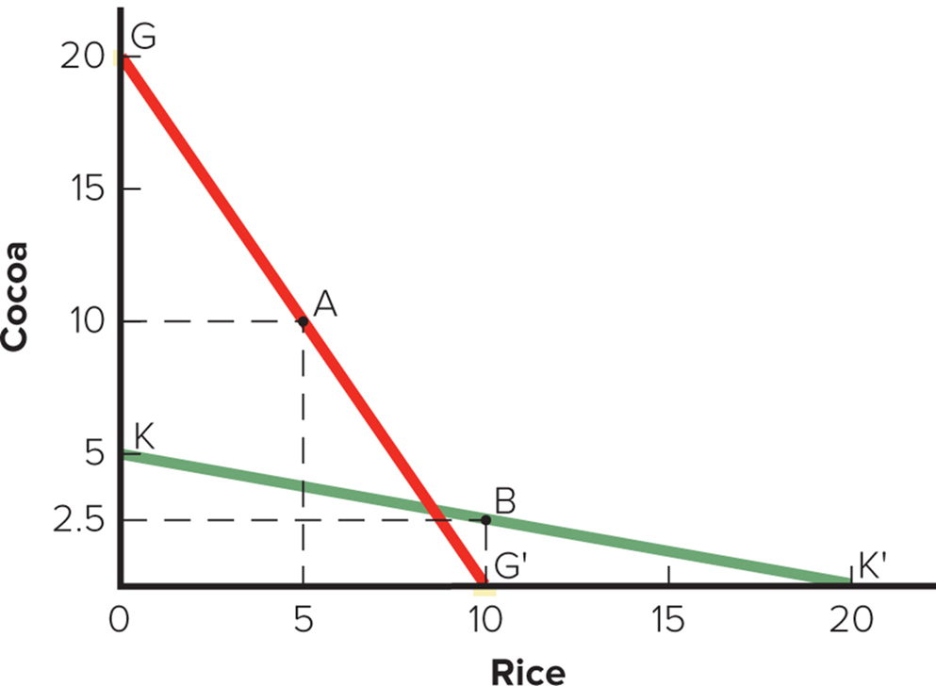
Figure 6.1 The Theory of Absolute Advantage
Notes:
Assume that two countries, Ghana and South Korea, both have 200 units of resources that could either be used to produce rice or cocoa. In Ghana, it takes 10 units of resources to produce one ton of cocoa and 20 units of resources to produce one ton of rice. So, Ghana could produce 20 tons of cocoa and no rice, 10 tons of rice and no cocoa, or some combination of rice and cocoa between the two extremes.
In South Korea it takes 40 units of resources to produce one ton of cocoa and 10 resources to produce one ton of rice. So, South Korea could produce 5 tons of cocoa and no rice, 20 tons of rice and no cocoa, or some combination in between.
Ghana has an absolute advantage in the production of cocoa.
South Korea has an absolute advantage in the production of rice.

Slide 11
Table 6.1 Absolute Advantage and the Gains from Trade 1
Resources Required to Produce 1 Ton of Cocoa and Rice
 | Cocoa | Rice
Ghana | 10 | 20
South Korea | 40 | 10
Production and Consumption without Trade
 | Cocoa | Rice
Ghana | 10.0 | 5.0
South Korea | 2.5 | 10.0
Total Production | 12.5 | 15.0
Production with Specialization
 | Cocoa | Rice
Ghana | 20.0 | 0.0
South Korea | 0.0 | 20.0
Total Production | 20.0 | 20.0
Notes:
We can see that trade is a positive-sum game; it produces net gains for all involved.

Slide 12
Table 6.1 Absolute Advantage and the Gains from Trade 2
Consumption after Ghana Trades 6 Tons of Cocoa for 6 Tons of South Korean Rice
 | Cocoa | Rice
Ghana | 14.0 | 6.0
South Korea | 6.0 | 14.0
Increase in Consumption as a Result of Specialization and Trade
 | Cocoa | Rice
Ghana | 4.0 | 1.0
South Korea | 3.5 | 4.0
Notes:
We can see that trade is a positive-sum game; it produces net gains for all involved.

Slide 13
Theory of Comparative Advantage 1
Theory of Comparative Advantage
  Ricardo (18 17): What happens when one country has an absolute advantage in the production of all goods?
  A country should specialize in production of goods that it produces most efficiently and buy goods that it produces less efficiently from other countries.
Notes:
Ricardo’s theory holds that this is true, even if it means the country buys goods from other countries that it could produce more efficiently itself.

Slide 14
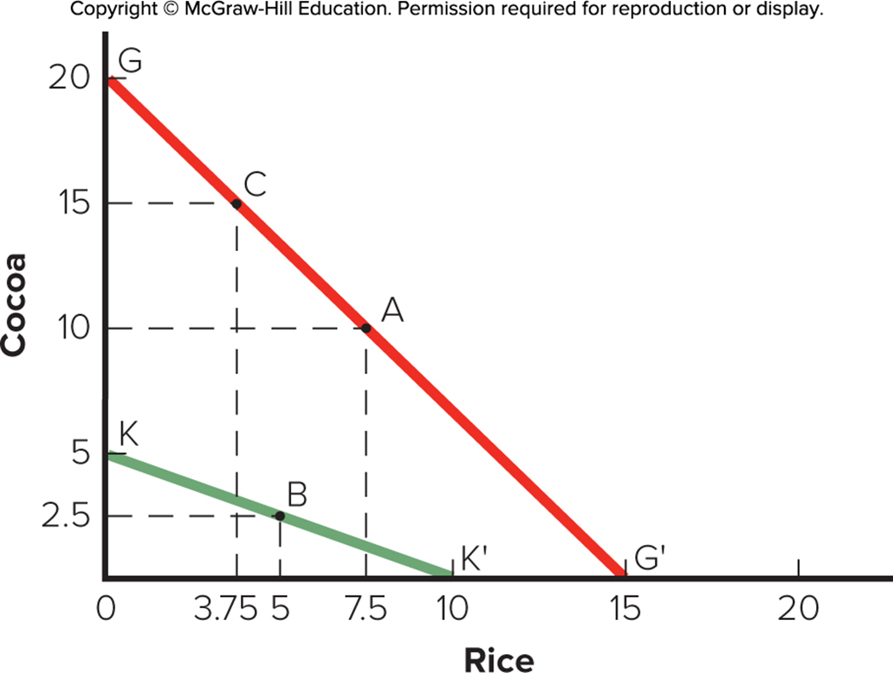
Figure 6.2 The Theory of Comparative Advantage
Notes:
Assume that Ghana is more efficient in the production of both cocoa and rice. In Ghana, it takes 10 resources to produce one tone of cocoa, and 13 1/3 resources to produce one ton of rice. So, Ghana could produce 20 tons of cocoa and no rice, 15 tons of rice and no cocoa, or some combination of the two. In South Korea, it takes 40 resources to produce one ton of cocoa and 20 resources to produce one ton of rice. So, South Korea could produce 5 tons of cocoa and no rice, 10 tons of rice and no cocoa, or some combination of the two.

Slide 15
Comparative Advantage 2
The Gains from Trade
  Trade is a positive-sum game in which all gain.
    Potential world production is greater with unrestricted free trade than with restricted trade.
    Provides a strong rationale for encouraging free trade.
Notes:
The basic message of the theory of comparative advantage is that potential world production is greater with unrestricted free trade than it is with restricted trade. Ricardo’s theory suggests that consumers in all nations can consume more if there are no restrictions on trade.

Slide 16
Table 6.2 Comparative Advantage and the Gains from Trade 1
Resources Required to Produce 1 Ton of Cocoa and Rice
 | Cocoa | Rice
Ghana | 10 | 13.33
South Korea | 40 | 20
Production and Consumption without Trade
 | Cocoa | Rice
Ghana | 10.0 | 7.5
South Korea | 2.5 | 5.0
Total Production | 12.5 | 12.5
Production with Specialization
 | Cocoa | Rice
Ghana | 15.0 | 3.75
South Korea | 0.0 | 10.0
Total Production | 15.0 | 13.75
Notes:
The theory of comparative advantage suggests that trade is a positive-sum game in which all countries that participate realize economic gains.

Slide 17
Table 6.2 Comparative Advantage and the Gains from Trade 2
Consumption after Ghana Trades 4 Tons of Cocoa for 4 Tons of South Korean Rice
 | Cocoa | Rice
Ghana | 11.0 | 7.75
South Korea | 4.0 | 6.0
Increase in Consumption as a Result of Specialization and Trade
 | Cocoa | Rice
Ghana | 1.0 | 0.25
South Korea | 1.5 | 1.0
Notes:
The theory of comparative advantage suggests that trade is a positive-sum game in which all countries that participate realize economic gains.

Slide 18
Comparative Advantage 3
Qualifications and Assumptions
  Only two countries and two goods.
  Zero transportation costs.
  Similar prices and values.
  Resources can move freely from production of one good to another within a country.
  Constant returns to scale.
  Fixed stocks of resources.
  No effects on income distribution within countries.
Notes:
LO 6-3 Recognize why many economists believe that unrestricted free trade between nations will raise the economic welfare of countries that participate in a free trade system.
Once all the assumptions are dropped, the case for unrestricted free trade, while still positive, has been argued by some economists associated with the “new trade theory” to lose some of its strength.

Slide 19
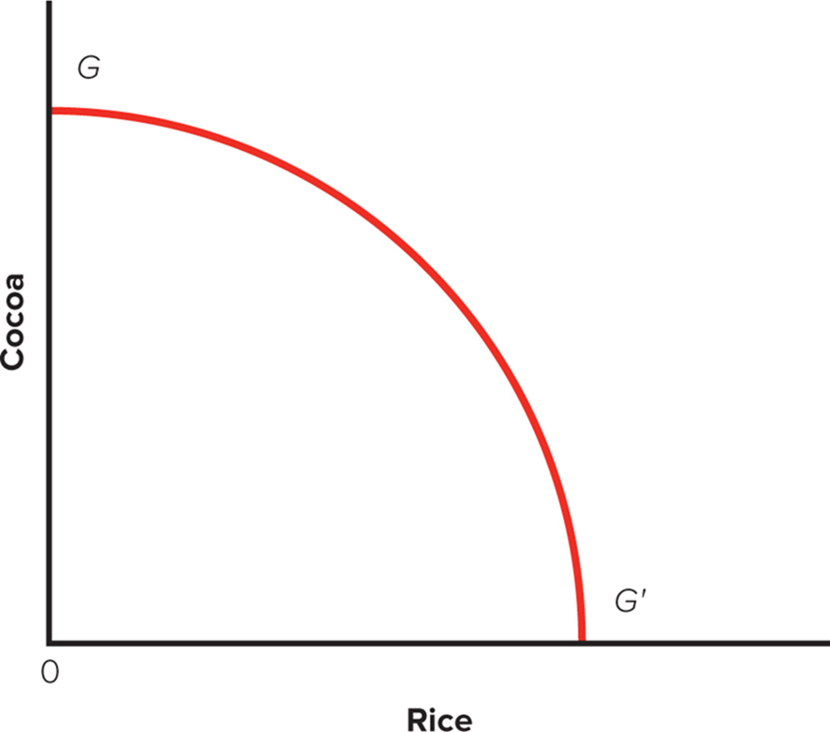
Figure 6.3 Ghana’s P P F under Diminishing Returns
PPF: Production Possibility Frontier
Notes:
Diminishing returns to specialization occur when more units of resources are required to produce each additional unit. While 10 units of resources may be sufficient to increase Ghana’s output of cocoa from 12 tons to 13 tons, 11 units of resources may be needed to increase output from 13 to 14 tons, 12 units of resources to increase output from 14 tons to 15 tons, and so on. Diminishing returns imply a convex PPF for Ghana.

Slide 20
Comparative Advantage 4
  Dynamic Effects and Economic Growth.
    Trade might increase a country's stock of resources as increased supplies become available from abroad.
    Free trade might increase the efficiency of resource utilization and free up resources for other uses.
    Dynamic gains will cause a country’s P P F to shift outward.
Notes:
LO 6-3 Recognize why many economists believe that unrestricted free trade between nations will raise the economic welfare of countries that participate in a free trade system.
The simple comparative advantage model assumed that trade does not change a country’s stock of resources or the efficiency with which it utilizes those resources. This static assumption makes no allowances for the dynamic changes that might result from trade.

Slide 21
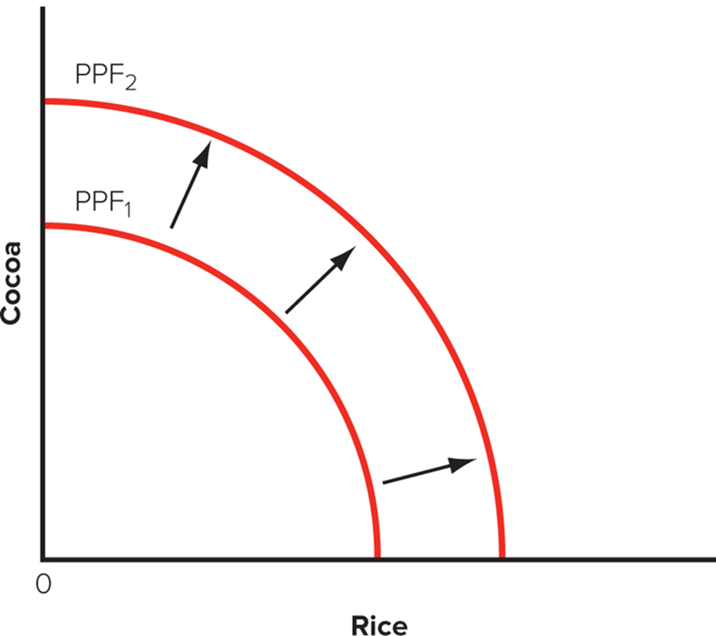
Figure 6.4 The Influence of Free Trade on the P P F
Notes:
Dynamic gains in both the stock of a country’s resources and the efficiency with which resources are utilized will cause a country’s PPF to shift outward. This is illustrated in Figure 6.4, where the shift from PPF₁ to PPF₂ results from the dynamic gains that arise from free trade. As a consequence of this outward shift, the country in Figure 6.4 can produce more of both goods than it did before introduction of free trade. The theory suggests that opening an economy to free trade not only results in static gains of the type discussed earlier but also results in dynamic gains that stimulate economic growth.

Slide 22
Comparative Advantage 5
  Trade, Jobs, and Wages: The Samuelson Critique.
    Dynamic gains can lead to less beneficial outcomes.
    Technology advances allow companies to offshore service jobs that were not traditionally internationally mobile.
    Lowers market clearing wage rate enough to outweigh positive benefits.
    Concedes that free trade has historically benefited rich countries, and that protectionist measures may be harmful.
Notes:
One recent study found evidence in support of Samuelson’s thesis. The study looked at every county in the United States for its manufacturers’ exposure to competition from China. The researchers found that regions most exposed to China tended not only to lose more manufacturing jobs but also to see overall employment decline. Areas with higher exposure to China also had larger increases in workers receiving unemployment insurance, food stamps, and disability payments. The costs to the economy from the increased government payments amounted to two-thirds of the gains from trade with China. In other words, many of the ways trade with China has helped the United States—such as providing inexpensive goods to U.S. consumers—have been wiped out.
Other economists have dismissed Samuelson’s fears. While not questioning his analysis, they note that as a practical matter, developing nations are unlikely to be able to upgrade the skill level of their workforce rapidly enough to give rise to the situation in Samuelson’s model. In other words, they will quickly run into diminishing returns.

Slide 23
Comparative Advantage 6
  Evidence for the Link between Trade and Growth.
    Countries that are open to trade have higher growth rates than countries that close economies to trade.
    Higher growth rates raise income levels and living standards.
Notes:
The message seems clear: Adopt an open economy and embrace free trade, and your nation will be rewarded with higher economic growth rates. Higher growth will raise income levels and living standards.
Research indicates that for every 10 percent increase in the importance of international trade in an economy, average income levels will rise by at least 5 percent.

Slide 24
Heckscher–Ohlin Theory 1
Heckscher–Ohlin Theory
  Comparative advantage reflects differences in national factor endowments: extent to which a country is endowed with resources such as land, labor, and capital.
  Theory has commonsense appeal.
    Export goods that make intensive use of factors that are locally abundant.
    Import goods that make intensive use of factors that are locally scarce.
Notes:
LO 6-2 Summarize the different theories explaining trade flows between nations.
The Heckscher–Ohlin theory has commonsense appeal. For example, the United States has long been a substantial exporter of agricultural goods, reflecting in part its unusual abundance of arable land. In contrast, China has excelled in the export of goods produced in labor-intensive manufacturing industries. This reflects China’s relative abundance of low-cost labor.

Slide 25
Heckscher–Ohlin Theory 2
The Leontief Paradox
  Leontief (19 53): Since U.S. was relatively abundant in capital, it would export capital-intensive goods and import labor-intensive goods.
    U.S. exports were less capital intensive than U.S. imports.
  Possible explanations include:
    U.S. has a special advantage in producing products made with innovative technologies that are less capital intensive.
    Differences in technology lead to differences in productivity, which then drives trade patterns.
Notes:
Tests of the Heckscher–Ohlin theory using data for a large number of countries tend to confirm the existence of the Leontief paradox. This leaves economists with a difficult dilemma. They prefer the Heckscher–Ohlin theory on theoretical grounds, but it is a relatively poor predictor of real-world international trade patterns. On the other hand, the theory they regard as being too limited, Ricardo’s theory of comparative advantage, actually predicts trade patterns with greater accuracy. The best solution to this dilemma may be to return to the Ricardian idea that trade patterns are largely driven by international differences in productivity.

Slide 26
New Trade Theory 1
New Trade Theory
  Trade can increase variety of goods available and decrease average cost of goods.
    Economies of scale: unit cost reductions associated with large scale output.
  When output required to attain economies of scale represents a significant proportion of total world demand, global market may only support a small number of firms.
Notes:
LO 6-2 Summarize the different theories explaining trade flows between nations.
World trade in certain products may be dominated by countries whose firms were first movers in their production.

Slide 27
New Trade Theory 2
Increasing Product Variety and Reducing Costs
  Without trade:
    A small nation may not be able to support demand necessary for producers to realize required economies of scale, so certain products may not be produced.
  With trade:
    A nation may be able to specialize in producing a narrower range of products and then buy goods that it does not make from other countries.
    Each nation then simultaneously increases variety of goods available to its consumers and lowers costs of those goods.
Notes:
LO 6-3 Recognize why many economists believe that unrestricted free trade between nations will raise the economic welfare of countries that participate in a free trade system.
Trade is mutually beneficial because it allows the specialization of production, the realization of scale economies, the production of a greater variety of products, and lower prices.

Slide 28
New Trade Theory 3
Economies of Scale, First-Mover Advantages, and the Pattern of Trade
  First-mover advantages: economic and strategic advantages that accrue to early entrants into an industry.
  Firms develop economies of scale and create barriers to entry for other firms.
    Pattern of trade in world economy may be result of first-mover advantages and economies of scale.
Notes:
New trade theory argues that for those products where economies of scale are significant and represent a substantial proportion of world demand, the first movers in an industry can gain a scale-based cost advantage that later entrants find almost impossible to match. Thus, the pattern of trade that we observe for such products may reflect first-mover advantages.
Example: commercial aerospace industry.

Slide 29
New Trade Theory 4
Implications of New Trade Theory
  Nations may benefit from trade even when they do not differ in resource endowments or technology.
  A country may predominate in export of goods because it was lucky enough to have one or more firms be first to produce them.
  New trade theory:
    At a variance with Heckscher-Ohlin theory.
    Useful in explaining trade patterns.
    Provides economic rationale for proactive trade policy that is at variance with other free trade theories.
Notes:
New trade theorists stress the role of luck, entrepreneurship, and innovation in giving a firm first-mover advantages.

