Slide 1
POM: Production and Operations Management Course Introduction
1
CYCU
Prof. CK Farn
mailto: ckfarn@gmail.com
http://www.mgt.ncu.edu.tw/~ckfarn/cycu
2024.09

Slide 2
Instructor
Prof. CK Farn
Retired professor from National Central University
B.S.E., Mech. Engineering, National Taiwan University
M.Sc., Management Sciences (POM), UMIST, Manchester, UK
Ph.D., Management (MIS), UCLA, USA
Email: ckfarn@gmail.com
Google “ckfarn”

Slide 3
Preparations
Web pages
http://www.mgt.ncu.edu.tw/~ckfarn/2024Fall.html
Class time
Thu. 09:10-12:00
Break once
Discussions on make up lessons
Roll call
English name
Nameplate
Team formation
Teams of 4, mixed gender (to be adjusted)

Slide 4
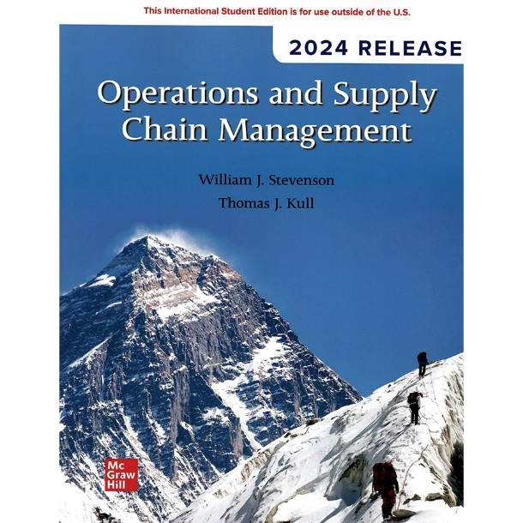
Teaching materials
Textbook
Stevenson & Kull (2024), Operations and Supply Chain Management, 2024 release, McGraw Hill.
A textbook that is adopted in many universities in the U.S.
900 pages
Lecture and self study
PowerPoint slides
On my web page, feel free to download

Slide 5
Objective of this class
Merging into the US program
English reading, writing, listening and speaking
Discussions and asking questions
Presentations, including Q&A
Learn how to learn: information collection and report formulation
Teamwork
Team assignments
Subject matter
POM: Production and Operations Management
English
Chinese
POM
Non
POM

Slide 6
Class content
Lecture
Instructor prepared slides
Assignments (team and individual)
Responding to a task assigned by instructor
Writeup and presentation
Questions and discussions
Class discussions
Roll call, warm call and cold call

Slide 7
Assessments
Assignments: 25%
Participation: 25%
Mid-term quiz: 25%
Final exam: 25%

Slide 8
What is POM
Production Management
planning and control of industrial processes to ensure that they move smoothly at the required level
five M’s: men, machines, methods, materials, and money
Production and Operations Management
operations management, operational management
Supply chain management
techniques of production management in manufacturing industries also employed in services

Slide 9
Operations Management
What is operations?
The part of a business organization that is responsible for producing goods or services
How are things done?
How can we define operations management?
The management of systems or processes that create goods and/or provide services

Slide 10
Good or Service?
Goods are physical items that include raw materials, parts, sub-assemblies, and final products
Automobile
Computer
Oven
Shampoo
Services are activities that provide some combination of time, location, form or psychological value
Air travel
Education
Haircut
Legal counsel

Slide 11
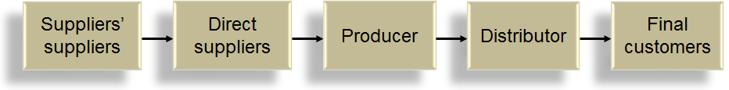
Supply Chain
Supply chain – a sequence of activities and organizations involved in producing and delivering a good or service
Buying a can of Coke
Product
Service

Slide 12
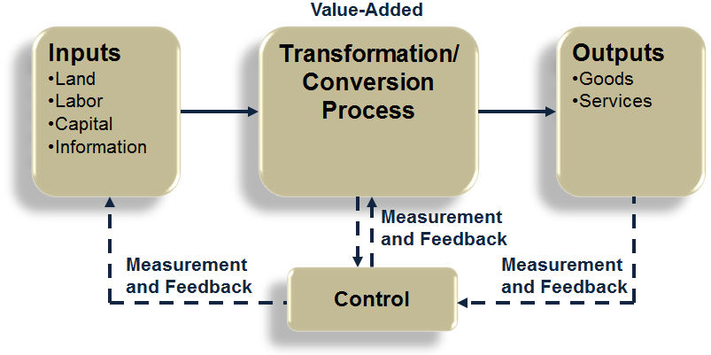
The Transformation Process: IPO General Systems Theory
Feedback = Measurements taken at various points in the transformation process
Control = The comparison of feedback against previously established standards to determine if corrective action is needed

Slide 13
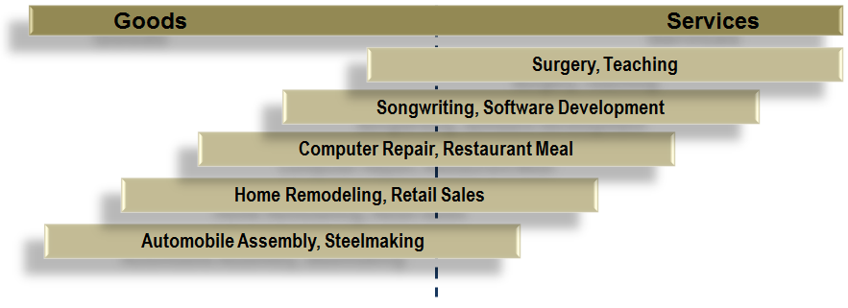
Goods-service Continuum
Products are typically neither purely service- or purely goods-based
Does TSMC provide goods or services to customers?

Slide 14
The transformation process
 | Inputs | Processing | Output
Food Processor | Raw vegetables | Cleaning | Canned vegetables
 | Metals sheets Water Energy Labor Building Equipment | Making cans Cutting Cooking Packing Labeling
Hospital | Doctors, nurses | Examination | Treated patients
 | Hospital Medical supplies Equipment Laboratories | Surgery Monitoring Medication Therapy

Slide 15
Typical differences between production of goods and provision of services
Characteristic | Goods | Services
Output | Tangible | Intangible
Customer contact | Low | High
Labor content | Low | High
Uniformity of input | High | Low
Measurement of productivity | Easy | Difficult
Opportunity to correct problems before delivery | High | Low
Inventory | Much | Little
Wages | Narrow range | Wide range
Patentable | Usually | Not usually

Slide 16
Why Study Operations Management?
Every aspect of business affects or is affected by operations
Many service jobs are closely related to operations
Financial services
Marketing services
Accounting services
Information services
Through learning about operations and supply chains you will have a better understanding of:
The world you live in
The global dependencies of companies and nations
Reasons that companies succeed or fail
The importance of working with others

Slide 17
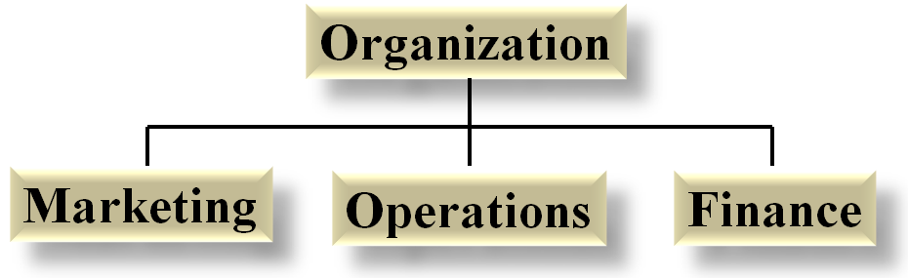
Basic Functions of the Business Organization

Slide 18
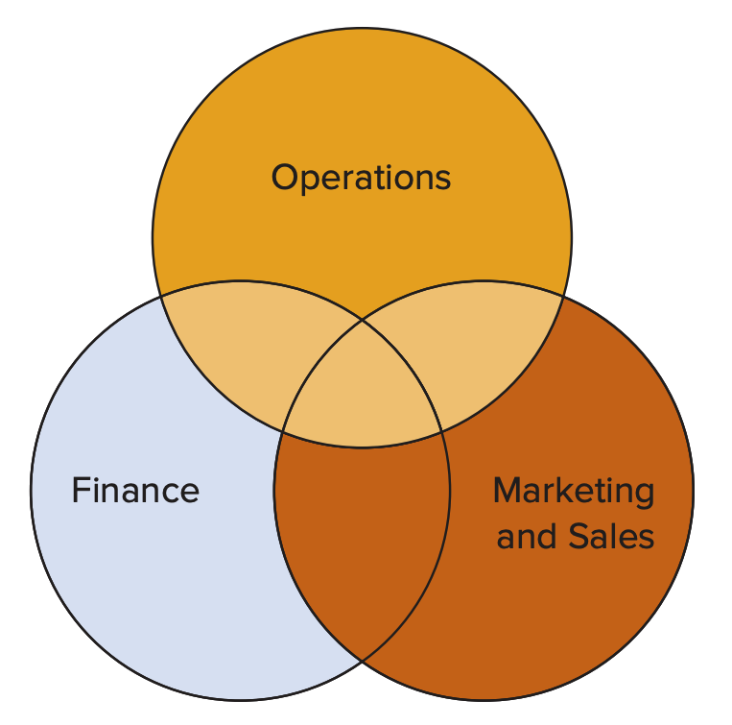
Function Overlap
Finance & operations
Budgeting
Economic analysis of investment proposals
Provision of funds
Marketing & operations
Demand data
Product and service design
Competitor analysis
Lead time data

Slide 19
Process Management
Process - one or more actions that transform inputs into outputs
Three Categories of Business Processes:
Upper-management processes | These govern the operation of the entire organization.
Operational processes | These are core processes that make up the value stream.
Supporting processes | These support the core processes.

Slide 20
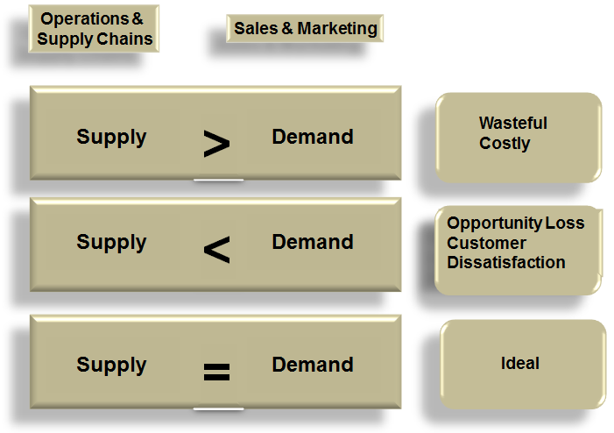
Supply & Demand

Slide 21
Process Variation
Four Sources of Variation:
Variety of goods or services being offered | The greater the variety of goods and services offered, the greater the variation in production or service requirements.
Structural variation in demand | These are generally predictable. They are important for capacity planning.
Random variation | Natural variation that is present in all processes. Generally, it cannot be influenced by managers.
Assignable variation | Variation that has identifiable sources. This type of variation can be reduced, or eliminated, by analysis and corrective action.
LO 1.5
Variations can be disruptive to operations and supply chain processes. They may result in additional costs, delays and shortages, poor quality, and inefficient work systems.

Slide 22
Resilient Supply Chain
Minimizing variations caused by environmental factors
Name some of the antecedent factors leading to variations in recent years

Slide 23
Scope of POM
The operations function includes many interrelated activities such as:
Forecasting
Capacity planning
Locating facilities
Facilities and layout
Scheduling
Managing inventories
Assuring quality
Motivating employees
And more . . .
The content of POM relates to these issues

Slide 24
System Design Decisions
System design
Capacity
Facility location
Facility layout
Product and service planning
Acquisition and placement of equipment
These are typically strategic decisions that
usually require long-term commitment of resources
determine parameters of system operation

Slide 25
System Operation Decisions
System operation
These are generally tactical and operational decisions
Management of personnel
Inventory management and control
Scheduling
Project management
Quality assurance
Operations managers spend more time on system operation decision than any other decision area
They still have a vital stake in system design

Slide 26
OM Decision Making
Most operations decisions involve many alternatives that can have quite different impacts on costs or profits
Typical operations decisions include:
What: What resources are needed, and in what amounts?
When: When will each resource be needed? When should the work be scheduled? When should materials and other supplies be ordered?
Where: Where will the work be done?
How: How will the product or service be designed? How will the work be done? How will resources be allocated?
Who: Who will do the work?

Slide 27
General Approach to Decision Making
Modeling is a key tool used by all decision makers
Model - an abstraction of reality; a simplification of something
Common features of models:
They are simplifications of real-life phenomena
They omit unimportant details of the real-life systems they mimic so that attention can be focused on the most important aspects of the real-life system
Physical Model – miniature airplane
Schematic Model – drawing of a city
Mathematical Model – Inventory optimization

Slide 28
Systems Perspective
System - a set of interrelated parts that must work together
The business organization is a system composed of subsystems
Marketing subsystem
Operations subsystem
Finance subsystem
The systems perspective
Emphasizes interrelationships among subsystems
Main theme is that the whole is greater than the sum of its parts
The output and objectives of the organization take precedence over those of any one subsystem

Slide 29
Historical Evolution of OM
Industrial Revolution
Scientific management
Human relations movement
Decision models and management science
Influence of Japanese manufacturers
Supply Chain interruptions in the 2020s

Slide 30
Industrial Revolution
Pre-Industrial Revolution
Craft production - System in which highly skilled workers use simple, flexible tools to produce small quantities of customized goods
Some key elements of the industrial revolution
Began in England in the 1770s
Division of labor - Adam Smith, 1776
Application of the “rotative” steam engine, 1780s
Cotton gin and interchangeable parts - Eli Whitney, 1792
Management theory and practice did not advance appreciably during this period

Slide 31
Scientific Management
Movement was led by efficiency engineer, Frederick Winslow Taylor
Believed in a “science of management” based on observation, measurement, analysis and improvement of work methods, and economic incentives
Management is responsible for planning, carefully selecting and training workers, finding the best way to perform each job, achieving cooperation between management and workers, and separating management activities from work activities
Emphasis was on maximizing output

Slide 32
Human Relations Movement
The human relations movement emphasized the importance of the human element in job design
Lillian Gilbreth – applications of psychology
Elton Mayo – Hawthorne studies on worker motivation, 1930
Abraham Maslow – motivation theory, 1940s; hierarchy of needs, 1954
Frederick Hertzberg – Two Factor Theory, 1959
Douglas McGregor – Theory X and Theory Y, 1960s
William Ouchi – Theory Z, 1981

Slide 33
Decision Models & Management Science
F.W. Harris – mathematical model for inventory management, 1915
Dodge, Romig, and Shewart – statistical procedures for sampling and quality control, 1930s
Tippett – statistical sampling theory, 1935
Operations Research (OR) Groups – OR applications in warfare (WWII)
George Dantzig – linear programming, 1947

Slide 34
Influence of Japanese Manufacturers
Refined and developed management practices that increased productivity
Credited with fueling the “quality revolution”
Just-in-Time production

Slide 35
Historical summary of POM
Approximate Date | Contribution/Concept | Originator
1776 | Division of labor | Adam Smith
1790 | Interchangeable parts | Eli Whitney
1911 | Principles of scientific management | Frederick W. Taylor
1911 | Motion study, use of industrial psychology | Frank and Lillian Gilbreth
1912 | Chart for scheduling activities | Henry Gantt
1913 | Moving assembly line | Henry Ford
1915 | Mathematical model for inventory ordering | F.W. Harris
1930 | Hawthorne studies on worker motivation | Elton Mayo
1935 | Statistical procedures for sampling and quality control | H.F. Dodge, H. G. Romig, W. Shewhart, L.H.C. Tippett
1940 | Operations research applications in warfare | Operations research groups
1947 | Linear programming | George Dantzig
1951 | Commercial digital computers | Sperry Univac, IBM
1950s | Automation | Numerous
1960s | Extensive development of quantitative tools | Numerous
1960s | Industrial dynamics | Jay Forrester
1975 | Emphasis on manufacturing strategy | W. Skinner
1980s | Emphasis on flexibility, time-based competition, lean production | T. Ohno, S. Shingo, Toyota
1980s | Emphasis on quality | W. Edwards Deming, J. Juran, K. Ishikawa
1990s | Internet, supply chain management | Numerous
2000s | Applications service providers and outsourcing Social media, YouTube, and others | Numerous Numerous

Slide 36
Operations Today
Technology Management
Global competition
Working with fewer resources
Revenue management
Agility

Slide 37
Key Issues for POM Today
Economic conditions
Innovating
Quality problems
Risk management
Cyber-security
Competing in a global economy
Resilient Supply Chain

Slide 38
Environmental Concerns
Sustainability
Using resources in ways that do not harm ecological systems that support human existence
Sustainability measures often go beyond traditional environmental and economic measures to include measures that incorporate social criteria in decision making
All areas of business will be affected
Product and service design
Consumer education programs
Disaster preparation and response
Supply chain waste management
Outsourcing decisions

Slide 39
Ethical Issues in Operations
Ethical issues that may arise in many aspects of operations management:
Financial statements
Worker safety
Product safety
Quality
The environment
The community
Hiring and firing workers
Closing facilities
Workers’ rights

Slide 40
The Need for Supply Chain Management
In the past, organizations did little to manage the supply chain beyond their own operations and immediate suppliers which led to numerous problems
Oscillating inventory levels
Inventory stockouts
Late deliveries
Quality problems

Slide 41
Supply Chain Issues
The need to improve operations
Increasing levels of outsourcing
Increasing transportation costs
Competitive pressures
Increasing globalization
Increasing importance of e-business
The complexity of supply chains
The need to manage inventories
Supply Chain interruptions

