Slide 1
POM:
Competitiveness, Strategy, and Productivity
2
  CYCU
  Prof. CK Farn
mailto: ckfarn@gmail.com
http://www.mgt.ncu.edu.tw/~ckfarn/cycu
  2024.09

Slide 2
Cold Hard Fact:
After Decades of Development
Better quality, higher productivity, lower costs, and the ability to respond quickly to customer needs are more important than ever, and…
  the bar is getting higher

Slide 3
The fundamental considerations
There are three separate but related ideas that are vitally important to business organizations
  Competitiveness
  Strategy
  Productivity

Slide 4
Competitiveness
How effectively an organization meets the wants and needs of customers relative to others that offer similar goods or services
Organizations compete through some combination of their marketing and operations functions
  What do customers want?
  How can these customer needs best be satisfied?

Slide 5
Marketing’s Influence
Identifying consumer wants and/or needs
Pricing and quality
Advertising and promotion

Slide 6
Businesses Compete Using Operations
Product and service design
Cost
Location
Quality
Quick response
Flexibility
Inventory management
Supply chain management
Service
Managers and workers
These are the core of POM

Slide 7
Why Some Organizations Fail
Neglecting operations strategy
Failing to take advantage of strengths and opportunities and/or failing to recognize competitive threats
Too much emphasis on short-term financial performance at the expense of R&D
Too much emphasis on product and service design and not enough on process design and improvement
Neglecting investments in capital and human resources
Failing to establish good internal communications and cooperation
Failing to consider customer wants and needs

Slide 8
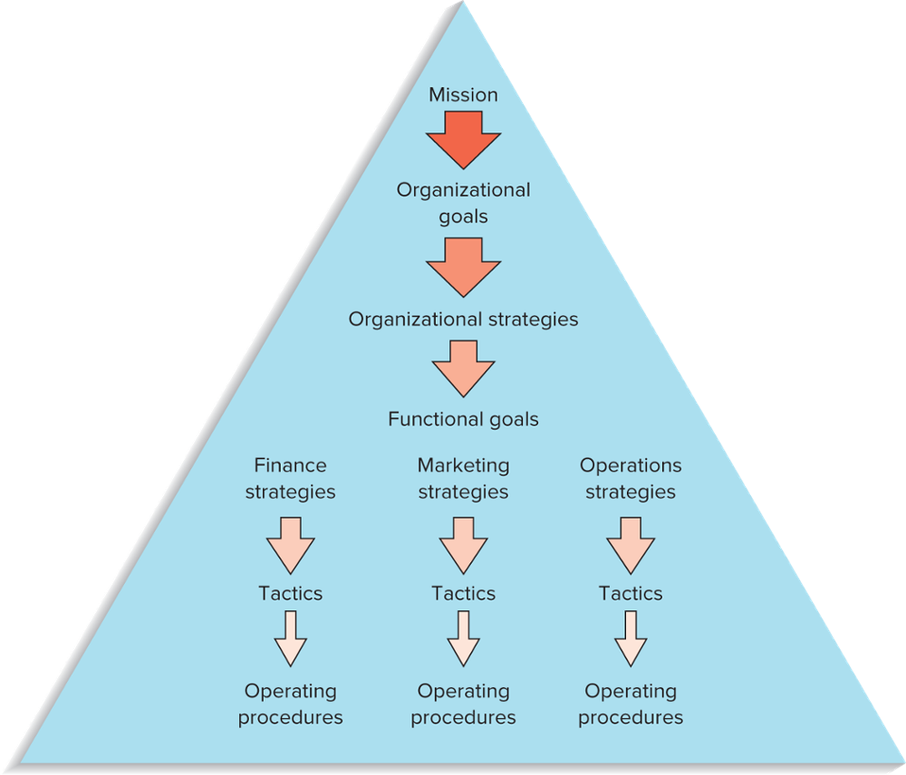
Hierarchical Planning
Mission
Goals
Organizational strategies
Functional strategies
Tactics
FIGURE 2.1
Planning and decision making are hierarchical in organizations

Slide 9
Mission
Mission
  The reason for an organization’s existence
Mission statement
  States the purpose of the organization
  The mission statement should answer the question of “What business are we in?”

Slide 10
Mission Statement
TABLE 2.1 Selected portions of company mission statements
Microsoft | To help people and businesses throughout the world to realize their full potential.
Verizon | To help people and businesses communicate with each other.
Starbucks | To inspire and nurture the human spirit—one cup and one neighborhood at a time.
U.S. Dept. of Education | To promote student achievement and preparation for global competitiveness and fostering educational excellence and ensuring equal access.

Slide 11
Goals
The mission statement serves as the basis for organizational goals
Goals
  Provide detail and the scope of the mission
    Goals can be viewed as organizational destinations
  Goals serve as the basis for organizational strategies

Slide 12
Strategies
A plan for achieving organizational goals
  Serves as a roadmap for reaching the organizational destinations
Organizations have
  Organizational strategies
      Overall strategies that relate to the entire organization
      Support the achievement of organizational goals and mission
  Functional level strategies
      Strategies that relate to each of the functional areas and that support achievement of the organizational strategy

Slide 13
Tactics and Operations
Tactics
  The methods and actions taken to accomplish strategies
  The “how to” part of the process
Operations
  The actual “doing” part of the process

Slide 14
Core Competencies
The special attributes or abilities that give an organization a competitive edge
To be effective, core competencies and strategies need to be aligned

Slide 15
Sample Operations Strategies
Organizational Strategy | Operations Strategy | Examples of Companies or Services
Low Price | Low cost | U.S. first-class postage Wal-Mart
Responsiveness | Short processing times On-time delivery | McDonald’s restaurants FedEx
Differentiation: High Quality | High performance design and/or high quality processing Consistent quality | Sony TV Coca-Cola
Differentiation: Newness | Innovation | 3M, Apple
Differentiation: Variety | Flexibility Volume | Burger King (“Have it your way”) McDonald’s (“Buses Welcome”)
Differentiation: Service | Superior customer service | Disneyland IBM
Differentiation: Location | Convenience | Supermarkets; mall stores

Slide 16
Strategy Formulation
Effective strategy formulation requires taking into account:
  Core competencies
  Environmental scanning
    SWOT: Strengths, Weaknesses, Opportunities, and Threats
Successful strategy formulation also requires taking into account:
  Order qualifiers
  Order winners

Slide 17

Environmental Scanning
Environmental scanning is necessary to identify
  Internal factors
    Strengths and weaknesses
  External factors
    Opportunities and threats
Like a Radar

Slide 18
Key External Factors
Political conditions
Economic conditions
Social environment
Technology conditions
Legal environment
Competition
Customers
Suppliers
Markets
PEST Analysis

Slide 19
SWOT: Strengths, Weaknesses, Opportunities, and Threats
 |  | Strength | Weakness
 | Internal External | … … | … …
Oppor-tunity | … … | ST Attack | WO reinforce
Threat | … … | ST Defend | WT Dodge

Slide 20
The Balanced Scorecard Approach
A top-down management system that organizations can use to clarify their vision and strategy and transform them into action
  Develop objectives
  Develop metrics and targets for each objective
  Develop initiatives to achieve objectives
Identify links among the various perspectives
  Finance
  Customer
  Internal business processes
  Learning and growth
  Monitor results
BSC

Slide 21
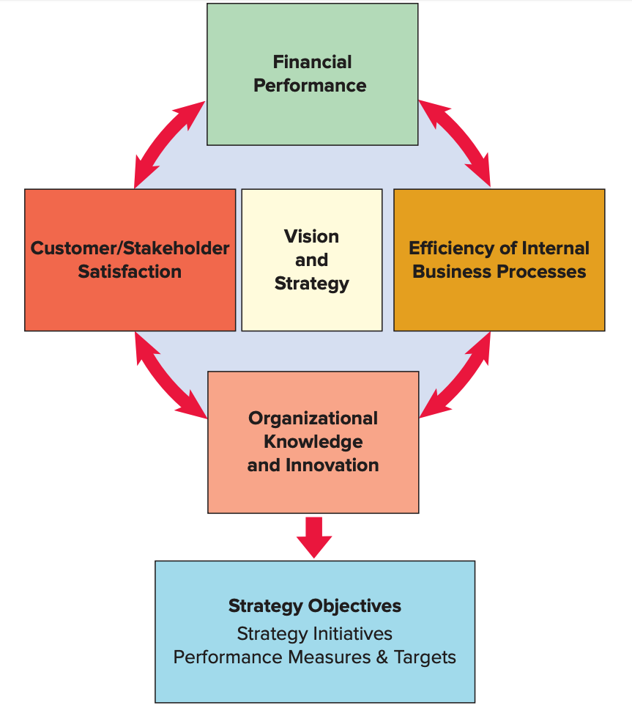
The Balanced Scorecard
FIGURE 2.2
The Balanced Scorecard
Source: Adapted from Robert S. Kaplan and David P. Norton, “Using the Balanced Scorecard as a Strategic Management System,” Harvard Business Review (January-February 1996): 76.

Slide 22
Productivity
Productivity
  A measure of the effective use of resources, usually expressed as the ratio of output to input
Productivity measures are useful for
  Tracking an operating unit’s performance over time
  Judging the performance of an entire industry or country

Slide 23
Why Productivity Matters
High productivity → higher standards of living
  As an economy replaces manufacturing jobs with lower productivity service jobs, it is more difficult to maintain high standards of living
Higher productivity relative to the competition → competitive advantage in the marketplace
  Pricing and profit effects
For an industry, high relative productivity → less likely to be supplanted by foreign industry

Slide 24
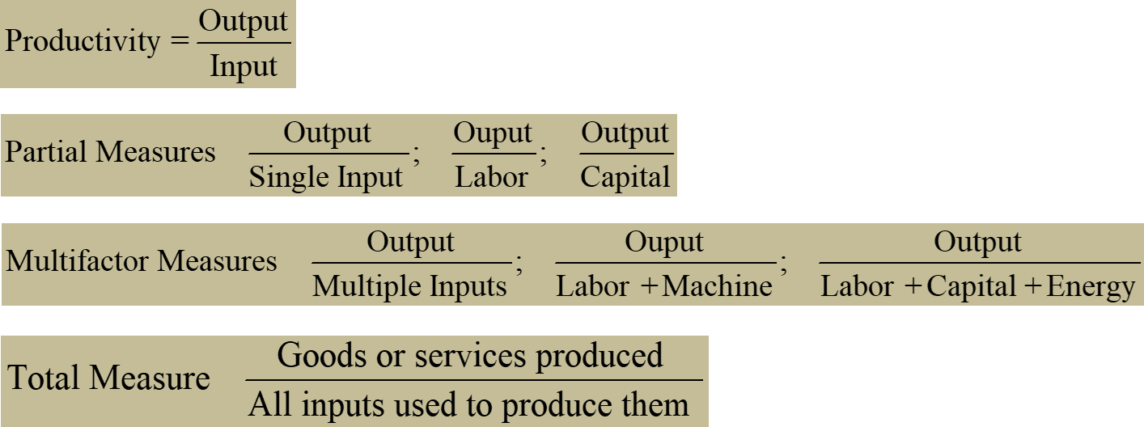
Productivity Measures

Slide 25
Table 2.8
Examples of partial productivity measures
Labor productivity | Units of output per labor hour Units of output per shift Value-added per labor hour Dollar value of output per labor hour
Machine productivity | Units of output per machine hour Dollar value of output per machine hour
Capital productivity | Units of output per dollar input Dollar value of output per dollar input
Enter productivity | Units of output per kilowatt-hour Dollar value of output per kilowatt-hour

Slide 26
Productivity Calculation Example
Units produced: 5,000
Standard price: $30/unit
Labor input: 500 hours
Cost of labor: $25/hour
Cost of materials: $5,000
Cost of overhead: 2 × labor cost
What is the multifactor productivity?

Slide 27
Solution
What is the implication of an unitless measure of productivity?

Slide 28
Solution
What is the implication of an unitless measure of productivity?

Slide 29
Productivity Growth
Example: Labor productivity on the ABC assembly line was 25 units per hour in 2014. In 2015, labor productivity was 23 units per hour. What was the productivity growth from 2014 to 2015?
同比：this period vs. SPLY (Same Period Last Year)
環比：this period vs. LP (Last Period): Month over month MoM, YoY

Slide 30
Service Sector Productivity
Service sector productivity is difficult to measure and manage because
  It involves intellectual activities
  It has a high degree of variability
A useful measure related to productivity is process yield
  Where products are involved
    Ratio of output of good product to the quantity of raw material input
  Where services are involved, process yield measurement is often dependent on the particular process:
    Ratio of cars rented to cars available for a given day
    Ratio of student acceptances to the total number of students approved for admission

Slide 31
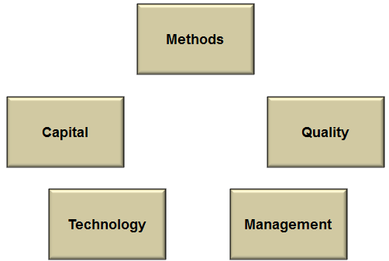
Factors Affecting Productivity

Slide 32
Recent Technological factors affecting productivity
Drones
GPS devices
Smartphones
3D printers
Radio frequency ID tags (RFID)
Medical imaging
Artificial intelligence

Slide 33
Improving Productivity
Develop productivity measures for all operations
Determine critical (bottleneck) operations
Develop methods for productivity improvements
Establish reasonable goals
Make it clear that management supports and encourages productivity improvement
Measure and publicize improvements
Don’t confuse productivity with efficiency

Slide 34
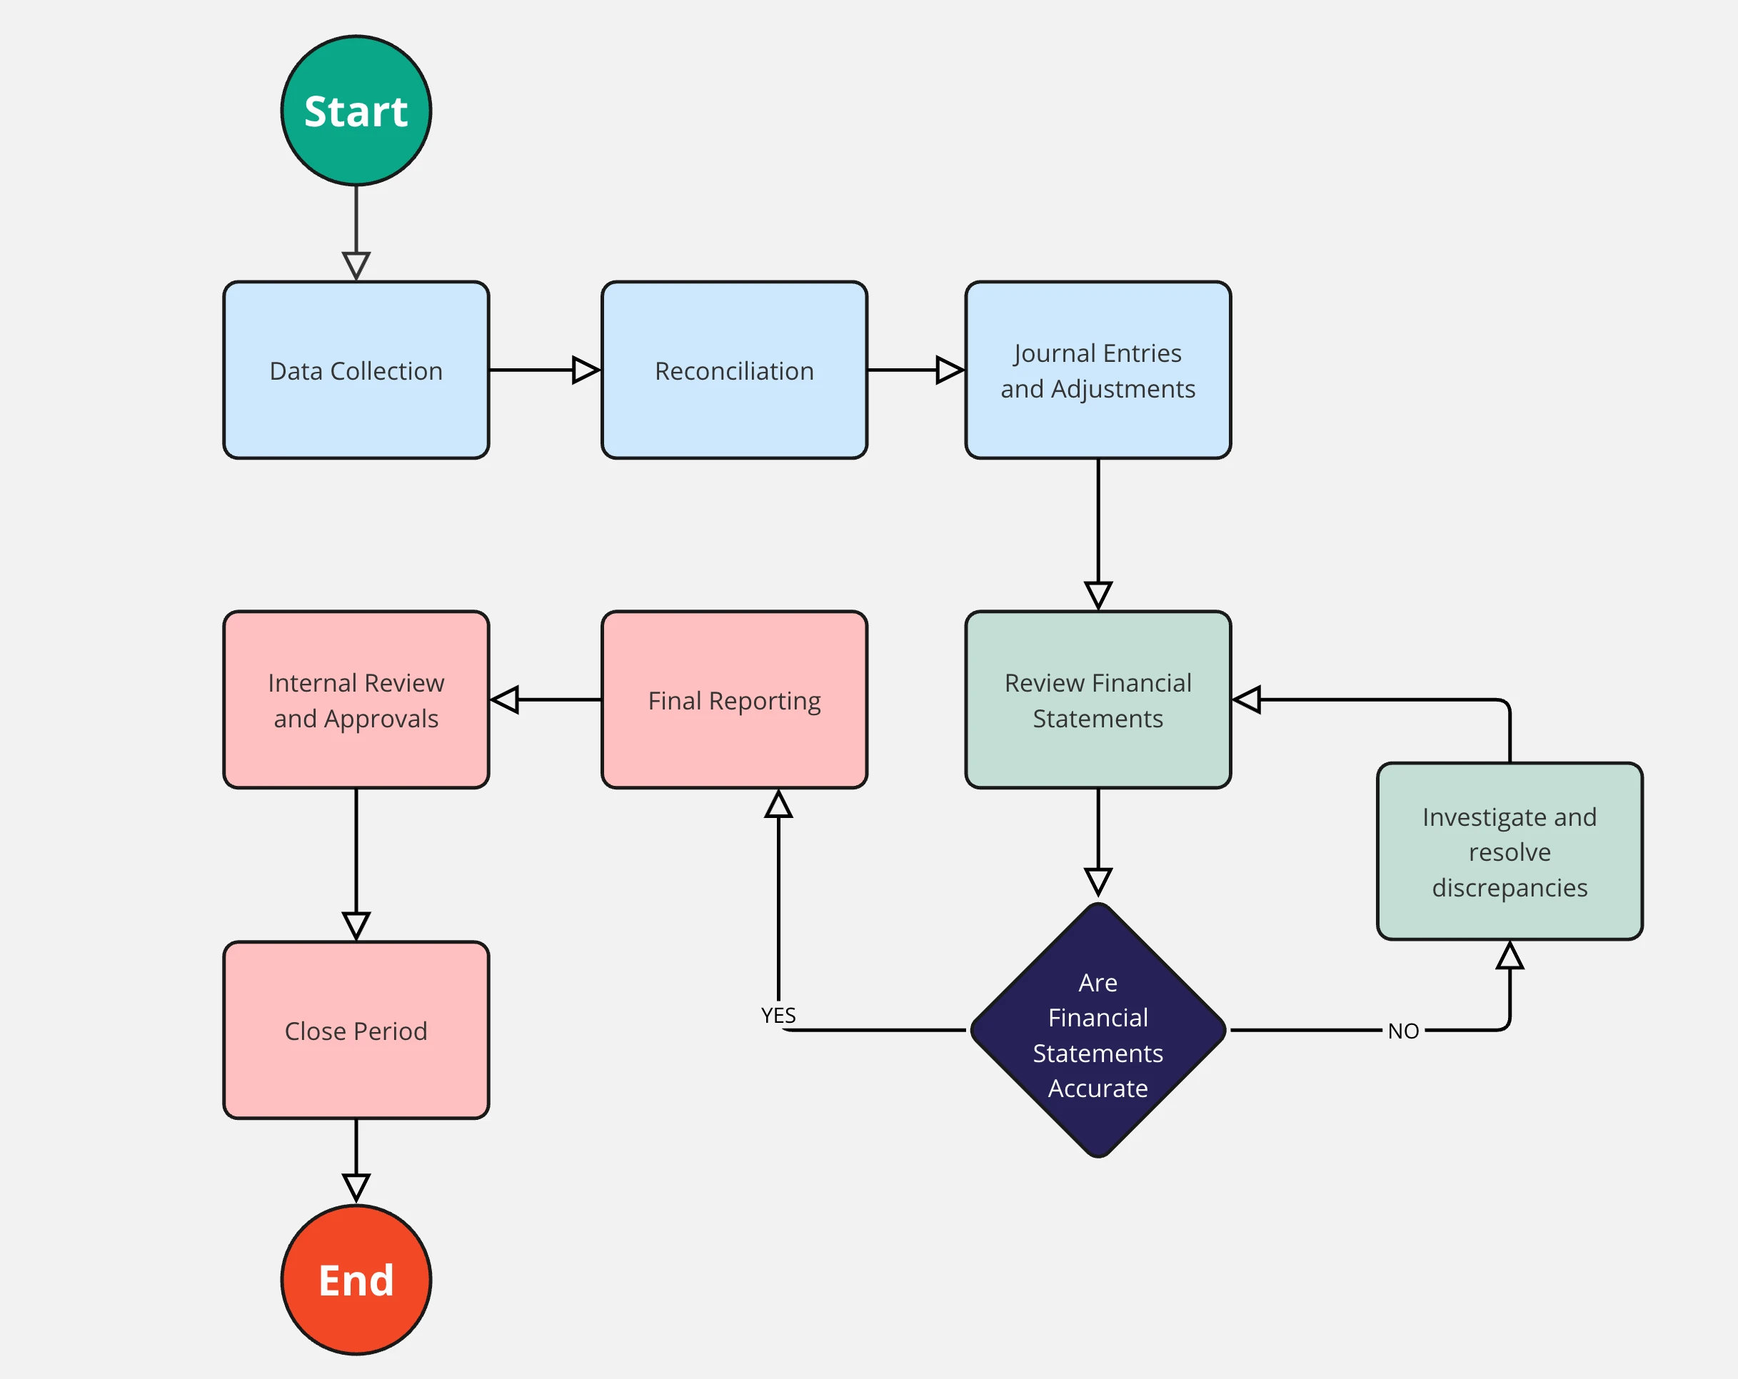
Assignment #1 (team)
Conduct a simple observation
  Prepare a presentation with PowerPoint, no more than 6 pages
  Making use of block diagrams to discribe processes
  Groups of 4
  Due Before Oct 11, 10 minutes presentation in class
Comparing processes of food services
  Choose a traditional local Taiwanese food eatery that you frequent, describe its service process, i.e.: order, payment, food preparations, etc.
  Choose an international fast food chain store that you are familiar with. Describe its service process.
  Compare the two, including pros and cons, from the customer perspective, as well as the vendors’ perspective.
File name: POM_HW1_GroupID_Names.pdf
Upload your pdf file before 23:59 Oct. 2 to: https://next.ezview.asia/s/5e6j6G6BWZijYrM

