Slide 1
POM: Forecasting
3
CYCU
Prof. CK Farn
mailto: ckfarn@gmail.com
http://www.mgt.ncu.edu.tw/~ckfarn/cycu
2024.10

Slide 2
Assignment #2: Individual
Read the Lilacs case on p.106 of the text book, and try to answer the 3 questions.
Answer Problem 1 and 2 on p.120/121 of the text book, using Excel spreadsheet.
File name: POM_HW2_SID_Name.pdf
Upload your pdf file before 23:59 Oct. 23 to: https://next.ezview.asia/s/ioNB7Wc3jdzHT2X

Slide 3
Forecast
Forecast – a statement about the future value of a variable of interest
We make forecasts about such things as weather, demand, and resource availability
Forecasts are important to making informed decisions
Decisions:
How many to buy
How many to make…

Slide 4
Two Important Aspects of Forecasts
Expected level of demand
The level of demand may be a function of some structural variation such as trend or seasonal variation
Accuracy
Related to the potential size of forecast error

Slide 5
Forecasts in Business Organizations
Accounting. New product/process cost estimates, profit projections, cash management.
Finance. Equipment/equipment replacement needs, timing and amount of funding/borrowing needs.
Human resources. Hiring activities, including recruitment, interviewing, and training; layoff planning, including outplacement counseling.
Marketing. Pricing and promotion, e-business strategies, global competition strategies.
MIS. New/revised information systems, internet services.
Operations. Schedules, capacity planning, work assignments and workloads, inventory planning, make-or-buy decisions, outsourcing, project management.
Product/service design. Revision of current features, design of new products or services.

Slide 6
Forecast Uses
Plan the system. Generally involves long-range plans related to:
Types of products and services to offer
Facility and equipment levels
Facility location
Plan the use of the system. Generally involves short- and medium-range plans related to:
Inventory management
Workforce levels
Purchasing
Production
Budgeting
Scheduling

Slide 7
Features Common to All Forecasts
Techniques assume some underlying causal system that existed in the past will persist into the future
Forecasts are not perfect
Forecasts for groups of items are more accurate than those for individual items
Forecast accuracy decreases as the forecasting horizon increases

Slide 8
Forecasts Are Not Perfect
Forecasts are not perfect:
Because random variation is always present, there will always be some residual error, even if all other factors have been accounted for.

Slide 9
Elements of a Good Forecast
The forecast
Should be timely
Should be accurate
Should be reliable
Should be expressed in meaningful units
Should be in writing
Technique should be simple to understand and use
Should be cost-effective

Slide 10
Steps in the Forecasting Process
Determine the purpose of the forecast
Establish a time horizon
Obtain, clean, and analyze appropriate data
Select a forecasting technique
Make the forecast
Monitor the forecast errors

Slide 11
Forecasting Approaches
Qualitative forecasting
Qualitative techniques permit the inclusion of soft information such as:
Human factors
Personal opinions
Hunches
These factors are difficult, or impossible, to quantify
Quantitative forecasting
These techniques rely on hard data
Quantitative techniques involve either the projection of historical data or the development of associative methods that attempt to use causal variables to make a forecast

Slide 12
Qualitative Forecasts
Forecasts that use subjective inputs such as opinions from consumer surveys, sales staff, managers, executives, and experts
Executive opinions
A small group of upper-level managers collectively develop a forecast
Salesforce opinions
Members of the sales or customer service staff have direct contact with customers and may be aware of customers plans in the future
Consumer surveys
Since consumers ultimately determine demand, solicit input from them
Consumer surveys typically represent a sample of consumer opinions
Other approaches
Managers may solicit opinions from other managers or staff people or outside experts to help with developing a forecast
The Delphi method is an iterative process intended to achieve a consensus

Slide 13
Time-Series Forecasts
Forecasts that project patterns identified in recent time-series observations
Time-series – a time-ordered sequence of observations taken at regular time intervals
Assume that future values of the time-series can be estimated from past values of the time-series

Slide 14
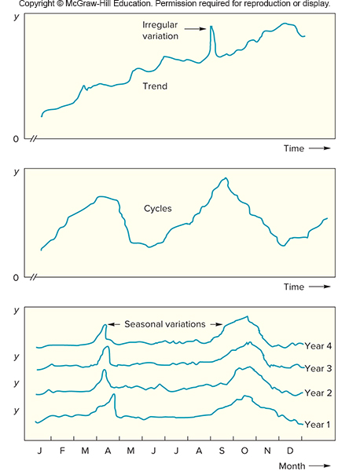
Time-Series Behaviors
Trend
Seasonality
Cycles
Irregular variations
Random variation

Slide 15
Trends and Seasonality
Trend
A long-term upward or downward movement in data
Population shifts
Changing income
Seasonality
Short-term, fairly regular variations related to the calendar or time of day
Restaurants, service call centers, and theaters all experience seasonal demand

Slide 16
Cycles and Variations
Cycle
Wavelike variations lasting more than one year
These are often related to a variety of economic, political, or even agricultural conditions
Irregular variation
Due to unusual circumstances that do not reflect typical behavior
Labor strike
Weather event
Random Variation
Residual variation that remains after all other behaviors have been accounted for

Slide 17
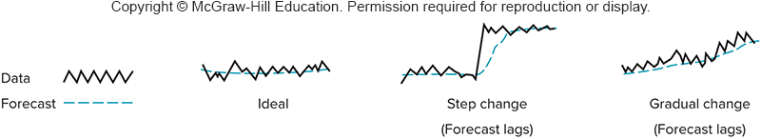
Forecast: Scenario and Lag

Slide 18
Time-Series Forecasting - Naïve Forecast
Naïve forecast
Uses a single previous value of a time series as the basis for a forecast
The forecast for a time period is equal to the previous time period’s value
Can be used with
A stable time series
Seasonal variations
Trend

Slide 19
Time-Series Forecasting - Averaging
These techniques work best when a series tends to vary about an average
Averaging techniques smooth variations in the data
They can handle step changes or gradual changes in the level of a series
Techniques
Moving average
Weighted moving average
Exponential smoothing

Slide 20
Moving Average 1
Technique that averages a number of the most recent actual values in generating a forecast
where

Slide 21
Moving Average
Period | Actual Sales | Moving Avg: n=3
1 | 100
2 | 130
3 | 130
4
120

Slide 22
Moving Average: Rolling
As new data become available, the forecast is updated by adding the newest value and dropping the oldest and then recomputing the average
The number of data points included in the average determines the model’s sensitivity
Fewer data points used—more responsive
More data points used—less responsive

Slide 23
Moving Average
Period | Actual Sales | Moving Avg: n=3
1 | 100
2 | 130
3 | 130
4
140
120.0
5
130
133.3
6
160
133.3
7
143.3

Slide 24
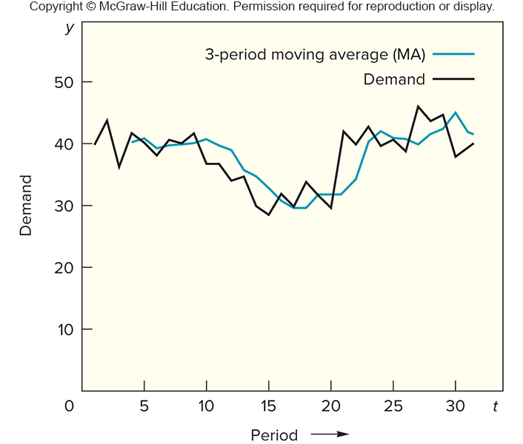
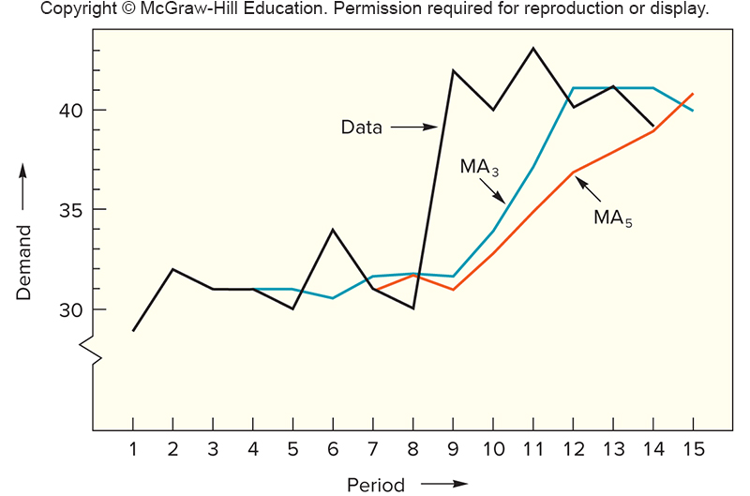
Moving average: Lagging
The more period, the greater
the forecast will lag

Slide 25
Weighted Moving Average
The most recent values in a time series are given more weight in computing a forecast
The choice of weights, w, is somewhat arbitrary and involves some trial and error
where
See pg.86

Slide 26
Exponential Smoothing
A weighted averaging method that is based on the previous forecast plus a percentage of the forecast error
where
See pg.88

Slide 27
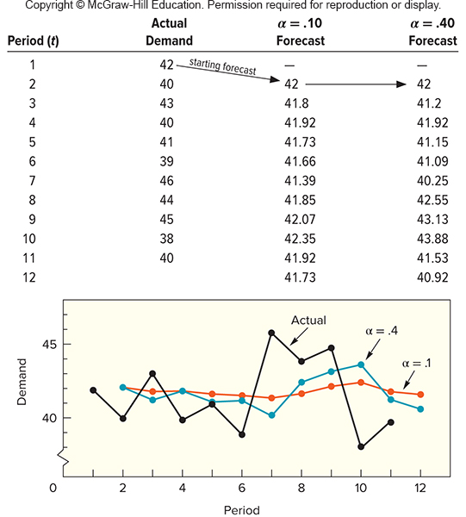
Exponential Smoothing

Slide 28
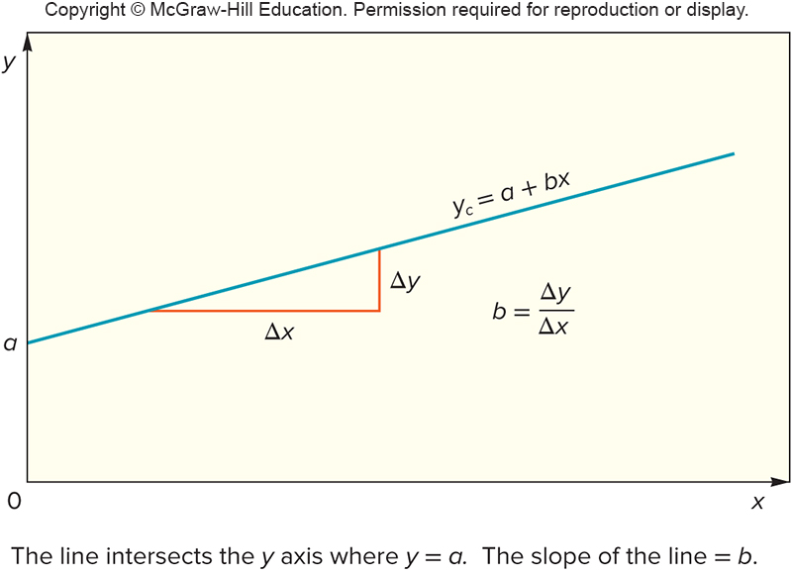
Linear Trend
A simple data plot can reveal the existence and nature of a trend
Linear trend equation
where

Slide 29
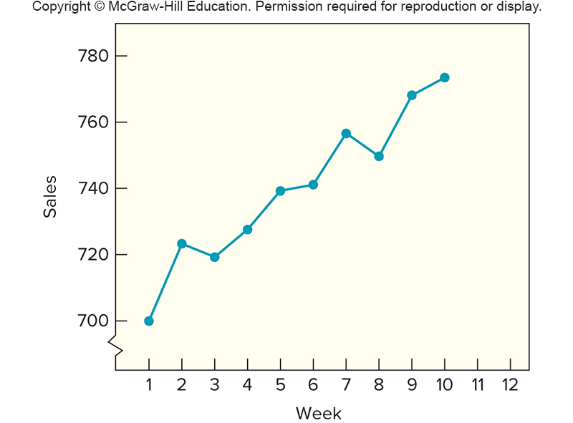
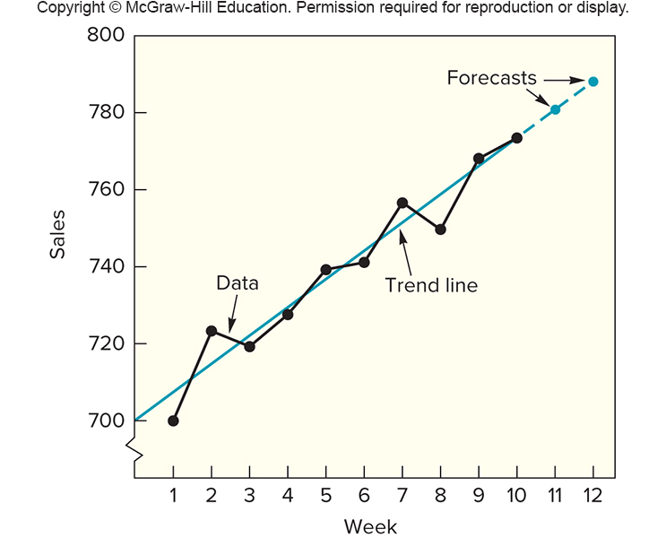
Trend
Calculating the trend line
Plotting the points

Slide 30
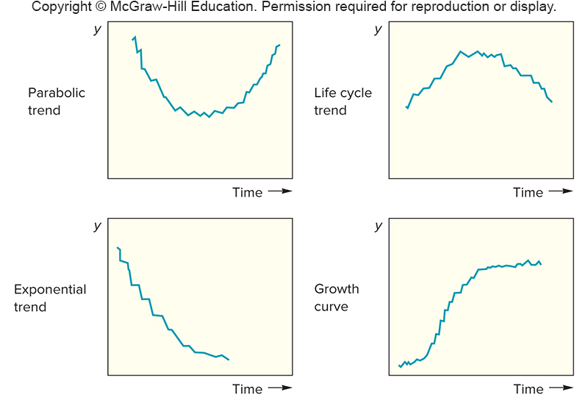
Non linear trends

Slide 31
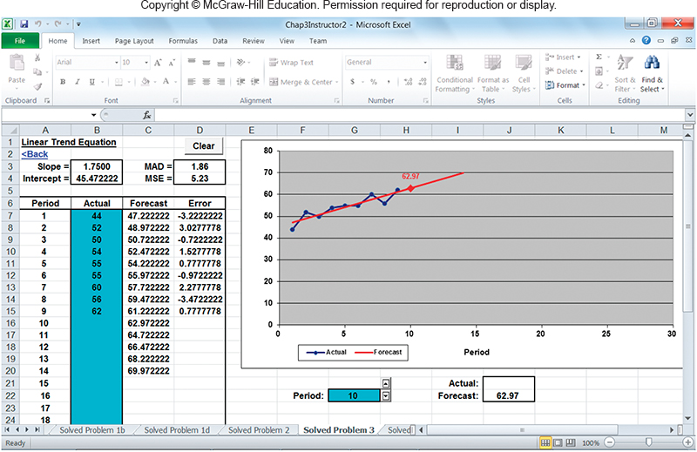
Example 3, p.92

Slide 32
Trend-Adjusted Exponential Smoothing 1
The trend adjusted forecast consists of two components
Smoothed error
Trend factor
where

Slide 33
Trend-Adjusted Exponential Smoothing 2
Alpha and beta are smoothing constants
Trend-adjusted exponential smoothing has the ability to respond to changes in trend

Slide 34
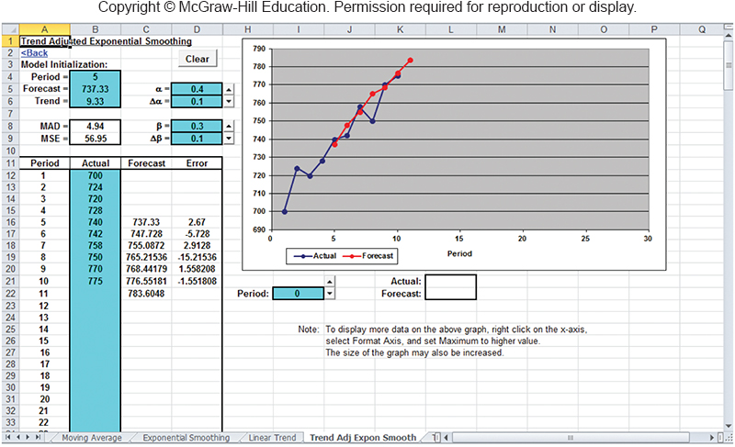
Table 3.2, pg.93

Slide 35
Techniques for Seasonality
Seasonality – regularly repeating movements in series values that can be tied to recurring events
Expressed in terms of the amount that actual values deviate from the average value of a series
Models of seasonality
Additive
Seasonality is expressed as a quantity that gets added to or subtracted from the time-series average in order to incorporate seasonality
Multiplicative
Seasonality is expressed as a percentage of the average (or trend) amount which is then used to multiply the value of a series in order to incorporate seasonality

Slide 36
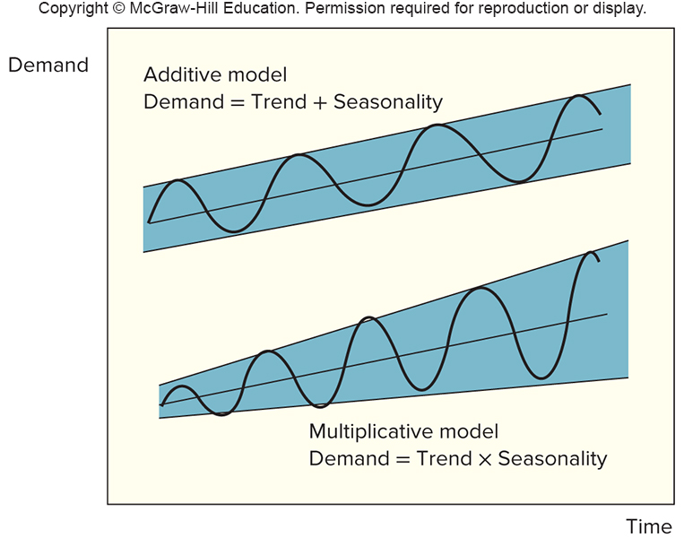
Seasoning models

Slide 37
Seasonal Relatives
Seasonal relatives
The seasonal percentage used in the multiplicative seasonally adjusted forecasting model
Using seasonal relatives
To deseasonalize data
Done in order to get a clearer picture of the nonseasonal (for example, trend) components of the data series
Divide each data point by its seasonal relative
To incorporate seasonality in a forecast
Obtain trend estimates for desired periods using a trend equation
Add seasonality by multiplying these trend estimates by the corresponding seasonal relative

Slide 38
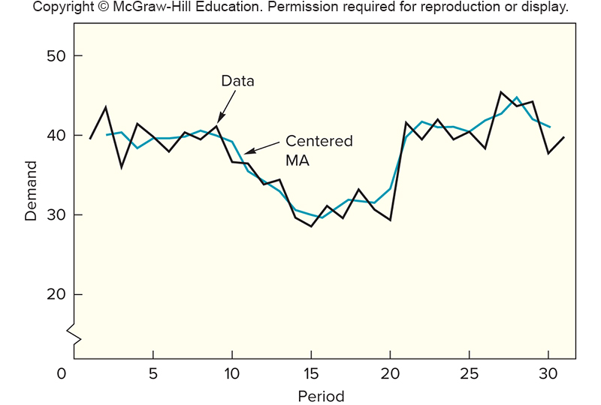
Centered Moving Average

Slide 39
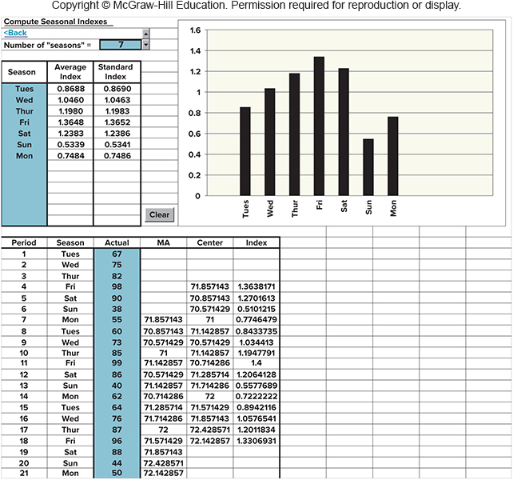
Computing Seasonal Relatives

Slide 40
Associative Forecasting Techniques
Associative techniques are based on the development of an equation that summarizes the effects of predictor variables
Predictor variables – variables that can be used to predict values of the variable of interest
Home values may be related to such factors as home and property size, location, number of bedrooms, and number of bathrooms
These are covered in details in the Statistics course, will skip here.

Slide 41
Simple Linear Regression
Regression – a technique for fitting a line to a set of data points
Simple linear regression – the simplest form of regression that involves a linear relationship between two variables
The object of simple linear regression is to obtain an equation of a straight line that minimizes the sum of squared vertical deviations from the line (that is, the least squares criterion)

Slide 42
Forecast Accuracy and Control
Allowances should be made for forecast errors
It is important to provide an indication of the extent to which the forecast might deviate from the value of the variable that actually occurs
Forecast errors should be monitored
Error = Actual − Forecast
If errors fall beyond acceptable bounds, corrective action may be necessary

Slide 43
Forecast Accuracy Metrics
MAD weights all errors evenly: Mean Absolute Deviation
MSE weights errors according to their squared values: Mean Squared Error
MAPE weights errors according to relative error: Mean Absolute Percentage Error
CYCU— Prof CK Farn
43

Slide 44
Forecast Accuracy Metrics
MAD weights all errors evenly: Mean Absolute Deviation
MSE weights errors according to their squared values: Mead Squared Error
MAPE weights errors according to relative error: Mead Absolute Percentage Error
CYCU— Prof CK Farn
44

Slide 45
Forecast Error Calculation
Period | Actual (A) | Forecast (F) | (A − F) Error | |Error| | Error² | [|Error|/Actual] × 100
1 | 107 | 110 | −3 | 3 | 9 | 2.80%
2 | 125 | 121 | 4 | 4 | 16 | 3.20%
3 | 115 | 112 | 3 | 3 | 9 | 2.61%
4 | 118 | 120 | −2 | 2 | 4 | 1.69%
5 | 108 | 109 | 1 | 1 | 1 | 0.93%
 |  |  | Sum | 13 | 39 | 11.23%
 |  |  |  | n = 5 | n − 1 = 4 | n = 5
 |  |  |  | MAD | MSE | MAPE
 |  |  |  | = 2.6 | = 9.75 | = 2.25%
CYCU— Prof CK Farn
45

Slide 46
Monitoring the Forecast
Tracking forecast errors and analyzing them can provide useful insight into whether forecasts are performing satisfactorily
Sources of forecast errors:
The model may be inadequate due to
omission of an important variable
a change or shift in the variable the model cannot handle
the appearance of a new variable
Irregular variations may have occurred
Random variation
Control charts are useful for identifying the presence of non-random error in forecasts
Tracking signals can be used to detect forecast bias

Slide 47
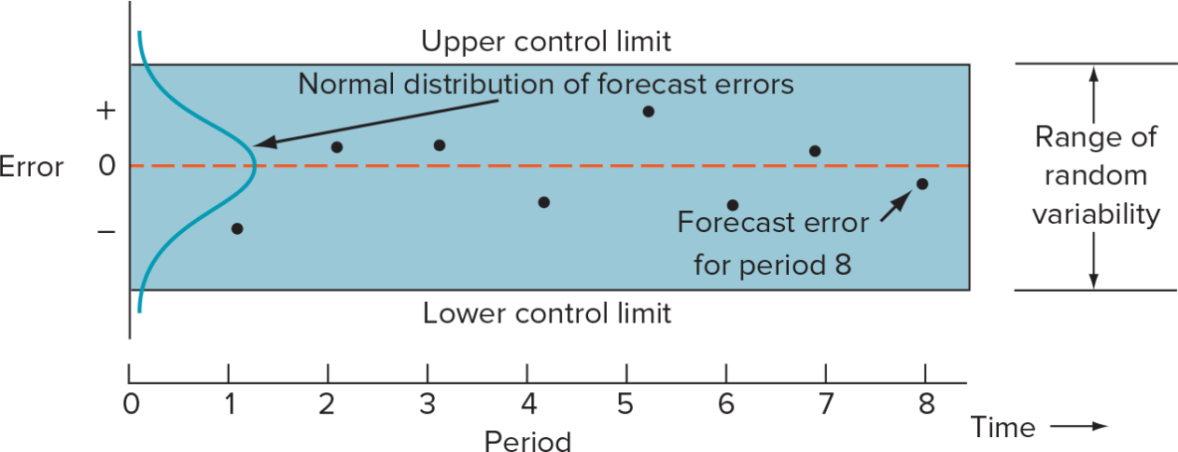
Control Chart Construction
1. Compute the MSE.
2. Estimate of standard deviation of the distribution of errors
where z = Number of standard deviations from the mean

Slide 48
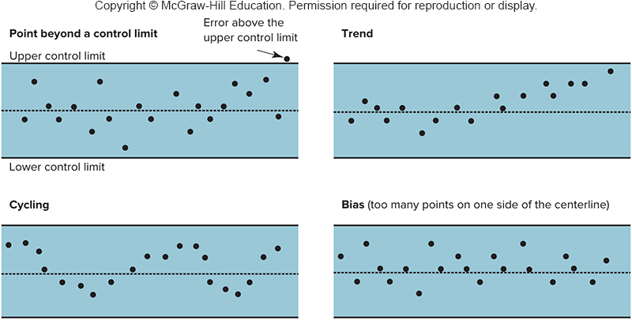
Patterns

Slide 49
Choosing a Forecasting Technique
Factors to consider
Cost
Accuracy
Availability of historical data
Availability of forecasting software
Time needed to gather and analyze data and prepare a forecast
Forecast horizon

Slide 50
Operations Strategy
The better forecasts are, the more able organizations will be to take advantage of future opportunities and reduce potential risks
A worthwhile strategy is to work to improve short-term forecasts
Accurate up-to-date information can have a significant effect on forecast accuracy:
Prices
Demand
Other important variables
Reduce the time horizon forecasts have to cover
Sharing forecasts or demand data through the supply chain can improve forecast quality

