Slide 1
POM:
Product and Service Design
4
  CYCU
  Prof. CK Farn
mailto: ckfarn@gmail.com
http://www.mgt.ncu.edu.tw/~ckfarn/cycu
  2024.10 updated

Slide 2
Strategic Product and Service Design
The essence of an organization is the goods and services it offers
  Every aspect of the organization is structured around them
Product and service design – or redesign – should be closely tied to an organization’s strategy

Slide 3
Activities and Responsibilities of Product & Service Design
Translate customer wants and needs into product and service requirements (sometime even invoke customer wants)
Refine existing products and services
Develop new products and services
Formulate quality goals
Formulate cost targets
Construct and test prototypes
Document specifications
Translate product and service specifications into process specifications
Involve inter-functional collaboration

Slide 4
Key Questions
Is there a demand for it?
  Market size
  Demand profile
Can we do it?
  Manufacturability - the capability of an organization to produce an item at an acceptable profit
  Serviceability - the capability of an organization to provide a service at an acceptable cost or profit
DfX: Design for X

Slide 5
Key Questions (cont.)
What level of quality is appropriate?
  Customer expectations
  Competitor quality
  Fit with current offering
Does it make sense from an economic standpoint?
  Liability issues, ethical considerations, sustainability issues, costs and profits

Slide 6
Reasons to Design or Re-Design
The driving forces for product and service design or redesign are market opportunities or threats:
  Economic
  Social and demographic
  Political, liability, or legal
  Competitive
  Cost or availability
  Technological

Slide 7
Idea Generation
Supply-chain based
Competitor based
Research based

Slide 8
Ideas: Supply-Chain Based
Ideas can come from anywhere in the supply chain:
  Customers
  Suppliers
  Distributors
  Employees
  Maintenance and repair personnel

Slide 9
Ideas: Competitor Based
By studying how a competitor operates and its products and services, many useful ideas can be generated
Reverse engineering
  Dismantling and inspecting a competitor’s product to discover product improvements

Slide 10
Ideas: Research Based
Research and development (R&D)
  Organized efforts to increase scientific knowledge or product innovation
  Basic research
    Has the objective of advancing the state of knowledge about a subject without any near-term expectation of commercial applications
  Applied research
    Has the objective of achieving commercial applications
  Development
    Converts the results of applied research into useful commercial applications

Slide 11
Legal Considerations
Legal considerations
  Product liability
    The responsibility a manufacturer has for any injuries or damages caused by a faulty product
    Some of the concomitant costs
      Litigation
      Legal and insurance costs
      Settlement costs
      Costly product recalls
      Reputation effects
  Uniform Commercial Code
    Under the UCC, products carry an implication of merchantability and fitness

Slide 12
Ethical Considerations
Designers are often under pressure to
  Speed up the design process
  Cut costs
These pressures force trade-off decisions
  What if a product has bugs?
    Release the product and risk damage to your reputation
    Work out the bugs and forego revenue

Slide 13
Other considerations
Human factors
  Ergonomics
  Safety and liability
Cultural factors
  Colors, preferred food, product labels
  e.g. Model name of cars (Alfa Romeo 164)
Global design
  Design teams can be in different countries

Slide 14
Sustainability
Sustainability
  Using resources in ways that do not harm ecological systems that support human existence
Key aspects of designing for sustainability
  Cradle-to-grave assessment (life cycle analysis)
  End-of-life programs
  The Three Rs

Slide 15
Cradle-to-Grave Assessment
Also known as life cycle analysis (LCA)
The assessment of the environmental impact of a product or service throughout its useful life
Focuses on such factors as
    Global warming
    Smog formation
    Oxygen depletion
    Solid waste generation
LCA procedures are part of the ISO 14000 environmental management procedures

Slide 16
The Three Rs
Designers often reflect on three particular aspects of potential cost savings and reducing environmental impact
Reduce
Reuse
Recycle

Slide 17
Reduce: Costs and Materials
Value analysis
  Examination of the function of parts and materials in an effort to reduce the cost and/or improve the performance of a product
  Common questions used in value analysis
    Is the item necessary; does it have value; could it be eliminated?
    Are there alternative sources for the item?
    Could another material, part, or service be used instead?
    Can two or more parts be combined?
    Can specifications be less stringent to save time or money?
    Do suppliers/providers have suggestions for improvements?
    Can packaging be improved or made less costly?

Slide 18
Reuse: Remanufacturing
Remanufacturing
  Refurbishing used products by replacing worn-out or defective components
    Can be performed by the original manufacturer or another company
  Reasons to remanufacture:
    Remanufactured products can be sold for about 50% of the cost of a new product
    The process requires mostly unskilled and semiskilled workers
    In the global market, European lawmakers are increasingly requiring manufacturers to take back used products
  Design for disassembly (DFD)
    Designing a product to that used products can be easily taken apart

Slide 19
Recycle
Recycling
  Recovering materials for future use
    Applies to manufactured parts
    Also applies to materials used during production
  Why recycle?
    Cost savings
    Environmental concerns
    Environmental regulations
  Companies doing business in the EU must show that a specified proportion of their products are recyclable
  Design for recycling (DFR)
    Product design that takes into account the ability to disassemble a used product to recover the recyclable parts

Slide 20
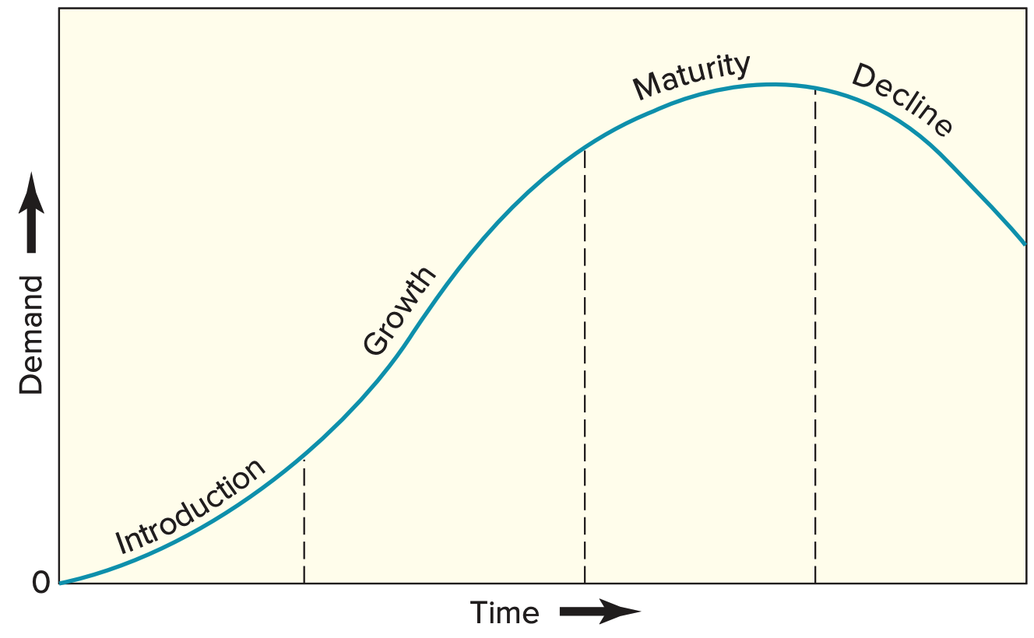
Product or Service Life Stages

Slide 21
Standardization
Extent to which there is an absence of variety in a product, service, or process
  Products are made in large quantities of identical items
  Every customer or item processed receives essentially the same service

Slide 22
Standardization – Advantages and Disadvantages
Advantages
  Fewer parts to deal with
  Reduced training costs and time
  More routine purchasing, handling, and inspection
  Orders fillable from inventory
  Opportunities for long production runs and automation
Disadvantages
  Designs may be frozen too early
  High cost of design changes
  Decreased product variety

Slide 23
Designing for Mass Customization
Mass customization
  A strategy of producing basically standardized goods or services, but incorporating some degree of customization in the final product or service
  Facilitating techniques
    Delayed differentiation
    Modular design

Slide 24
Delayed Differentiation
The process of producing a product or service but not quite completing production until customer preferences are known
It is a postponement tactic
  Produce a piece of furniture, but do not stain it; the customer chooses the stain
  Customization

Slide 25
Modular Design
A form of standardization in which component parts are grouped into modules that are easily replaced or interchanged
  Advantages
    Easier diagnosis and remedy of failures
    Easier repair and replacement
    Simplification of manufacturing and assembly
    Training costs are relatively low
  Disadvantages
    Limited number of possible product configurations
    Limited ability to repair a faulty module; if it cannot be disassembled, the entire module must often be scrapped

Slide 26
Reliability
Reliability
  The ability of a product, part, or system to perform its intended function under a prescribed set of conditions
Failure
  Situation in which a product, part, or system does not perform as intended
Reliabilities are always specified with respect to certain conditions
  Normal operating conditions
    The set of conditions under which an item’s reliability is specified

Slide 27
Potential ways to improve reliability
Improve component design
Improve production and/or assembly techniques
Improve testing
Use backups
Improve preventive maintenance procedures
Improve user education
Improve system design

Slide 28
Robust Design
A design that results in products or services that can function over a broad range of conditions
  The more robust a product or service, the less likely it will fail due to a change in the environment in which it is used or in which it is performed
Pertains to product as well as process design
  Consider the following automobiles:
    Ferrari Enzo
    Toyota Camry
  Which design is more robust?

Slide 29
Degree of Newness
Product or service design changes:
  Modification of an existing product or service
  Expansion of an existing product line or service offering
  Clone of a competitor’s product or service
  New product or service
The degree of change affects the newness of the product or service to the market and to the organization
  Risks and benefits?

Slide 30
Quality Function Deployment
Quality Function Deployment (QFD)
  An approach that integrates the “voice of the customer” into both product and service development
    The purpose is to ensure that customer requirements are factored into every aspect of the process
    Listening to and understanding the customer is the central feature of QFD
House of Quality

Slide 31
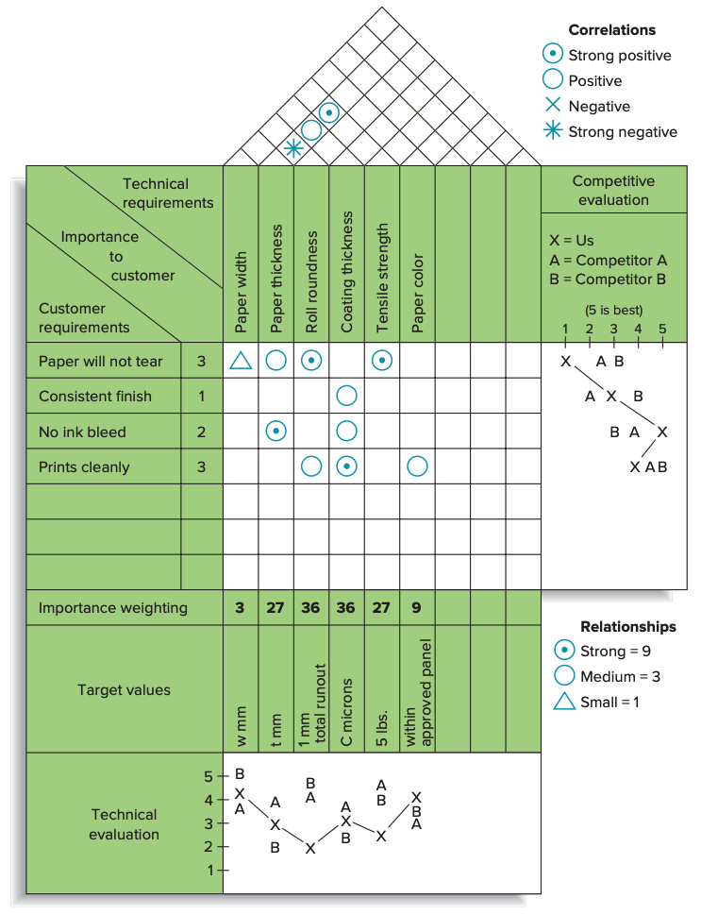
FIGURE 4.4
An example of the house of quality

Slide 32
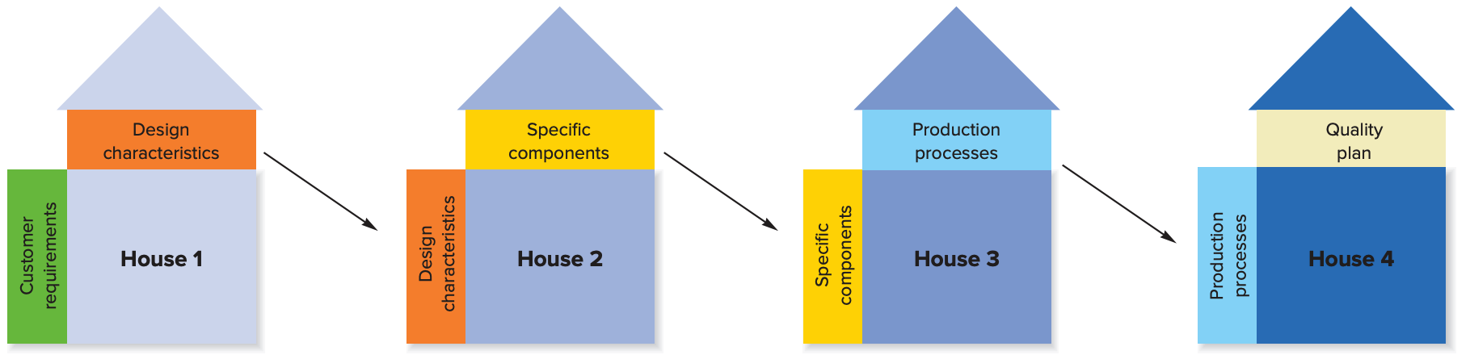
The House of Quality Sequence

Slide 33
Kano Model 狩野模型
A way of assessing the impact of services or product features on customer satisfaction
Basic quality
  Refers to customer requirements that have only limited effect on customer satisfaction if present, but lead to dissatisfaction if absent
Performance quality
  Refers to customer requirements that generate satisfaction or dissatisfaction in proportion to their level of functionality and appeal
Excitement quality
  Refers to a feature or attribute that was unexpected by the customer and causes excitement

Slide 34
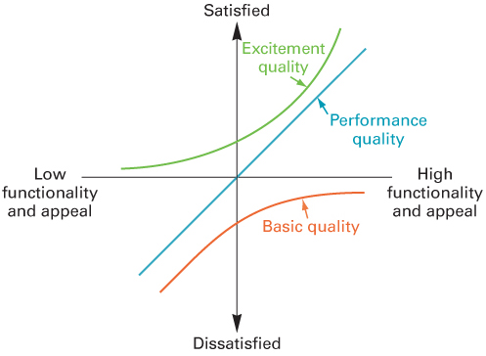
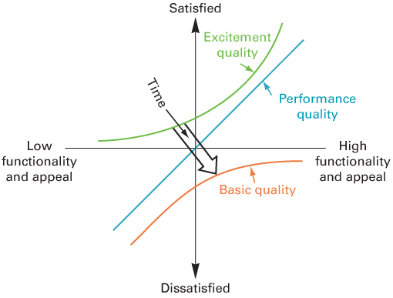
The Kano Model – As Time Passes

Slide 35
Phases in Product Design and Development
Feasibility analysis
Product specifications
Process specifications
Prototype development
Design review
Market test
Product introduction
Follow-up evaluation

Slide 36
Concurrent Engineering
Bringing engineering design and manufacturing personnel together early in the design phase
  Also may involve manufacturing, marketing and purchasing personnel in loosely integrated cross-functional teams
Views of suppliers and customers may also be sought
The purpose is to achieve product designs that reflect customer wants as well as manufacturing capabilities

Slide 37
Computer-Aided Design (CAD)
  Product design using computer graphics
  Advantages
    Increases productivity of designers, 3 to 10 times
    Creates a database for manufacturing information and product specifications
    Provides possibility of engineering and cost analysis on proposed designs
  CAD that includes finite element analysis (FEA) can significantly reduce time to market
    Enables developers to perform simulations that aid in the design, analysis, and commercialization of new products

Slide 38
Production Requirements
Designers must take into account production capabilities
  Equipment
  Skills
  Types of materials
  Schedules
  Technologies
  Special abilities

Slide 39
Manufacturability
  Ease of fabrication and/or assembly
  It has important implications for
    Cost
    Productivity
    Quality
  Design for manufacturing
  Design for assembly

Slide 40
Component Commonality
When products have a high degree of similarity in features and components, a part can be used in multiple products
Benefits:
  Savings in design time
  Standard training for assembly and installation
  Opportunities to buy in bulk from suppliers
  Commonality of parts for repair
  Fewer inventory items must be handled

Slide 41
Service Design
Begins with a choice of service strategy, which determines the nature and focus of the service, and the target market
Key issues in service design
  Degree of variation in service requirements
  Degree of customer contact and involvement

Slide 42
Differences between Service and Product Design
Products are generally tangible; services are intangible
Services are created and delivered at the same time
Services cannot be inventoried
Services are highly visible to consumers
Some services have low barriers to entry and exit
Location is often important to service design, with convenience as a major factor
Service systems range from those with little or no customer contact to those that have a very high degree of customer contact
Demand variability alternately creates waiting lines or idle service resources

Slide 43
Phases in Service Design Process
Conceptualize
  Idea generation
  Assessment of customer wants/needs
  Assessment of demand potential
Identify service package components needed
Determine performance specifications
Translate performance specifications into design specifications
Translate design specifications into delivery specifications

Slide 44
The Well-Designed Service System
Characteristics
  Consistent with the organization mission
  User-friendly
  Robust if variability is a factor
  Easy to sustain
  Cost-effective
  Has value that is obvious to the customer
  Has effective linkages between back- and front-of-the-house operations
  Has a single, unifying theme
  Has design features and checks that will ensure service that is reliable and of high quality

Slide 45
Successful Service Design
Define the service package in detail
Focus on the operation from the customer’s perspective
Consider the image that the service package will present both to customers and to prospective customers
Recognize that designers’ familiarity with the system may give them a quite different perspective than that of the customer, and take steps to overcome this
Make sure that managers are involved and will support the design once it is implemented
Define quality for both tangibles and intangibles
Make sure that recruitment, training, and reward policies are consistent with service expectations
Establish procedures to handle both predictable and unpredictable events
Establish system to monitor, maintain, and improve service

Slide 46
Operations Strategy
Effective product and service design can help the organization achieve competitive advantage:
  Packaging products and ancillary services to increase sales
  Using multiple-use platforms
  Implementing tactics that will achieve the benefits of high volume while satisfying customer needs for variety
  Continually monitoring products and services for small improvement opportunities
  Reducing the time it takes to get a new or redesigned product or service to the market

