Slide 1
Process Selection and
Facility Layout
5
  CYCU
  Prof. CK Farn
mailto: ckfarn@gmail.com
http://www.mgt.ncu.edu.tw/~ckfarn/cycu
  2024.11

Slide 2
Process Selection
Deciding on the way production of goods or services will be organized
It has major implications for
  Capacity planning
  Layout of facilities
  Equipment
  Design of work systems

Slide 3
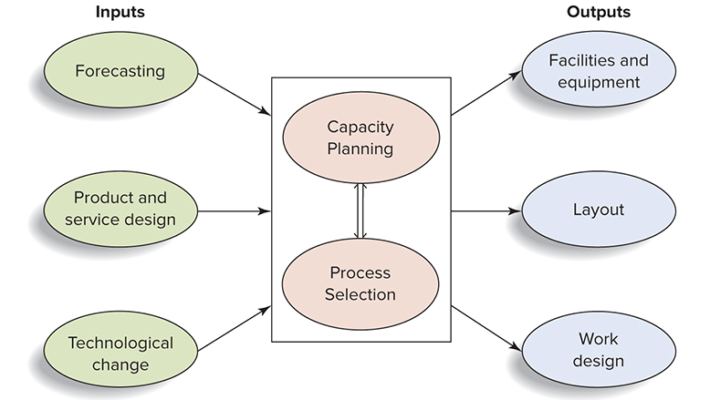
Process Selection and System Design

Slide 4
Key Aspects of Process Strategy
Capital intensity
  The mix of equipment and labor that will be used by the organization
Process flexibility
  The degree to which the system can be adjusted to changes in processing requirements due to such factors as
    Product and service design changes
    Volume changes
    Changes in technology

Slide 5
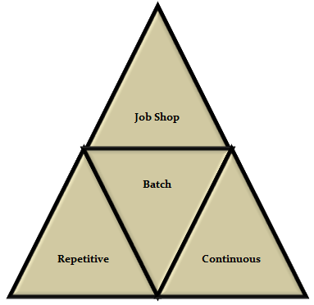
2 Key Questions in Process Selection
How much variety will the process need to be able to handle?
How much volume will the process need to be able to handle?

Slide 6
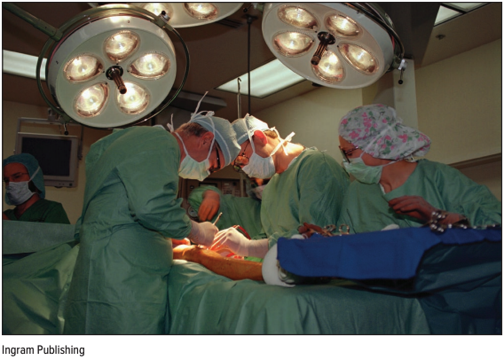
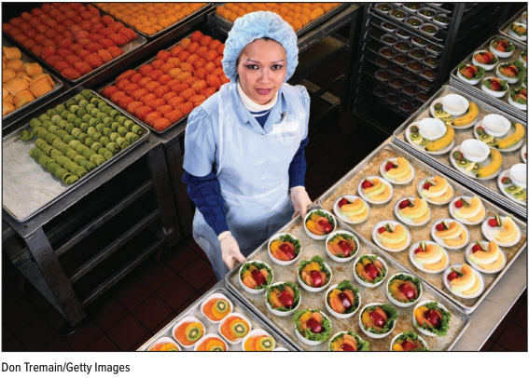
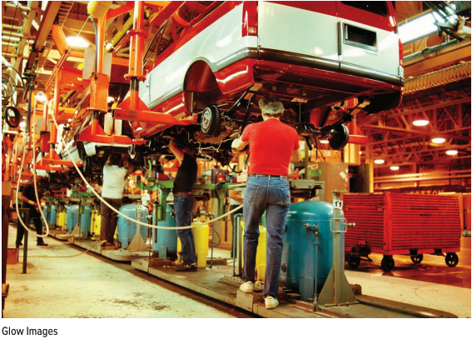
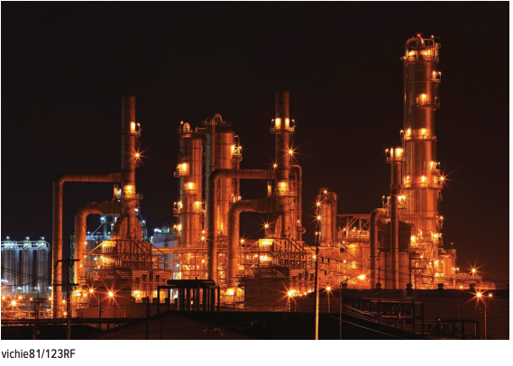
Process Types
A job shop
A batch process
A repetitive process/ Assembly Line
A continuous process

Slide 7
Types of Processing
 | Job Shop | Batch | Repetitive/ Assembly | Continuous
Description | Customized goods or services | Semi- standardized goods or services | Standardized goods or services | Highly standardized goods or services
Advantages | Able to handle a wide variety of work | Flexibility; easy to add or change products or services | Low unit cost, high volume, efficient | Very efficient, very high volume
Disadvantages | Slow, high cost per unit, complex planning and scheduling | Moderate cost per unit, moderate scheduling complexity | Low flexibility, high cost of downtime | Very rigid, lack of variety, costly to change, very high cost of downtime

Slide 8
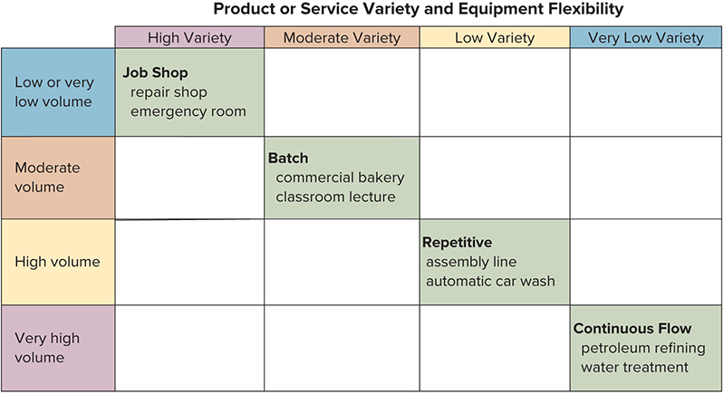
Types of Processing

Slide 9
Sustainable Production of Goods and Services
Increasing pressure for organizations to operate sustainable production processes
According to the Lowell Center for Sustainable Production:
  “Sustainable Production is the creation of goods and services using processes and systems that are: non-polluting; conserving of energy and natural resources; economically efficient; safe and healthful for workers, communities, and consumers; and, socially and creatively rewarding for all working people.”

Slide 10
Sustainable Production of Goods and Services (cont.)
Reduce/recycle waste and ecologically incompatible parts and byproducts
Eliminate hazardous chemicals/physical agents
Conserve energy and materials
Redesign workspace to minimize hazards to the workers and the environment

Slide 11
Process and Information Technology
Process and information technology can have a major impact on costs, productivity and competitiveness:
Process technology
  Methods, procedures, and equipment used to produce goods and provide services
Information technology
  The science and use of computers and other electronic equipment to store, process, and send information

Slide 12
The Need to Manage Technology
Process technology and information technology can have a profound impact on:
  Costs
  Productivity
  Competitiveness

Slide 13
Automation
Automation
  Machinery that has sensing and control devices that enable it to operate automatically
    Fixed automation
    Programmable automation
    Flexible automation

Slide 14
Programmable Automation
The use of high-cost, general-purpose equipment controlled by a computer program that provides both the sequence of operations and specific details about each operation
  Computer-Aided Manufacturing (CAM)
    The use of computers in process control, ranging from robots to automated quality control
  Numerically Controlled (N/C) Machines
    Machines that perform operations by following mathematical processing instructions
  Robot
    A machine consisting of a mechanical arm, a power supply, and a controller

Slide 15
Various types of Robots
Robots that follow a fixed set of instructions
Programmable robots
  Repeat a set of movements after being led through a sequence
  Follow instructions from a computer
Collaborative robots, also known as cobots

Slide 16
Flexible Automation
Evolved from programmable automation.
Uses equipment that is more customized than that of programmable automation.
A key difference between the two is that flexible automation requires significantly less changeover time.
  FMS (Flexible Manufacturing System)
  CIM (Computer Integrated Manufacturing)

Slide 17
Flexible Manufacturing System (FMS)
A group of machines designed to handle intermittent processing requirements and produce a variety of similar products
  Have some of the benefits of automation and some of the flexibility of individual, or stand-alone, machines
  Includes supervisory computer control, automatic material handling, and robots or other automated processing equipment
Flexible: each product is different from others

Slide 18
Computer Integrated Manufacturing (CIM)
A system for linking a broad range of manufacturing activities through an integrated computer system, including:
  Engineering design
  FMS
  Purchasing
  Order processing
  Production planning and control
  Internet of Things (IoT) further enhances connectivity of devices through internet
Goal: to link various parts of an organization to achieve rapid response to customer orders and/or product changes, to allow rapid production, and to reduce indirect labor costs

Slide 19
Facilities Layout
The configuration of departments, work centers, and equipment, with particular emphasis on movement of work (customers or materials) through the system
Facilities layout decisions arise when:
  Designing new facilities
  Re-designing existing facilities

Slide 20
The Need for Layout Planning
Inefficient operations
  High cost
  Bottlenecks
Accidents or safety hazards
Changes in product or service design
Introduction of new products or services
Changes in output volume or product mix
Changes in methods or equipment
Changes in environmental or other legal requirements
Morale problems

Slide 21
Layout Design Objectives
Basic objective
  Facilitate a smooth flow of work, material, and information through the system
Supporting objectives
  Facilitate product or service quality
  Use workers and space efficiently
  Avoid bottlenecks
  Minimize material handling costs
  Eliminate unnecessary movement of workers or material
  Minimize production time or customer service time
  Design for safety

Slide 22
Basic Layout Types
Product layouts
Process layouts
Fixed-position layout
Combination layouts

Slide 23
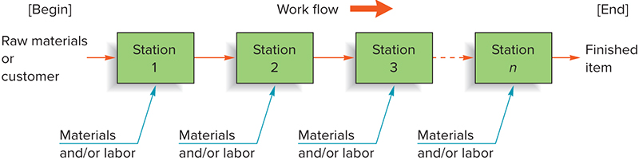
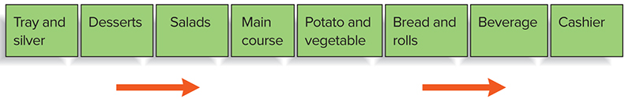
Repetitive Processing:
Product Layouts (Line Layouts)
Production Line
Layout that arranged according to the sequence of operations of the product to achieve smooth, rapid, high-volume flow
  Used for Repetitive or Continuous Processing
Cafeteria Line

Slide 24
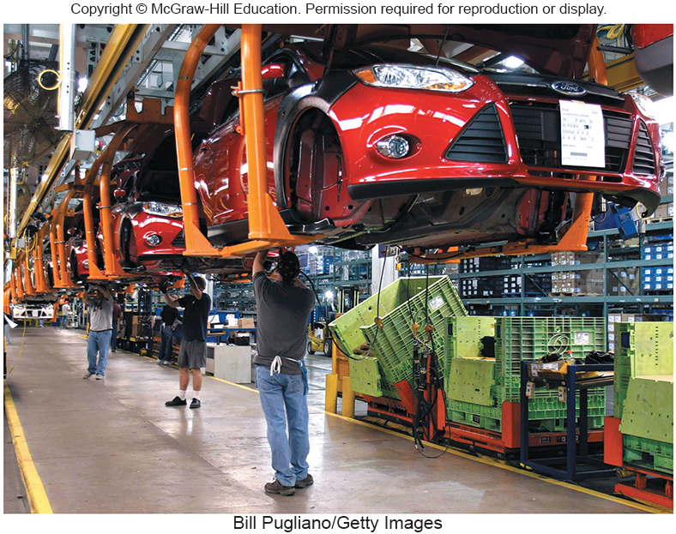
Automobile Assembly Line

Slide 25
Product Layouts:
Advantages & Disadvantages
Advantages
High rate of output
Low unit cost
Labor specialization
Low material handling cost per unit
High utilization of labor and equipment
Established routing and scheduling
Routine accounting, purchasing, and inventory control
Disadvantages
Creates dull, repetitive jobs
Poorly skilled workers may not maintain equipment or quality of output
Fairly inflexible to changes in volume or product or process design
Highly susceptible to shutdowns
Preventive maintenance, capacity for quick repair, and spare-parts inventories are necessary expenses
Individual incentive plans are impractical

Slide 26
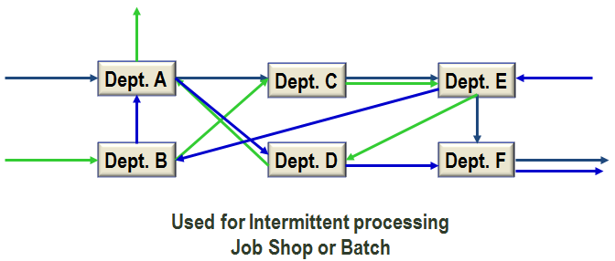
Non-repetitive Processing:
Process Layouts
Layouts that can handle varied processing requirements

Slide 27
Process Layouts: Advantages & Disadvantages (cont.)
Advantages
Can handle a variety of processing requirements
Not particularly vulnerable to equipment failures
General-purpose equipment is often less costly and easier to maintain
It is possible to use individual incentive systems
Disadvantages
In-process inventories can be high
Routing and scheduling pose continual challenges
Equipment utilization rates are low
Material handling is slow and inefficient
Reduced spans of supervision
Special attention necessary for each product or customer
Accounting, inventory control, and purchasing are more involved

Slide 28
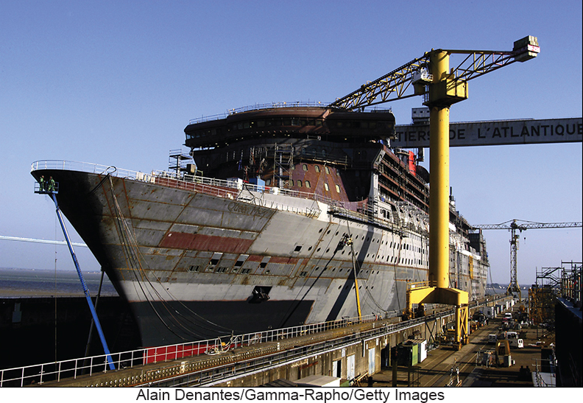
Fixed Position Layouts
Layout in which the product or project remains stationary, and workers, materials, and equipment are moved as needed
  Large construction projects
  Shipbuilding/aircraft manufacturing
  Space mission

Slide 29
Combination Layouts
Some operational environments use a combination of the three basic layout types:
  Hospitals
  Supermarket
  Shipyards
Some organizations are moving away from process layouts in an effort to capture the benefits of product layouts
  Cellular manufacturing
  Flexible manufacturing systems

Slide 30
Cellular Layouts
Layout in which workstations are grouped into a cell that can process items that have similar processing requirements
  Groupings are determined by the operations needed to perform the work for a set of similar items, part families, that require similar processing
  The cells become, in effect, miniature versions of product layouts
  Enables companies to produce a variety of products with very little waste

Slide 31
Group Technology
The grouping into part families of items with similar design or manufacturing characteristics
  Design characteristics:
    Size
    Shape
    Function
  Manufacturing or processing characteristics
    Type of operations required
    Sequence of operations required
Requires a systematic analysis of parts to identify the part families

Slide 32
Service Layouts
Service layout requirements are somewhat different due to such factors as:
  Degree of customer contact
  Degree of customization
Common service layouts:
  Warehouse and storage layouts – minimize item movement
  Retail layouts – influence customers into buying more
  Office layouts – increase employee interactions

Slide 33
Designing Product Layouts:
Line Balancing
Goal of line balancing in a product layout:
  Arrange workers or machines in the sequence that operations need to be performed

Slide 34
Designing Product Layouts:
Line Balancing
The process of assigning tasks to workstations in such a way that the workstations have approximately equal time requirements
Goal:
  Obtain task grouping that represents approximately equal time requirements, since this minimizes idle time along the line and results in a high utilization of equipment and labor
Why is line balancing important?
  It allows us to use labor and equipment more efficiently
  To avoid fairness issues that arise when one workstation must work harder than another

Slide 35
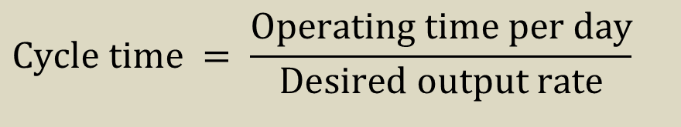
Cycle Time
The maximum time allowed at each workstation to complete its set of tasks on a unit
Cycle time also establishes the output rate of a line
$$\text{Cycle} \text{time} = \frac{\text{Operating} \text{time} \text{per} \text{day}}{\text{Desired} \text{output} \text{rate}}$$

Slide 36

How Many Workstations Are Needed?
The required number of workstations is a function of
  Desired output rate
  Our ability to combine tasks into a workstation
Theoretical minimum number of stations
$${N\frac{\sum{t}}{\text{Cycle} \text{time}}}_{min} \\ \text{where} \\ {N\text{theoretical} \text{minimum} \text{number} \text{of} \text{stations}}_{min} \\ \sum{t= \text{Sum} \text{of} \text{task} \text{times}}$$

Slide 37
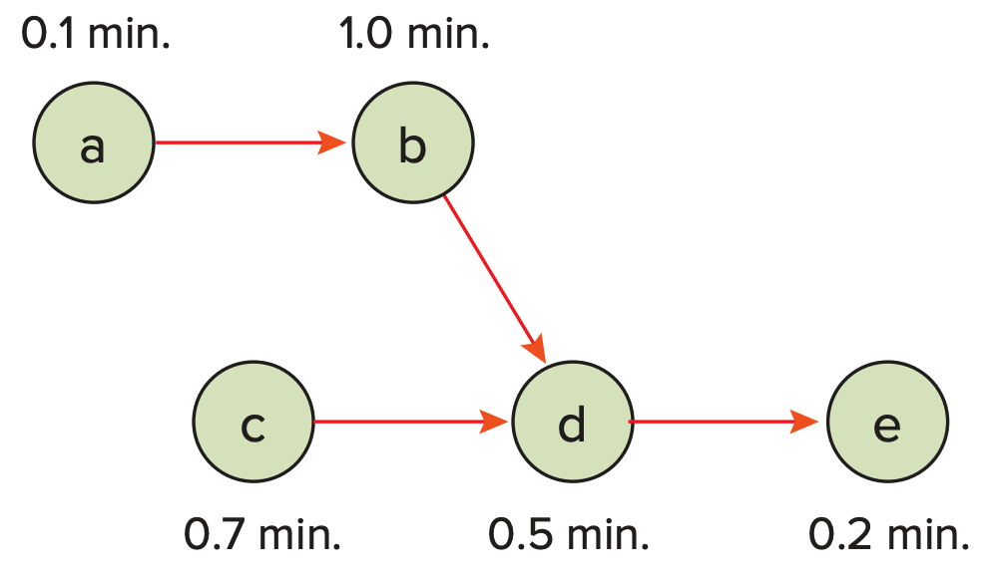
Precedence Diagram
A diagram that shows elemental tasks and their precedence requirements

Slide 38
Designing Process Layouts
The main issue in designing process layouts concerns the relative placement of the departments
Measuring effectiveness
  A major objective in designing process layouts is to minimize transportation cost, distance, or time

Slide 39
Information Requirements
Information is required in designing process layouts
  A list of departments to be arranged and their dimensions
  A projection of future work flows between the pairs of work centers
  The distance between locations and the cost per unit of distance to move loads between them
  The amount of money to be invested in the layout
  A list of any special considerations
  The location of key utilities, access and exit points, etc.

Slide 40
Process Layout Problem
 |  |  | To
 |  | A | B | C
 | A |  | 20 | 40
From | B |  |  | 30
 | C
 |  |  | To
 |  | 1 | 2 | 3
 | 1 |  | 170 | 30
From | 2 |  |  | 100
 | 3
Distance between locations in meters
Interdepartmental work flows (loads per day)

Slide 41
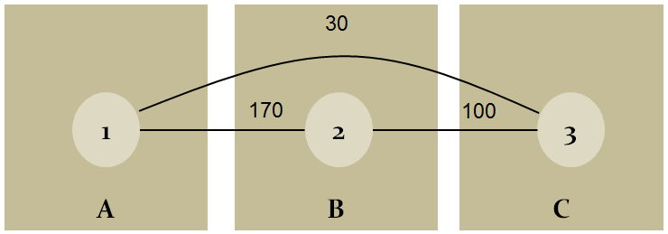
Process Layout Problem (cont.)
Dept. | Loads | Location | Distance (meters) | Load Distance Score
1 to 2 | 170 | A to B | 20 | 170 × 20 = 3,400
1 to 3 | 30 | A to C | 40 | 30 × 40 = 1,200
2 to 3 | 100 | B to C | 30 | 100 × 30 = 3,000
 |  |  | Total | 7,600

