Slide 1
Quality Management (Ch.9)
7
  CYCU
  Prof. CK Farn
mailto: ckfarn@gmail.com
http://www.mgt.ncu.edu.tw/~ckfarn/cycu
  2024.11

Slide 2
Assignment #3 (Individual)
Investigate the differences between Quality assurance (QA) and Quality control (QC). Pick an industry that you like, and give concrete examples of QA and QC practices in this industry.
Due Nov 27 (wed.)

Slide 3
Quality
The ability of a product or service to consistently meet or exceed customer expectations
For a decade or so, quality was an important focal point in business.

Slide 4
Attention to Quality
Attention to quality given the costs and adverse attention associated with highly visible quality failures:
  Auto recalls
  Toys
  Produce
  Dog food
  Pharmaceuticals

Slide 5
Quality Contributors
Walter Shewart
  “Father of statistical quality control”
  Control charts
  Variance reduction
W. Edwards Deming
  Special versus common cause variation
  Deliver what you promised
Joseph Juran
  Quality Control Handbook, 1951
  Viewed quality as fitness-for-use
  Quality trilogy – quality planning, quality control, quality improvement

Slide 6
Quality Contributors 2
Armand Feigenbaum
  Quality is a “total field”
  The customer defines quality
Philip B. Crosby
  Zero defects
  Quality is Free, 1979
Kaoru Ishikawa （石川）
  Cause-and-effect diagram
  Quality circles
  Recognized the internal customer

Slide 7
Quality Contributors 3
Genichi Taguchi （田口）
  Taguchi loss function
Taiichi Ohno （大野）and Shigeo Shingo （新鄉）
  Developed philosophy and methods of kaizen （改善）

Slide 8
Dimensions of Product Quality
Performance – main characteristics of the product
Aesthetics – appearance, feel, smell, taste
Special features – extra characteristics
Conformance – how well the product conforms to design specifications
Reliability – consistency of performance
Durability – the useful life of the product
Perceived quality – indirect evaluation of quality
Serviceability – handling of complaints or repairs
Consistency – quality doesn’t vary

Slide 9
Dimensions of Service Quality
Convenience – the availability and accessibility of the service
Reliability – ability to perform a service dependably, consistently, and accurately
Responsiveness – willingness to help customers in unusual situations and to deal with problems
Time – the speed with which the service is delivered
Assurance – knowledge exhibited by personnel and their ability to convey trust and confidence
Courtesy – the way customers are treated by employees
Tangibles – the physical appearance of facilities, equipment, personnel, and communication materials
Consistency – the ability to provide the same level of good quality repeatedly
Expectancy – meet (or exceed) customer expectations

Slide 10
Assessing Service Quality
Audit service to identify strengths and weaknesses
In particular, look for discrepancies between:
  Customer expectations and management perceptions of those expectations
  Management perceptions, customer expectations, and service-quality specifications
  Service quality and service actually delivered
  Service actually delivered and what is communicated about the service to customers
  Customers’ expectations of the service provider and their perceptions of provider delivery

Slide 11
Determinants of Quality
Quality of design
  Intention of designers to include or exclude features in a product or service
Quality of conformance
  The degree to which goods or services conform to the intent of the designers
Ease-of-use and user instructions
  Increase the likelihood that a product will be used for its intended purpose and in such a way that it will continue to function properly and safely
After-the-sale service
  Taking care of issues and problems that arise after the sale

Slide 12
Responsibility for Quality
Top management
Design
Procurement
Production/operations
Quality assurance
Packaging and shipping
Marketing and sales
Customer service
Everyone in the organization has some responsibility for quality, but certain areas of the organization are involved in activities that make them key areas of responsibility

Slide 13
Benefits of Good Quality
Enhanced reputation for quality
Ability to command premium prices
Increased market share
Greater customer loyalty
Lower liability costs
Fewer production or service problems
Lower production costs
Higher profits

Slide 14
The Consequences of Poor Quality
Loss of business
Liability
Productivity
Costs

Slide 15
Costs of Quality
Appraisal costs
  Costs of activities designed to ensure quality or uncover defects
Prevention costs
  All TQ training, TQ planning, customer assessment, process control, and quality improvement costs to prevent defects from occurring

Slide 16
Costs of Quality (cont.)
Failure costs - costs incurred by defective parts/products or faulty services
  Internal failure costs
    Costs incurred to fix problems that are detected before the product/service is delivered to the customer
  External failure costs
    All costs incurred to fix problems that are detected after the product/service is delivered to the customer

Slide 17
Ethics and Quality
Substandard work
  Defective products
  Substandard service
  Poor designs
  Shoddy workmanship
  Substandard parts and materials
Having knowledge of this and failing to correct and report it in a timely manner is unethical, even illegal.

Slide 18
Quality Certification
International Organization for Standardization
ISO 9000
  Set of international standards on quality management and quality assurance, critical to international business
ISO 14000
  A set of international standards for assessing a company’s environmental performance
ISO 24700
  Pertains to the quality and performance of office equipment that contains reused components

Slide 19
ISO 9000 Quality principles
Principle 1 Customer focus
Principle 2 Leadership
Principle 3 Involvement of people
Principle 4 Process approach
Principle 5 System approach to management
Principle 6 Continual improvement
Principle 7 Factual approach to decision making
Principle 8 Mutually beneficial supplier relationships

Slide 20
Quality and the Supply Chain
Business leaders are increasingly recognizing the importance of their supply chains in achieving their quality goals
Requires:
  Measuring customer perceptions of quality
  Identifying problem areas
  Correcting these problems
Supply chain quality management can benefit from a collaborative relationship with suppliers
  Helping suppliers with quality assurance efforts
  Information sharing on quality-related matters

Slide 21

Total Quality Management
A philosophy that involves everyone in an organization in a continual effort to improve quality and achieve customer satisfaction

Slide 22
TQM Approach
Find out what the customer wants
Design a product or service that meets or exceeds customer wants
Design processes that facilitate doing the job right the first time
Keep track of results
Extend these concepts throughout the supply chain
Top management must be involved and committed

Slide 23
TQM Elements
Continuous improvement
Competitive benchmarking
Employee empowerment
Team approach
Decision based on fact, not opinion
Knowledge of tools
Supplier quality
Champion
Quality at the source
Suppliers are partners in the process

Slide 24
Continuous Improvement
Continuous improvement
  Philosophy that seeks to make never-ending improvements to the process of converting inputs into outputs
Kaizen 改善
  Japanese word for continuous improvement

Slide 25
Quality at the Source
The philosophy of making each worker responsible for the quality of his or her work
  “Do it right” and “If it isn’t right, fix it”

Slide 26
Obstacles to Implementing TQM
  Lack of company-wide definition of quality
  Lack of strategic plan for change
  Lack of customer focus
  Poor intra-organizational communication
  Lack of employee empowerment
  View of quality as a “quick fix”
  Emphasis on short-term financial results
  Inordinate presence of internal politics and “turf” issues
  Lack of strong motivation
  Lack of time to devote to quality initiatives
  Lack of leadership

Slide 27
Criticisms of TQM
  Overzealous advocates may pursue TQM programs blindly, focusing attention on quality
  Programs may not be linked to the strategies of the organization in a meaningful way
  Quality-related decisions may not be tied to market performance
  Failure to carefully plan a program before embarking on it can lead to false starts, employee confusion, and meaningless results
  Organizations sometimes pursue continuous improvement
  Quality efforts may not be tied to results

Slide 28

PDSA (Plan-Do-Study-Act) Cycle
Plan
  Begin by studying and documenting the current process.
  Collect data on the process or problem
  Analyze the data and develop a plan for improvement
  Specify measures for evaluating the plan
Do
  Implement the plan, document any changes made, collect data for analysis

Slide 29

PDSA Cycle (cont.)
Study
  Evaluate the data collection during the do phase
  Check results against goals formulated during the plan phase
Act
  If the results are successful, standardize the new method and communicate it to the relevant personnel
  Implement training for the new method
  If unsuccessful, revise the plan and repeat the process

Slide 30
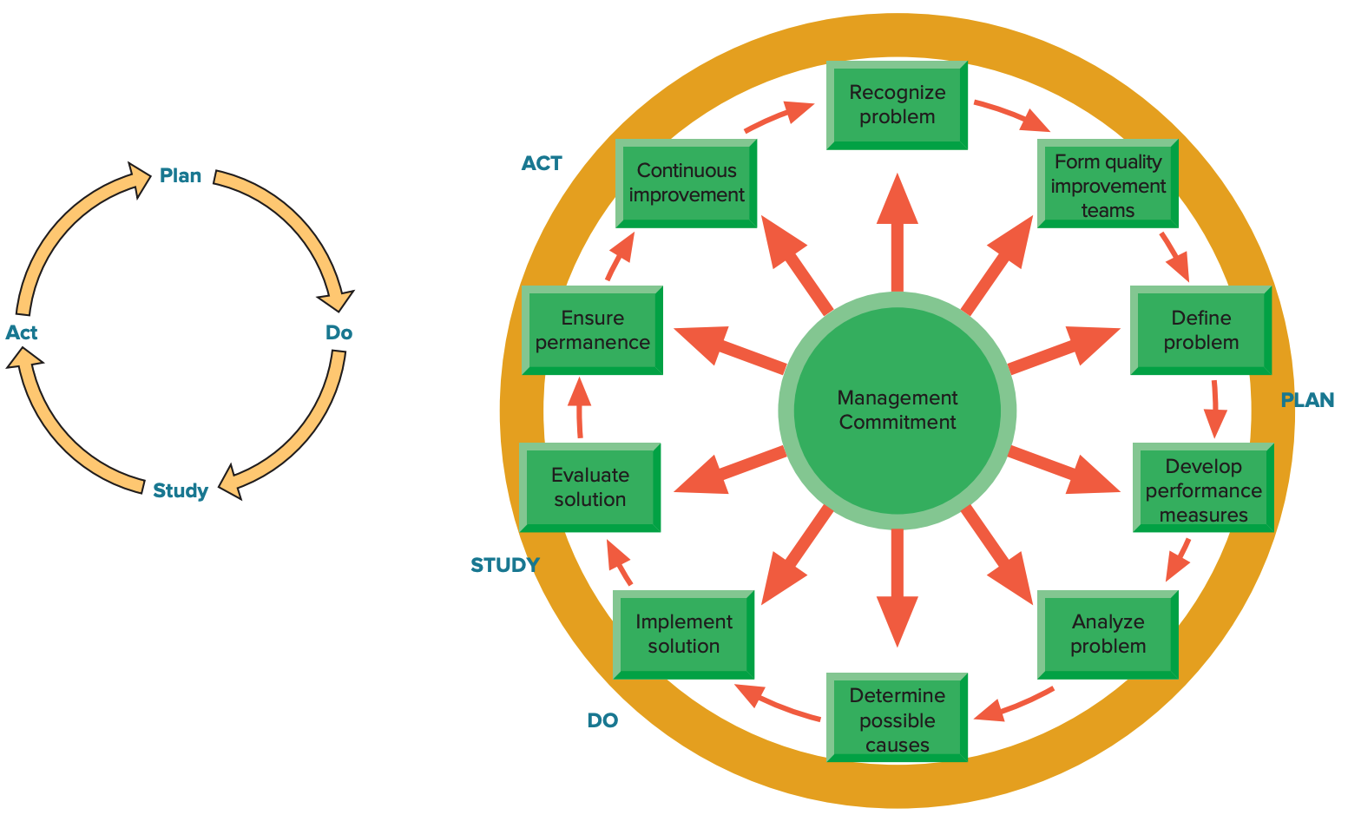
Problem Solving

Slide 31
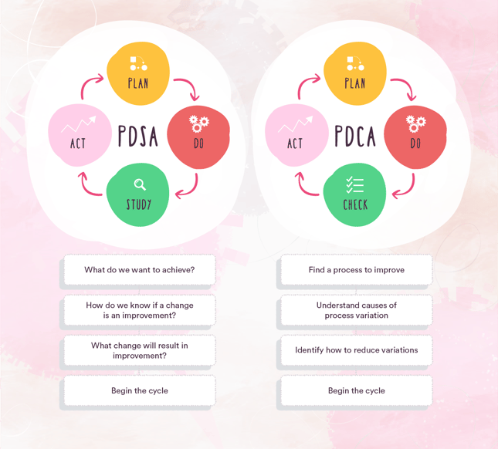
Similar Method: PDCA

Slide 32
Process Improvement
A systematic approach to improving a process
  Map the process
    Collect information about the process and identify each step in the process
    Prepare a flowchart that accurately depicts the process
  Analyze the process
    Ask critical questions about the process
    Ask specific questions about each step in the process
  Redesign the process

Slide 33
Six Sigma
A business process for improving quality, reducing costs, and increasing customer satisfaction
Statistically
  Having no more than 3.4 defects per million
Conceptually
  Program designed to reduce defects
  Requires the use of certain tools and techniques

Slide 34
Six Sigma (cont.)
Principles
  Reduction in variation is an important goal
  The methodology is data driven; it requires data validation
  Outputs are determined by inputs
  Only a critical few inputs have a significant impact on outputs
DMAIC
  Define: Set the context and objectives for improvement
  Measure: Determine the baseline performance and capability of the process
  Analyze: Use data and tools to understand the cause-and-effect relationships of the process
  Improve: Develop the modifications that lead to a validated improvement of the process
  Control: Establish plans and procedures to ensure that improvements are sustained

Slide 35
Basic Quality Tools ₁
  Flowchart
  Check sheet
  Histogram
  Pareto chart
  Scatter diagram
  Control chart
  Cause-and-effect diagram

Slide 36
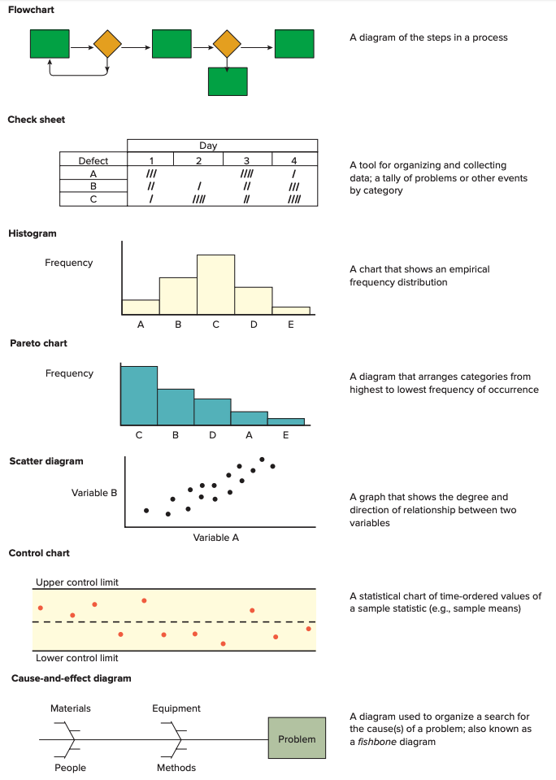
Basic Quality Tools 2

Slide 37
Basic Quality Tools 3

Slide 38
Methods for Generating Ideas
Brainstorming
Quality circles
Benchmarking

Slide 39
Quality Circles
Groups of workers who meet to discuss ways of improving products or processes
  Less structured and more informal than teams involved in continuous improvement
  Quality circle teams have historically had relatively little authority to make any but the most minor changes

Slide 40
Benchmarking Process
Identify a critical process that needs improvement
Identify an organization that excels in this process
Contact that organization
Analyze the data
Improve the critical process

Slide 41
Operations Strategy
Quality is a strategic imperative for organizations
  Customers are very concerned with the quality of goods and services they receive
Quality is a never-ending journey
  It is important that most organizational members understand and buy into this idea
Customer satisfaction ≠ customer loyalty
Quality needs to be incorporated throughout the entire supply chain, not just the organization itself

