Slide 1
MRP:
Material Requirement Planning _{(Ch.13)}
11
  CYCU
  Prof. CK Farn
mailto: ckfarn@gmail.com
http://www.mgt.ncu.edu.tw/~ckfarn/cycu
  2024.12

Slide 2
MRP:
Material requirements planning
MRP
  A computer-based information system that translates master schedule requirements for end items into time-phased requirements for subassemblies, components, and raw materials
Designed to answer three questions:
  What is needed?
  How much is needed?
  When is it needed?

Slide 3
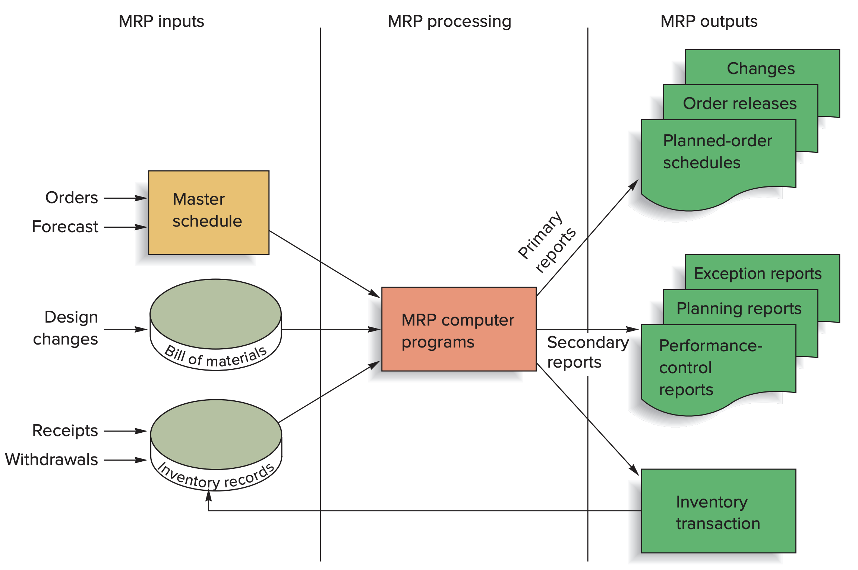
Overview of MRP

Slide 4
MRP Inputs: Master Schedule
Master schedule:
  One of three primary inputs in MRP; states which end items are to be produced, when these are needed, and in what quantities
  Plan far enough into the future to have reasonable estimates of upcoming demands
  Should cover a period that is at least equivalent to the cumulative lead time:
    The sum of the lead times that sequential phases of a process require, from ordering of parts or raw materials to completion of the final assembly

Slide 5
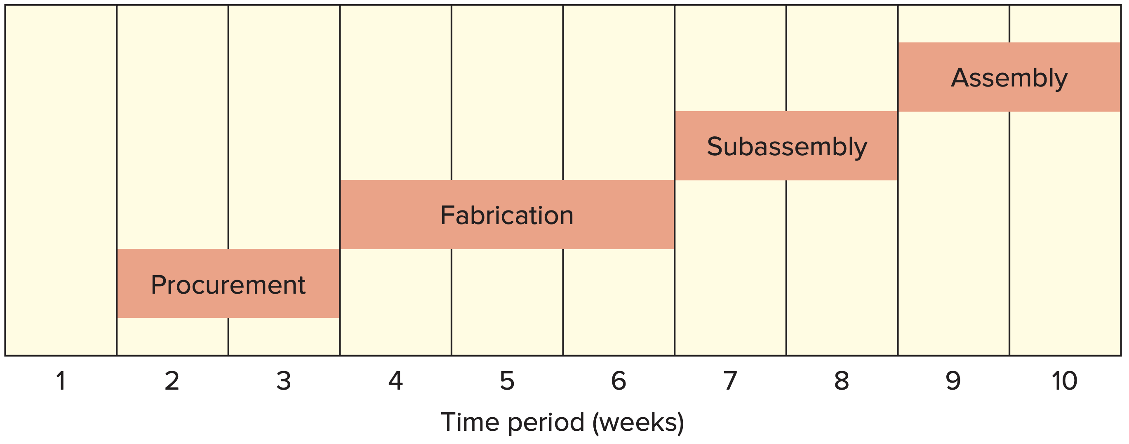
Cumulative Lead Time

Slide 6
MRP Inputs: Bill of Materials
Bill of Materials (BOM)
  A listing of all of the assemblies, subassemblies, parts, and raw materials needed to produce one unit of a product
Product structure tree
  A visual depiction of the requirements in a bill of materials, where all components are listed by levels

Slide 7
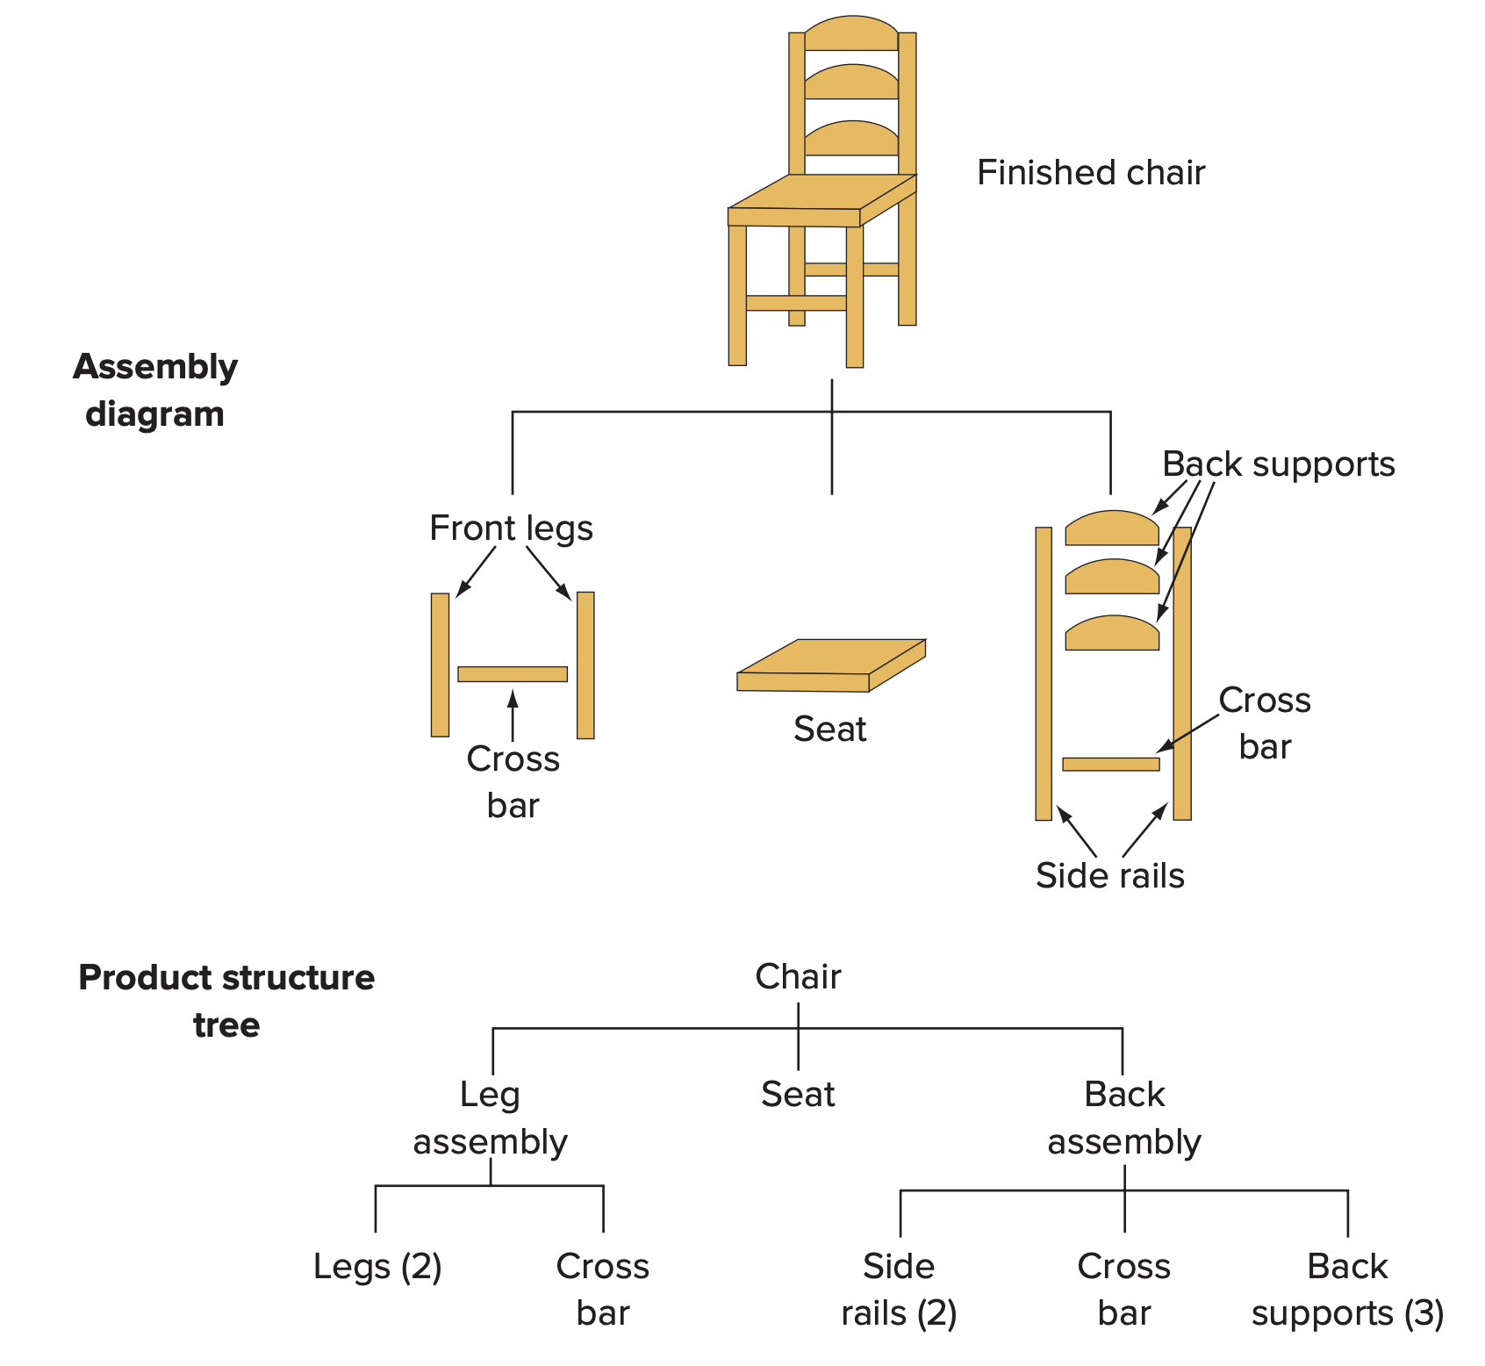
Assembly Diagram and
Product Structure Tree

Slide 8
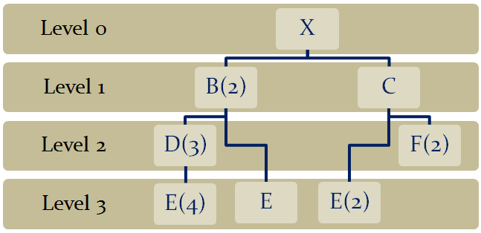
Low-Level Coding
Low-level coding
  Restructuring the bill of materials so that multiple occurrences of a component all coincide with the lowest level at which the component occurs

Slide 9
MRP Inputs: Inventory Records
Inventory records
  Includes information on the status of each item by time period, called time buckets
  Information about
    Gross requirements
    Scheduled receipts
    Expected amount on hand
  Other details for each item such as
    Supplier
    Lead time
    Lot size policy
    Changes due to stock receipts and withdrawals
    Canceled orders and similar events

Slide 10
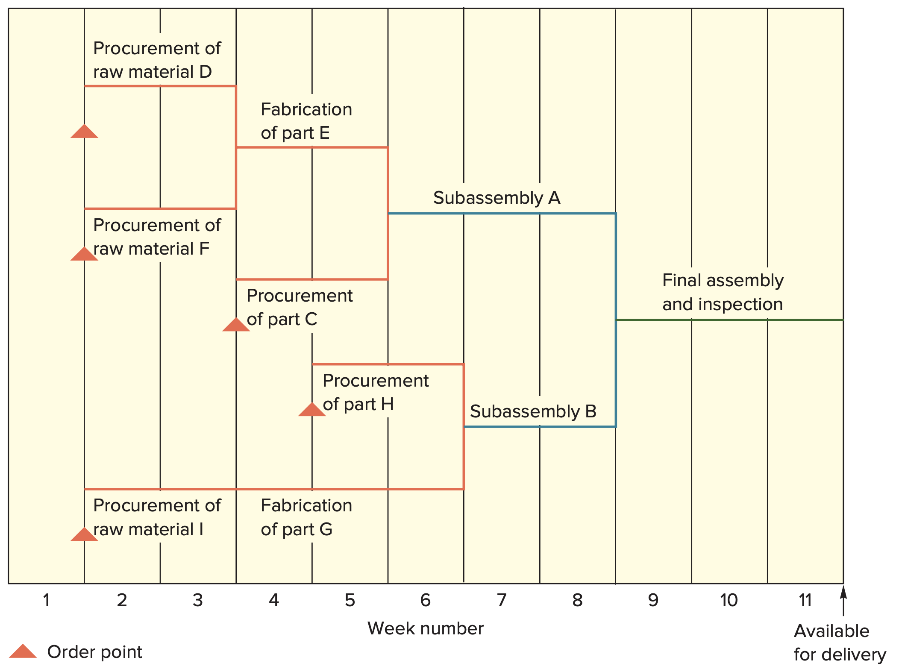
Assembly Time Chart

Slide 11
MRP Outputs: Primary
Primary Outputs
  Planned orders
    A schedule indicating the amount and timing of future orders
  Order releases
    Authorizing the execution of planned orders
  Changes
    Revisions of the dates or quantities, or the cancellation of orders

Slide 12
MRP Outputs: Secondary
Secondary Outputs
  Performance-control reports
    Evaluation of system operation, including deviations from plans and cost information
      for example missed deliveries and stockouts
  Planning reports
    Data useful for assessing future material requirements
      for example purchase commitments
  Exception reports
    Data on any major discrepancies encountered
      for example late and overdue orders, excessive scrap rates, requirements for nonexistent parts

Slide 13
MRP Processing
MRP processing takes the end item requirements specified by the master schedule and “explodes” them into time-phased requirements for assemblies, parts, and raw materials offset by lead times

Slide 14
MRP Record
Week Number | 1 | 2 | 3 | 4 | 5 | 6
Gross Requirements
Scheduled Receipts
Projected on hand
Net requirements
Planned-order receipt
Planned-order release
Gross requirements
  Total expected demand
Scheduled receipts
  Open orders scheduled to arrive
Projected Available
  Expected inventory on hand at the beginning of each time period

Slide 15
MRP Record _{(cont.)}
Week Number | 1 | 2 | 3 | 4 | 5 | 6
Gross Requirements
Scheduled Receipts
Projected on hand
Net requirements
Planned-order receipt
Planned-order release
Net requirements
  Actual amount needed in each time period
Planned-order receipts
  Quantity expected to received at the beginning of the period offset by lead time
Planned-order releases
  Planned amount to order in each time period

Slide 16
MRP: Development
The MRP is based on the product structure tree diagram
Requirements are determined level by level, beginning with the end item and working down the tree
  The timing and quantity of each “parent” becomes the basis for determining the timing and quantity of the “children” items directly below it
  The “children” items then become the “parent” items for the next level, and so on

Slide 17
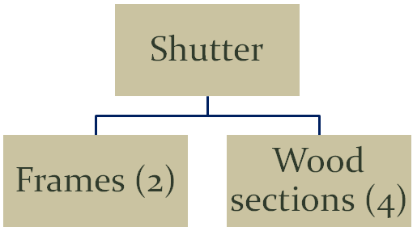
Example MRP

Slide 18
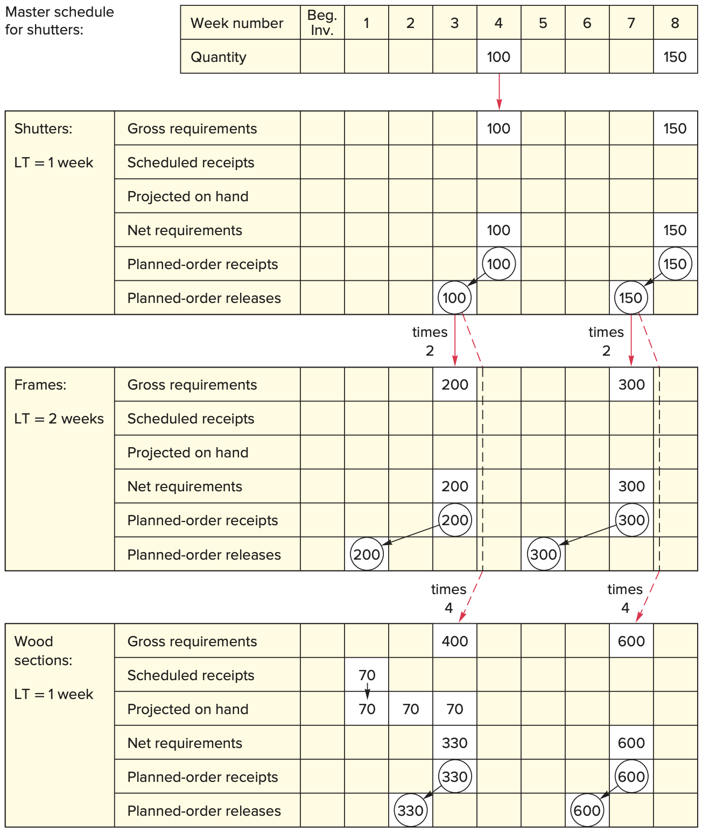
Example MRP _{(cont.)}

Slide 19
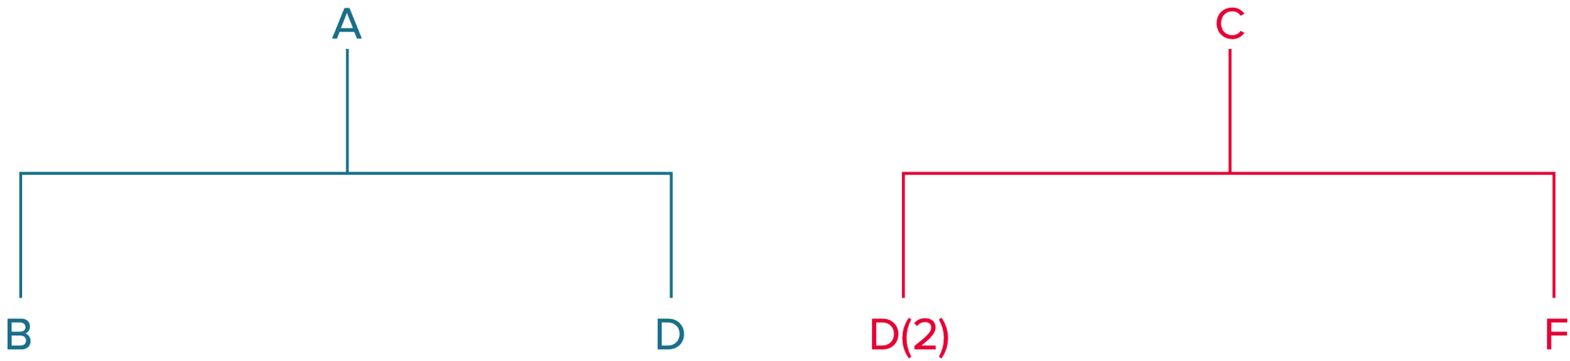
Using the MRP
Pegging
  The process of identifying the parent items that have generated a given set of material requirements for an item

Slide 20
Updating the System
An MRP is not a static document
  As time passes
    Some orders get completed
    Other orders are nearing completion
    New orders will have been entered
    Existing orders will have been altered
      Quantity changes
      Delays
      Missed deliveries

Slide 21
Updating the System (cont.)
Two basic systems
Regenerative system
  Approach that updates MRP records periodically
    Essentially a batch system that compiles all changes that occur within the time interval and periodically updates the system
    A revised production plan is developed in the same way the original plan was developed
Net-change system
  Approach that updates MRP records continuously
    The production plan is modified to reflect changes as they occur
    Only the changes are exploded through the system

Slide 22
MRP Benefits
Enables managers to easily
  Determine the quantities of each component for a given order size
  Know when to release orders for each component
  Be alerted when items need attention
Additional benefits
  Low levels of in-process inventories
  The ability to track material requirements
  The ability to evaluate capacity requirements
  A means of allocating production time
  The ability to easily determine inventory usage via backflushing
      Exploding an end item’s BOM to determine the quantities of the components that were used to make the item

Slide 23
MRP Requirements
To implement an effective MRP system requires:
  A computer and the necessary software to handle computations and maintain records
  Accurate and up-to-date
    Master schedules
    Bills of materials
    Inventory records
  Integrity of data files

Slide 24
MRP Difficulties
Consequence of inaccurate data
  Missing parts
  Ordering incorrect numbers of items
  Inability to stay on schedule
Other problems
  Assumptions of constant lead times
  Products being produced differently from the BOM
  Failure to alter a BOM when customizing a product
  Inaccurate forecasts

Slide 25
MRP II
Manufacturing resources planning (MRP II)
  Expanded approach to production resource planning, involving other areas of the firm in the planning process and enabling capacity requirements planning
    Most MRP II systems have the capability of performing simulations to answer a variety of “what if” questions so they can gain a better appreciation of available options and their consequences

Slide 26
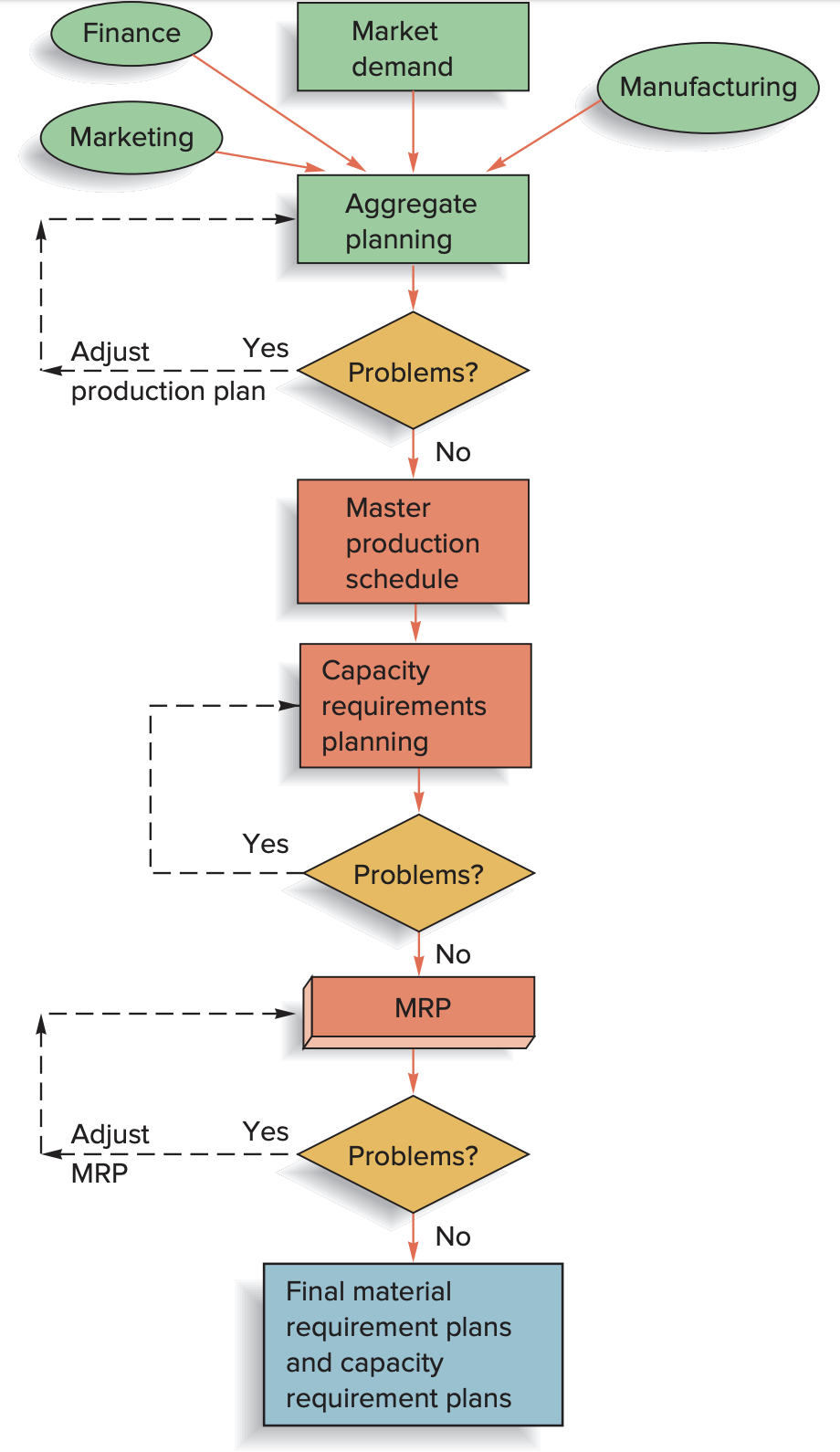
MRP II:
Overview

Slide 27
Closed Loop MRP
When MRP II systems began to include feedback loops, they were referred to as Closed Loop MRP
Closed Loop MRP
  Systems evaluate a proposed material plan relative to available capacity
  If a proposed plan is not feasible, it must be revised
    This evaluation is referred to as capacity requirements planning

Slide 28
Capacity Requirements Planning
Capacity requirements planning (CRP)
  The process of determining short-range capacity requirements.
  Inputs to capacity requirement planning
    Planned-order releases for the MRP
    Current shop loading
    Routing information
    Job time
  Key outputs
    Load reports for each work center

Slide 29
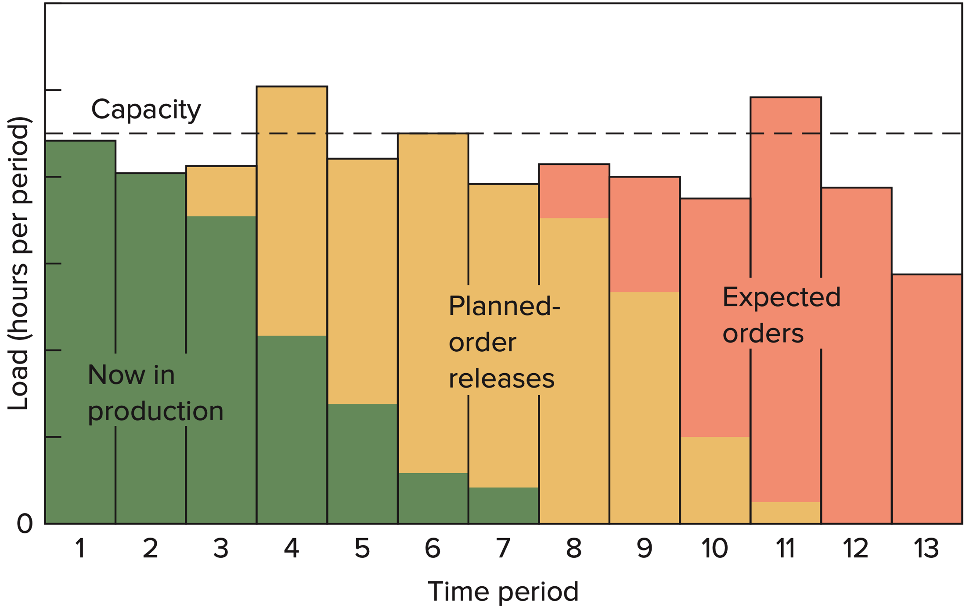
Load Reports
Load reports
  Department or work center reports that compare known and expected future capacity requirements with projected capacity availability

Slide 30
Enterprise Resource Planning
Enterprise resource planning (ERP)
  ERP was the next step in an evolution that began with MRP and evolved into MRPII
  ERP, like MRP II, typically has an MRP core
  ERP provides a system to capture and make data available in real time to decision makers and other users throughout an organization
  ERP systems are composed of a collection of integrated modules

Slide 31
Overview of ERP Software Modules
Module | Brief Description
Accounting/Finance | A central component of most ERP systems. It provides a range of financial reports, including general ledger, accounts payable, accounts receivable, payroll, income statements, and balance sheets
Marketing | Supports lead generation, target marketing, direct mail, and sales
Human Resources | Maintains a complete data base of employee information such as date of hire, salary, contact information, performance evaluations, and other pertinent information
Purchasing | Facilitates vendor selection, price negotiation, making purchasing decisions, and bill payment
Production Planning | Integrates information on forecasts, orders, production capacity, on-hand inventory quantities, bills of material, work in process, schedules, and production lead times
Inventory Management | Identifies inventory requirements, inventory availability, replenishment rules, and inventory tracking
Distribution | Contains information on third-party shippers, shipping and delivery schedules, delivery tracking
Sales | Information on orders, invoices, order tracking, and shipping
Supply Chain Management | Facilitates supplier and customer management, supply chain visibility, and event management

Slide 32
ERP Project Organization
The “big bang”
  Companies cast off all of their legacy systems at once and implement a single ERP system across the entire company
  The most ambitious and difficult implementation approach
Franchising strategy
  Independent ERP systems are installed in each business unit of the enterprise while linking common processes across the enterprise
  Suits large or diverse companies that do not share many common processes across business units
Slam dunk
  ERP dictates the process design where the focus is on a few key processes
  More appropriate for smaller companies expecting to grow into ERP

Slide 33
ERP Considerations
How can ERP improve a company’s business performance?
How long will an ERP implementation project take?
How will ERP affect current business processes?
What is the ERP total cost of ownership?
What are the hidden costs of ERP ownership?

