Slide 1
Business Simulation Game– 8-cross Simulation
6
Dr. CK Farn
2024 Spring

Slide 2
Some important concepts
Decision making under resource constraints
Business Intelligence, KPI

Slide 3
System concept
Decision
Performance
Feedback
You made decisions, and there will be results, which reflect the business performance. You have to review the results and make further decisions down the road.

Slide 4
Decision making under resource constraints
Every company operates under resource constraints
Example: buying clothing with limited budget
You have to make trade-offs
You can spend within the budget you have
You can expand your budget:
borrow from the bank at a cost

Slide 5
Examples of decisions
Product types
Investments CAPEX (capital expenditure), R&D, etc.
Human resources
Hiring, compensation, training, incentives
Allocation
Production
Product pricing
Materials
Marketing (advertisement)

Slide 6
Types of decisions
Directly affecting money issues
CAPEX: invest in equipment will require spending money
Buying raw materials spend money
…
Indirectly affecting money issue
Product pricing: the sales volume may be affected, and it will affect income
Hiring workers at certain level of skills
Product quality
…

Slide 7
Constraints
Budget constraints
Resource constraints (customer demand, production lines, customer preferences, availability of supply, etc.)
Lead time: most of the time, you have to wait!
Example: You may have 2 production lines, each has a capacity of 100 units in a time period. However, you may only be able to produce 60 due to material shortages, labor shortage, etc.

Slide 8
Multiple constraints
Many constraints co-exist
You may be able to produce as many as expected, but the customer demand is low
You may be aware of some, but unaware of others
The is a fact of life

Slide 9
Stochastic/probabilistic outcome
Important factors may varies
Demand
Labor efficiency
Sales force efficiency
…
Things may not happen as you wish

Slide 10
You have competitors
The market demand may exceed you production capacity, but you cannot successfully sale it, because
You have competitors
In this class, you have one
You opponent may set a better price, may have a quality

Slide 11
Decision making over time
Some decisions are “one shot”
Purchasing equipment
Production pricing
Some need to be done every month
Raw Materials sourcing – to get RM delivered next month
Deploy Production Manpower – to enable production for current month
Production Planning – to enable products made for current month

Slide 12
Business intelligence
KPI: Key performance indicator
See next page
You performance can be summarized in performance reports
P.59-64 of the manual

Slide 13
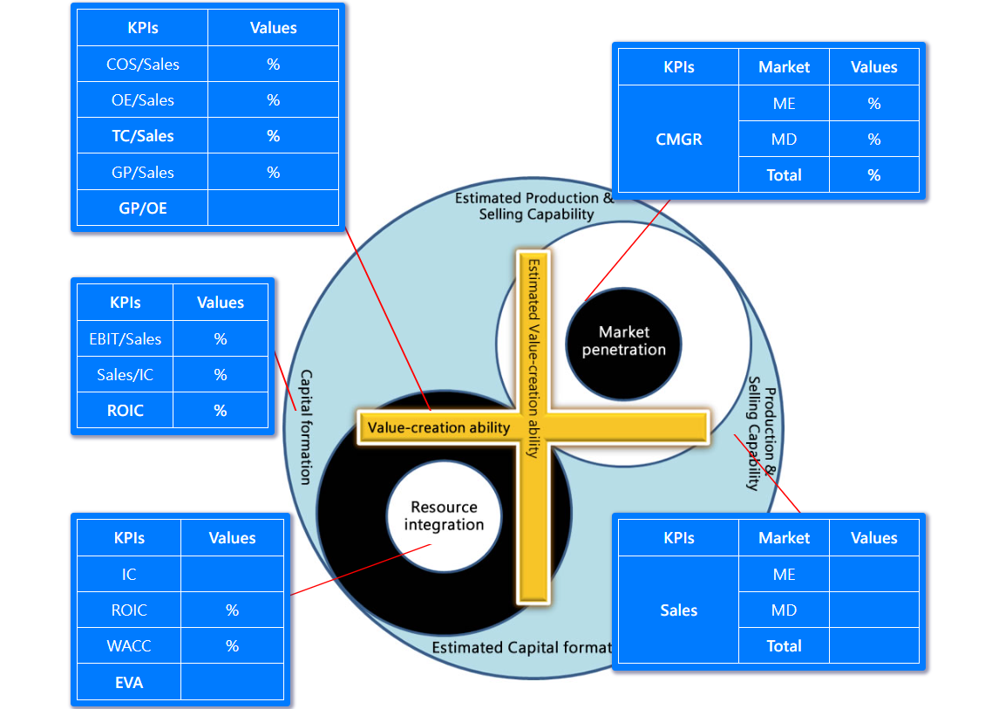
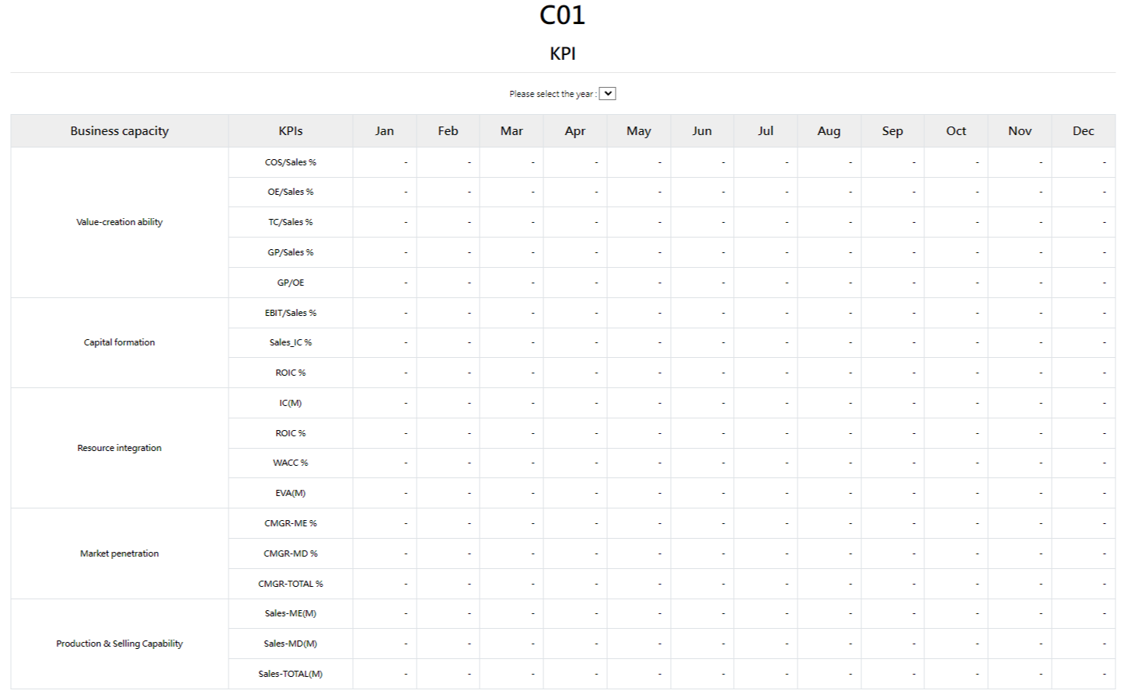
KPI

Slide 14
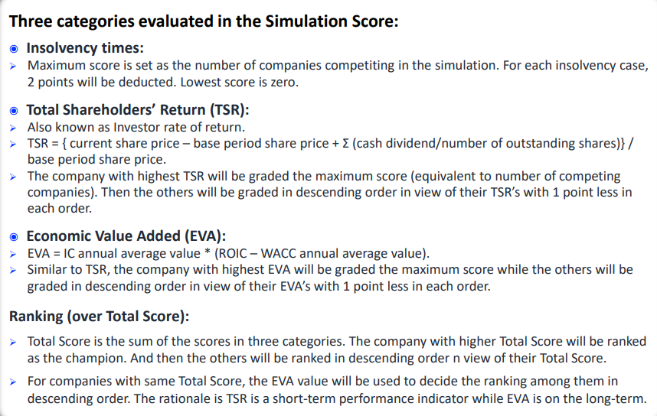
What is your performance? p.66

Slide 15
Terms
Abv | Meaning
COS | Cost of sales
OE | Operating expenses
TC
GP | Gross profit
EBIT | Earning before interest and taxes
TC | Total cost
CMGR | Compound market growth rate
Abv | Meaning
IC | Invested capital
ROIC | Return on invested capital
WACC | Weighted average cost of capital
EVA | Economic value added
ME | Market: emerging
MD | Market: developed
PA | Product A

Slide 16
Simulation Settings
Company organization
Operations
Procurement
Marketing
Finance
A team of 4-5 students
Roles: Chief X Officer
COO, CPO, CMO, CFO, CEO
You started out with $10,000,000 NTD

Slide 17
Things to do
Select the decisions to make
Some decisions are independent, but some are inter-related:
CFO has to approve the monetary decisions
CEO has to coordinate the decisions, so that you have resources to continue the game
CEO can take on the role of any other player, if needed
If you run out of cash, you company bankrupts, and new capital will be injected (a second life)

Slide 18
After class
A new game will be restarted
The game will be set such that the pace will be ONE day (24 hours) for TWO months, cutting off at 10 am and 10 pm
10 am to 10 pm: month one
10 pm to 10 am: month two
However, you can make decisions before 10 pm (for month one) and after 10 pm (for month two)
A total of 3 years (18 days)

Slide 19
Assignment #3
Due next week after game closed
Prepare an Analysis Report (pdf)
How is your performance
What did you do wrong
What have you learnt?
Prepare a 15-20 minutes presentation (ppt)

