Slide 1
Information Systems:
Integration of Functions
2
  CYCU
  Prof. CK Farn
mailto: ckfarn@gmail.com
http://www.mgt.ncu.edu.tw/~ckfarn/cycu
  2025.02 Rev

Slide 2
Rapid improvement of IT
Computers (Mainframe)
…+ time sharing
…+ direct access storage devices
…+ personal computers
…+ networking
…+ Internet
…+ WiFi + mobile networks + display+ printing+ GPS
…+ IoT, Big Data
5G communications, AI

Slide 3
Applications of IT in Businesses
Tech. Innovation
Internet
Cloud computing
Mobile business
5G, IoT, AI, BigData
1995
Integration
Computers
Database
Telecoms
eC
B2C EC
Data
Processing
DP/EDP
MIS
Decision
Support
DSS/EIS
Online
Trans.
OLTP
ERP
eBusiness
EB
XXX
4.0
50s
60s
70s
80s
90s
00s
Data
Analysis
New Business
Models
Decision
Models
POM, Fin.,
BPR
Business
Transformation
New Concepts

Slide 4
Example: Changes in Channels
Physical stores
eTailing, eCommerce
  Independent online channels
multi-channel
  Physical and On-line (mobile) channels at the same time
  Mutually independent
  O2O On-line to Off-line
Omni-Channel
  Improving the customer experience with anywhere, anytime, any way access to information.
  Fully integrated services

Slide 5
Evolution of IT Applications
Internal → External
Operational → Strategic
Independent → Integration
Opportunity → Investment

Slide 6
Operations of early businesses
Procurement
Production
Delivery
Materials
Sales
One or two individuals take care of all

Slide 7

Early business operations: Independent business functions
Procurement
Production
Delivery
Materials
Sales
Inter-functional obstacle: silos

Slide 8
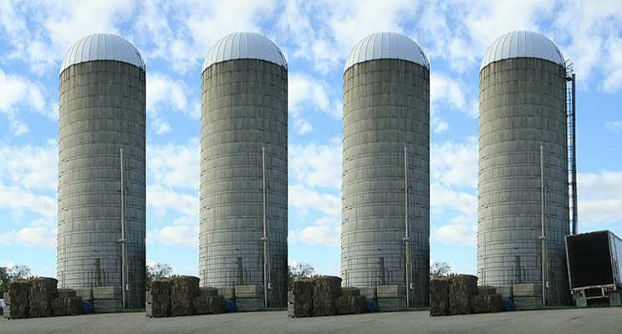
Silo

Slide 9
Early Information Systems
Input
Production
Sales
Delivery
Output
Lack of cross functional integration

Slide 10
Integrated Systems
Input
Production
Sales
Delivery
Output
Functional Integration

Slide 11
Internal Functions
Material
Mgt
Production Mgt
Delivery
Mgt
Obstacle

Slide 12
Ideal ERP: Internal Functions
Material
Resources
Production Management
Delivery
Management
Obstacle
Obstacle

Slide 13
Typical Information Systems
MRP (Material Requirement Planning)
ERP (Enterprise Resource Planning)
  Replacing MRP
CRM (Customer Relationship Management)
  Sales management
  CDP: customer data platform
SCM (Supply Chain Management)
PDM (Product Data Management)
SFC (Shop Floor Control)

Slide 14
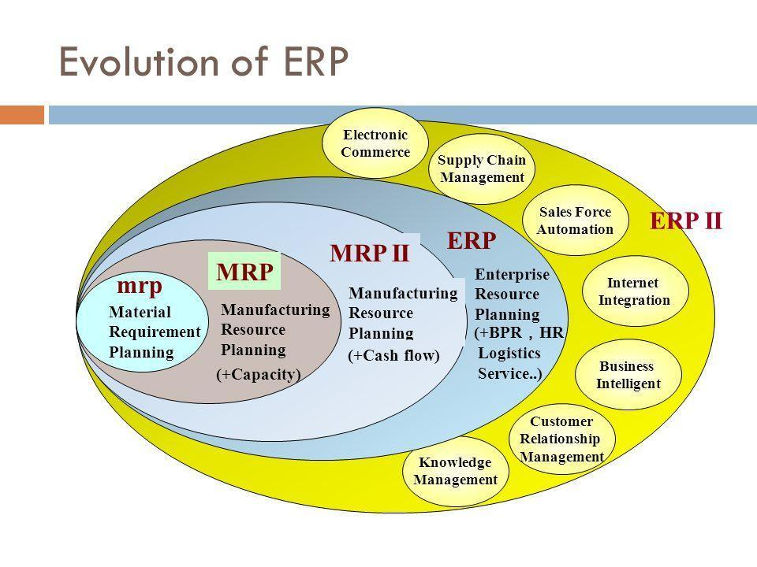

Slide 15
Integration of Systems
EDI(電子資訊交換)
E-Commerce
(電子商務)
SFA
(銷售自動化)
E-Business
(電子企業環境)
CRM
(客戶關係管理)
Planning(計劃)
SCM
(供應鏈管理)
ESCM
(延伸型供應鏈管理)
Scheduling(排程)
Distribution(配銷)
MRP(物料需求規劃)
MRPⅡ
(製造需求規劃)
ERP
(企業資源規畫)
Payroll(薪資系統)
HR(人力資源)
EERP
(延伸型企業資源規劃)
GL(總帳會計)
FMIS(財務系統)
AP(應收帳款系統)
AR(應付帳款系統)
1970
1980
1990
2000
*資料來源：HP簡報

Slide 16
E-Business Integration
E-Business
SCM
ERP
CRM
Supplier
Customer
E-Commerce
CRM: Customer Relationship Management)
SCM: Supply Chain Management)

Slide 17
Why Integration of Information Systems
Efficiency
  Manpower replacement
  Faster response time: shorter lead time
Visibility and communications
  Intra-function
  Inter-functions
  Inter-companies
Process reengineering
  Disintermediation and reintermediation
  Redefinition of business operations

Slide 18


Slide 19
Visibility
One can only do things if it is visible
The higher the visibility, the faster one can move
Take ATM for example
  Before the ’70s, no bank offers ATM
  In the late ‘70s, inter-branch services within a bank
  → inter-bank → international
Paradigm shift in customer relations
  Banks, department stores, airlines, …

Slide 20
Airlines: Frequent flyer programs
Membership, prestigious cards
Accumulation of milage, VIP services
Airlines
Specify airlines
Travel
Agents
Ticketing
Services

Slide 21

Importance of integrations
Breaking the silo mentality
  Inter-functional communications and cooperations
  Achieve common corporate goal
Visibility and communications
Effectiveness

Slide 22
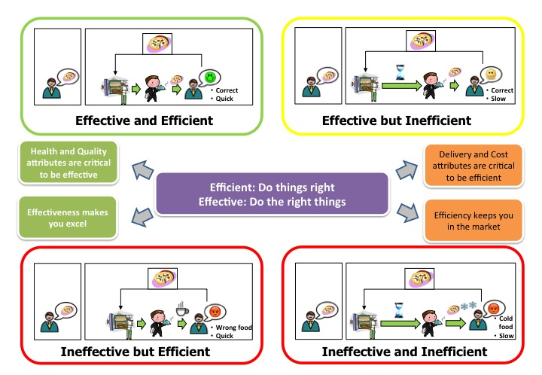
Business performance
Efficiency
  Do the thing right
Effectiveness
  Do the right thing
… ultimately
  Do the right thing right

