Slide 1
Supply Chain
Procurement, Inventory and Logistics
3
  CYCU
  Prof. CK Farn
mailto: ckfarn@gmail.com
http://www.mgt.ncu.edu.tw/~ckfarn/cycu
  2025.02 Rev

Slide 2
Supply chain
Evolution
  https://www.youtube.com/watch?v=uDrQv8Z7owU
  https://www.youtube.com/watch?v=B9OSy-JM8mQ
Value Chain
  https://www.youtube.com/watch?v=MC_hByD8nBY
Logistics
  https://www.youtube.com/watch?v=YugqpSfG87Y

Slide 3
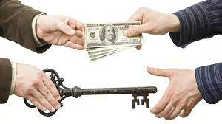
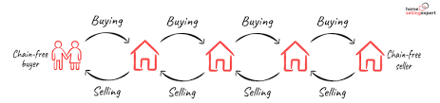
Business transactions
Buy and Sell
  A simple business transaction is buying and selling of goods between two parties: buyer and seller
  Transactions can be between business entities (B2B), between a business and a consumer (B2C), or between consumers (C2C)
Transactions can be linked together to form a “chain” or a “web”

Slide 4
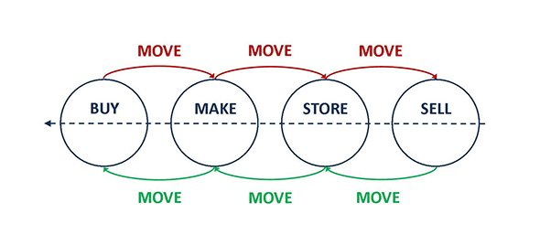
Within a company
Buy in, and sell out directly
  Without any transformation of the product
Most of the time, there are transformation involved
  Unpacking into smaller packets
  Packaging
  Assembly
  Fabrication
Moving

Slide 5
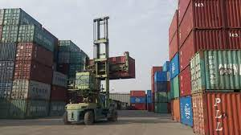
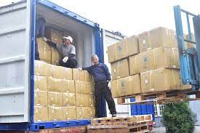
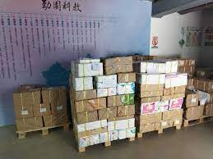
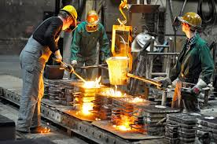
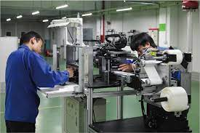
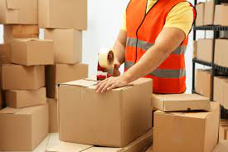
Processing and transformation
container
pallet
Carton and boxes on pallet
assemble
packaging
casting (fabrication)

Slide 6
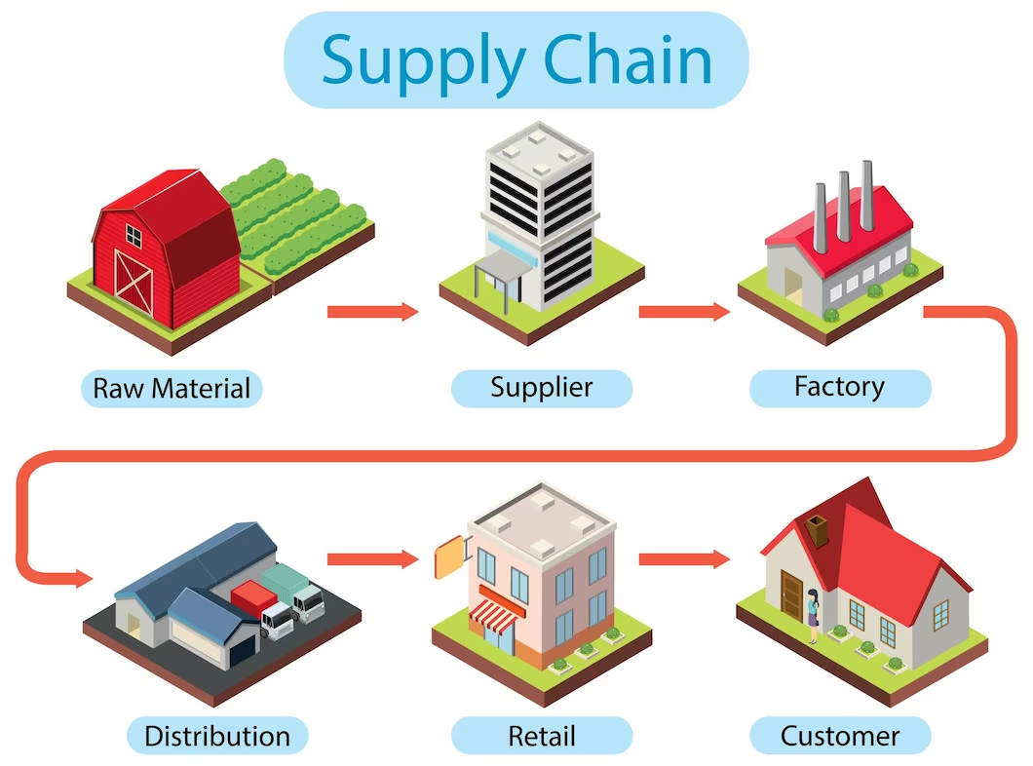
Supply Chain (value chain)

Slide 7
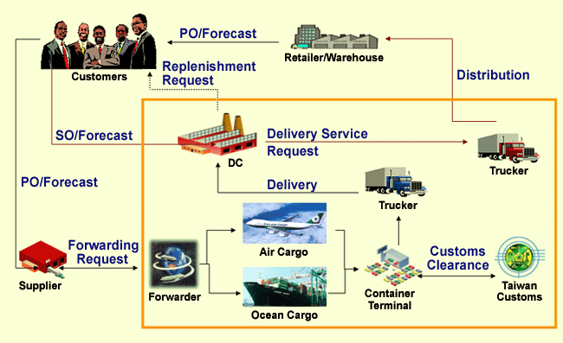
Supply Chain (Logistics)

Slide 8
Inventory
Inventory
  A stock or store of goods
Independent-demand items
  Items that are ready to be sold or used
Inventories are a vital part of business: (1) necessary for operations and (2) contribute to customer satisfaction
  A “typical” firm has roughly 30% of its current assets and as much as 90% of its working capital invested in inventory

Slide 9
Warehouse, inventory, stock
Inventory
  goods and materials owned by a company at a particular time, including parts, products being made, and finished products
Stock of goods
  the inventory of a business held for sale to customers in the ordinary course of business
Warehouse
  a facilities to store their products, such as raw materials, packing materials, components, or unfinished goods until they are ready to be shipped to the distributor or manufacturer where it turns into finished goods

Slide 10
Types of Inventory
Raw materials and purchased parts
Work-in-process (WIP)
Finished goods inventories or merchandise
Tools and supplies
Maintenance and repairs (MRO) inventory
Goods-in-transit to warehouses or customers (pipeline inventory)

Slide 11
Inventory Functions
To meet anticipated customer demand
To smooth production requirements
To decouple operations
To protect against stockouts
To take advantage of order cycles
To hedge against price increases
To permit operations
To take advantage of quantity discounts

Slide 12
Inventory Costs
Purchase cost
  The amount paid to buy the inventory
Holding (carrying) costs
  Cost to carry an item in inventory for a length of time, usually a year
Ordering costs
  Costs of ordering and receiving inventory
Setup costs
  The costs involved in preparing equipment for a job
  Analogous to ordering costs
Shortage costs
  Costs resulting when demand exceeds the supply of inventory; often unrealized profit per unit

Slide 13
Lead time
PO: purchase order
SO: sales order
LT: Leadtime
Make to stock model
Buy
Sell
Seller
PO
Receive
Make
Store
SO
Delivery
Buy
Sell
Buyer
PO
Receive
Leadtime
Make to order model
Sell
Buy
Sell
Seller
SO
PO
Receive
Make
Store
Delivery
Buy
Sell
Buyer
PO
Receive
Leadtime

Slide 14
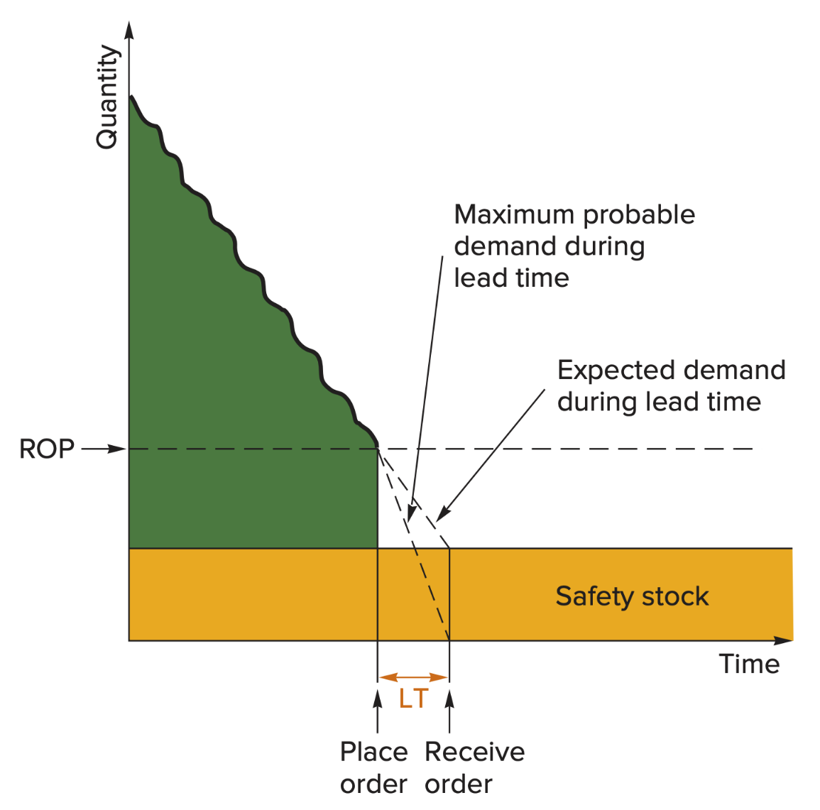
Safety Stock

